Slide 1
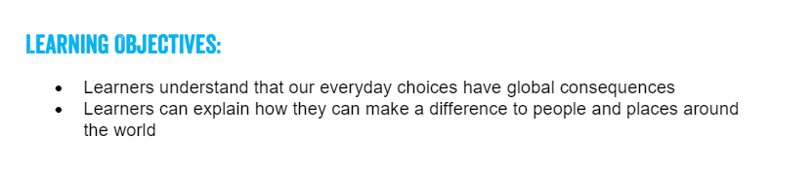
Tuesday 2nd March 2021
Can I understand how my choices have consequences?
Lesson 4
FAIRTRADE FORTNIGHT
22 FEBRUARY – 8 MARCH 2021

Slide 2

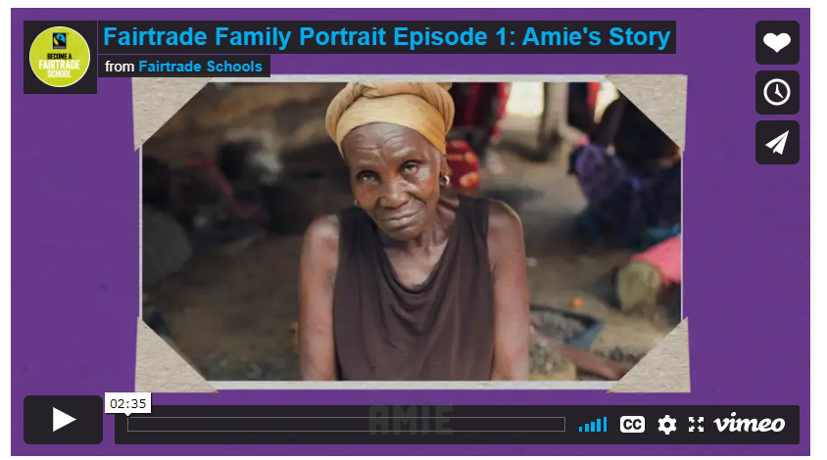
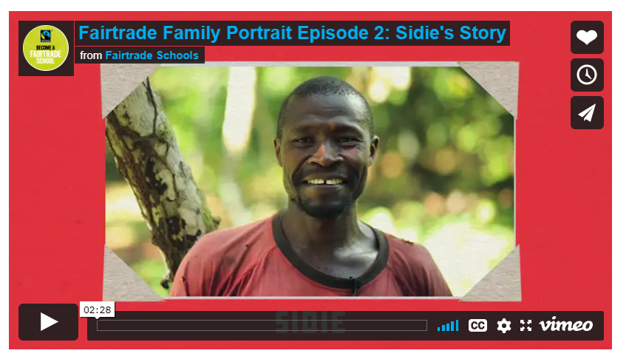
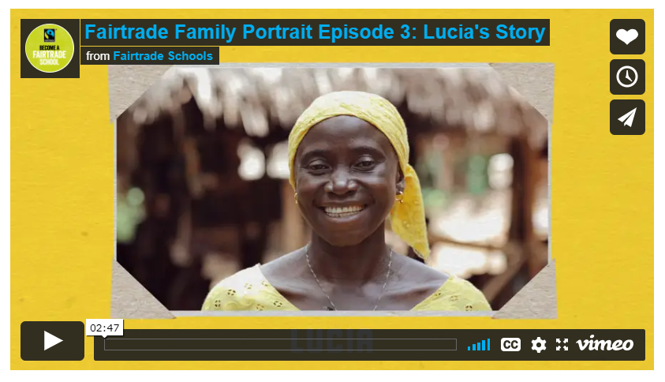
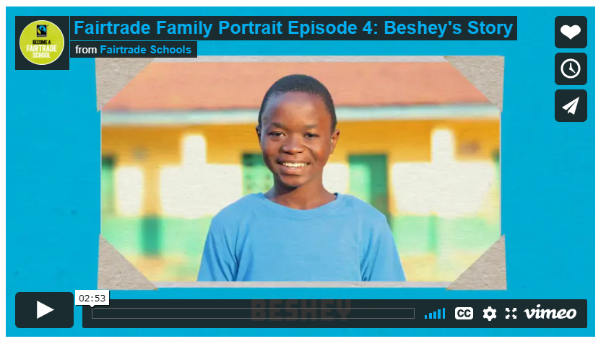
This week we are going to look at how our actions have global consequences. You will see how you have the power to make a difference in the world through the choices you make every day.
You will need to understand what Fairtrade is and its benefits for farmers and workers around the world.
Watch the 4 film clip and make notes to use in next Tuesday’s lesson
Beshey's story
Amie's story
Sidie's story
Lucia's story

Slide 3
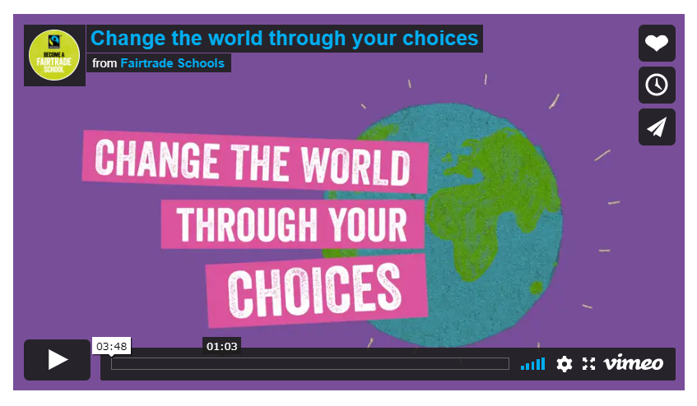
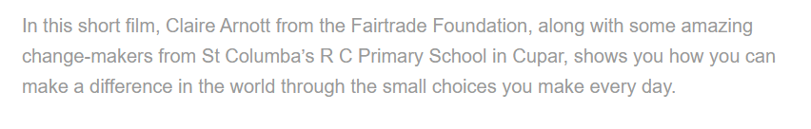
change-the-world-through-your-choices
Watch the film

Slide 4
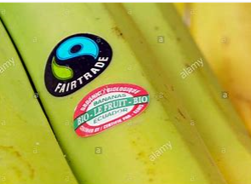
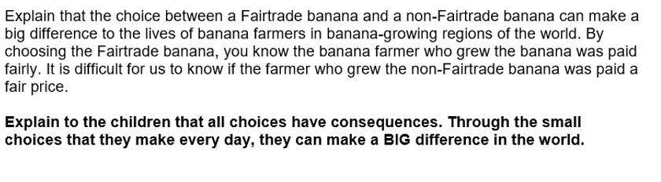
Why would you choose a banana with a Fair Trade label?
T
C

Slide 5
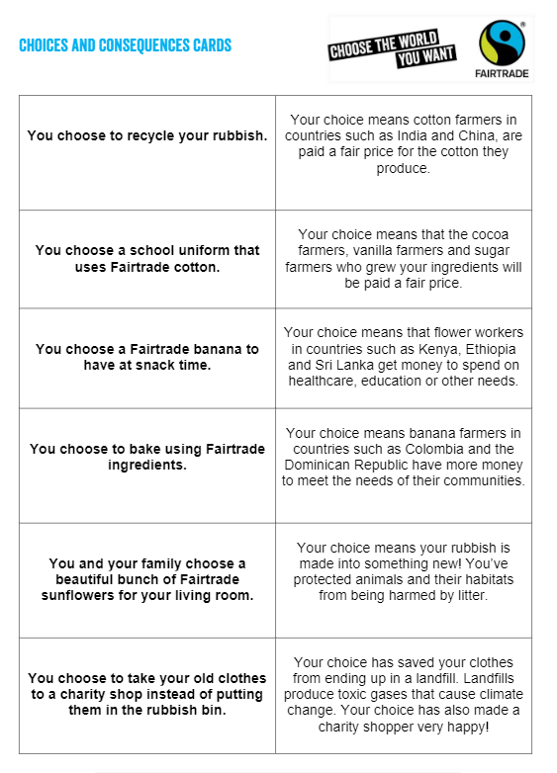
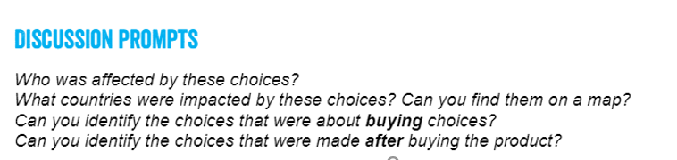
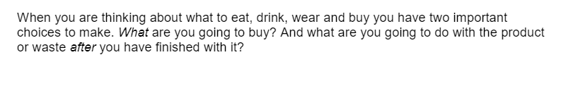
The film helps you think about the power of your choices and how they can have an impact on people all around the world.
Look at the choices and consequences matching cards and match them up. Now discuss your choices.

Slide 6
The choices on the cards had positive consequences.
Look at the choice cards again and consider alternative more negative consequences.
Use the links below to help you.
What should i do with my rubbish
What can you recycle in your food shop?

