Slide 1
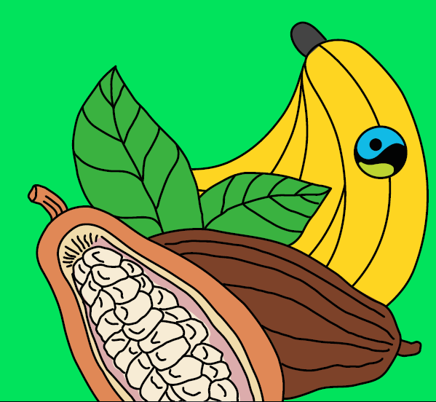

Tuesday 23rd February 2021
Geography Fairtrade Fortnight
(22nd February-7th march 2021
An introduction to Fairtrade

Slide 2
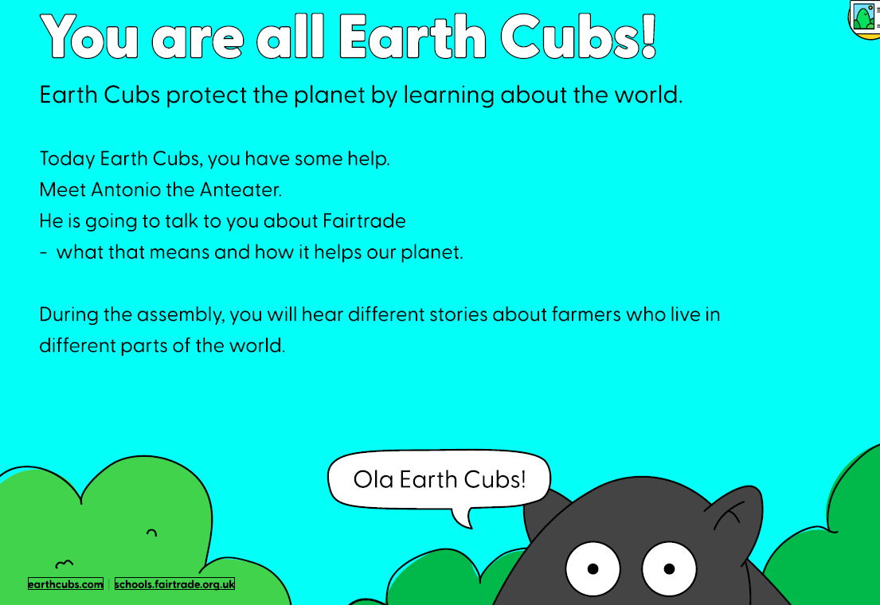

Slide 3
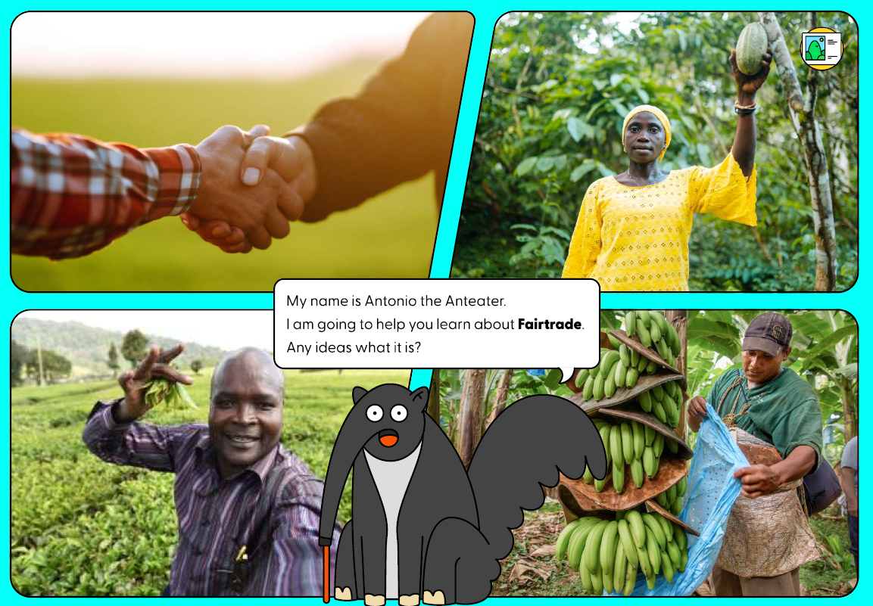

Slide 4
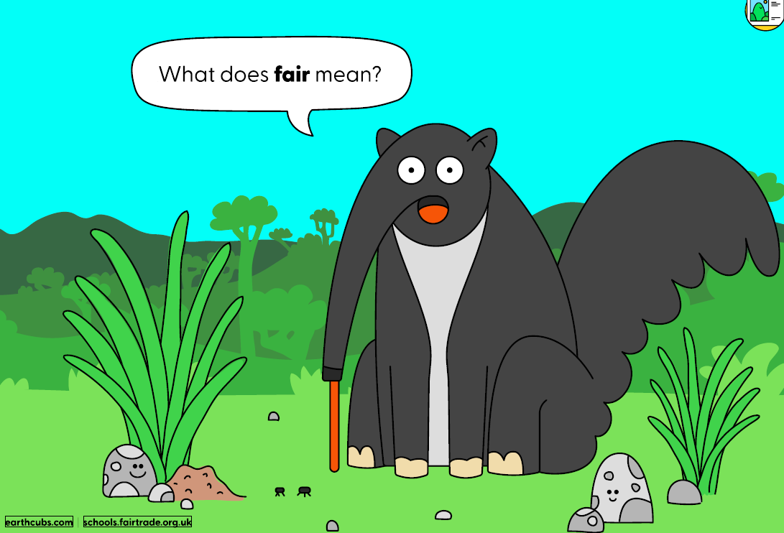
Can you discuss your ideas with someone at home?

Slide 5
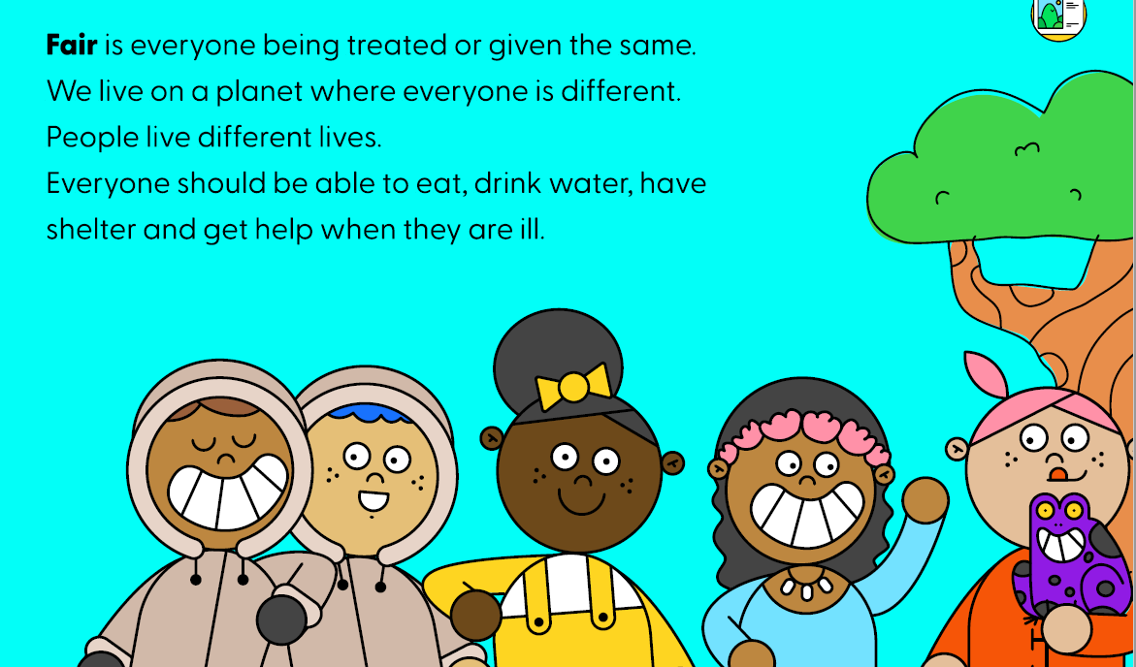
What does fair mean?

Slide 6
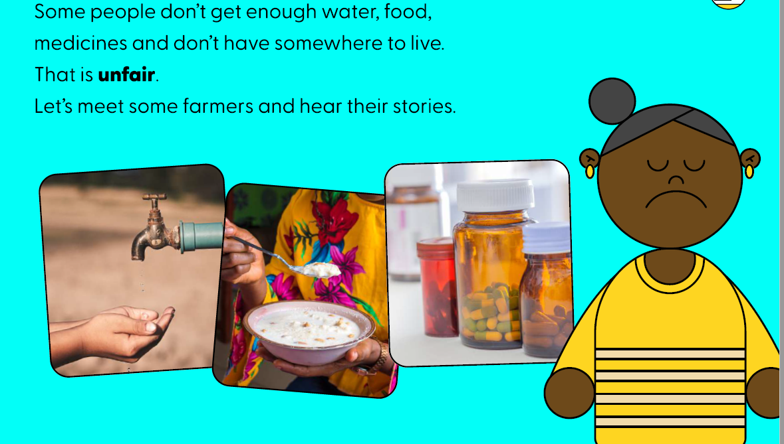
What does unfair mean?

Slide 7
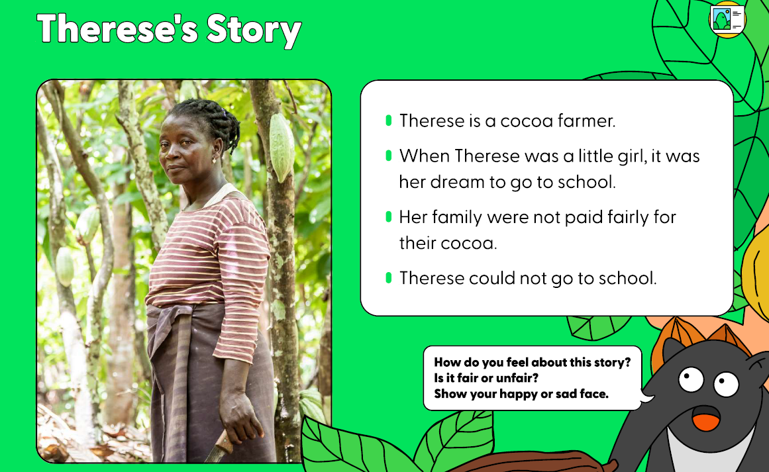
Let’s meet some farmers and hear their stories.

Slide 8
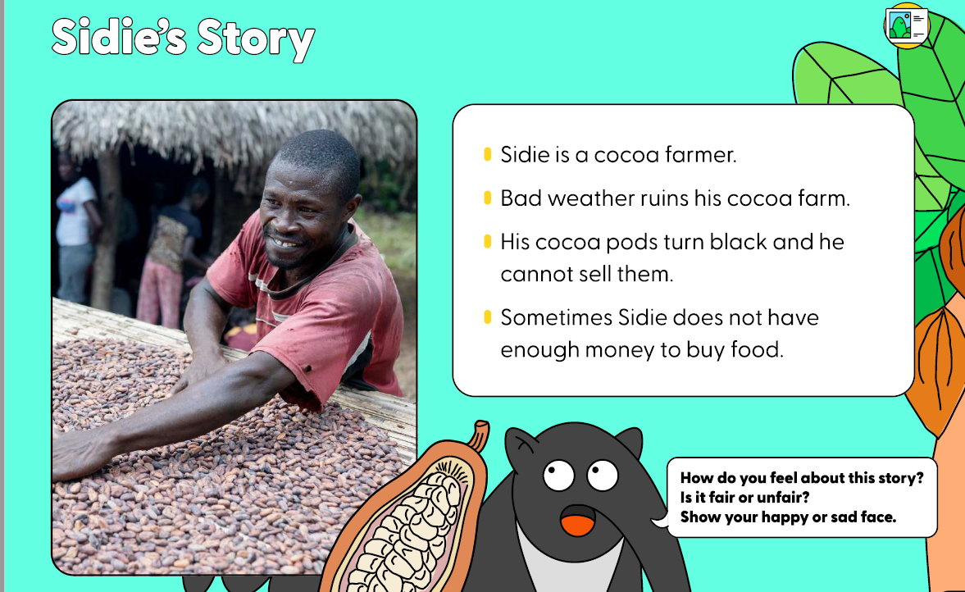

Slide 9
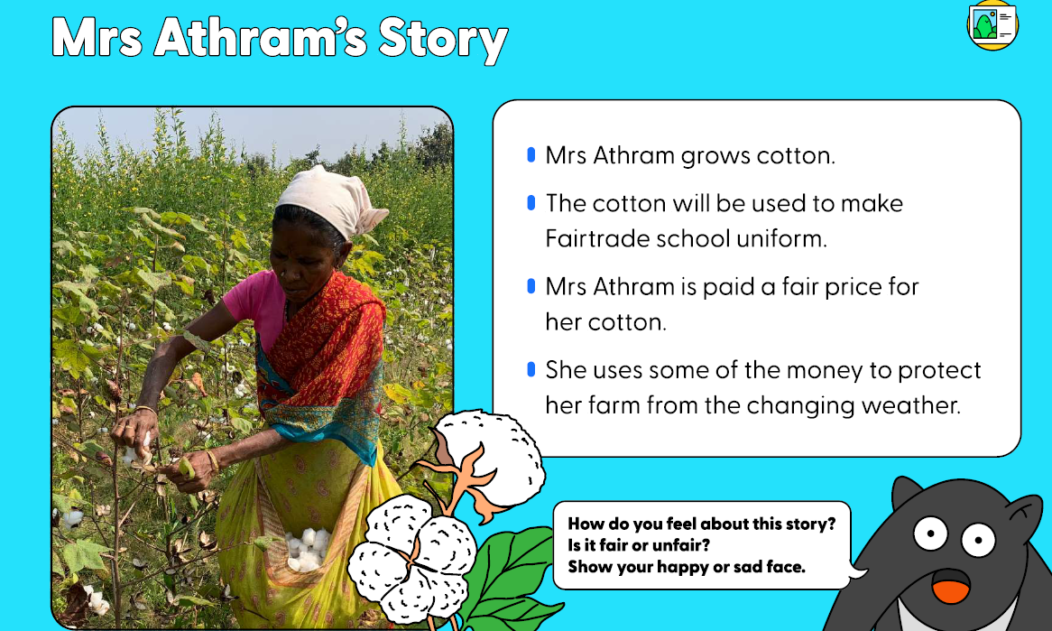

Slide 10
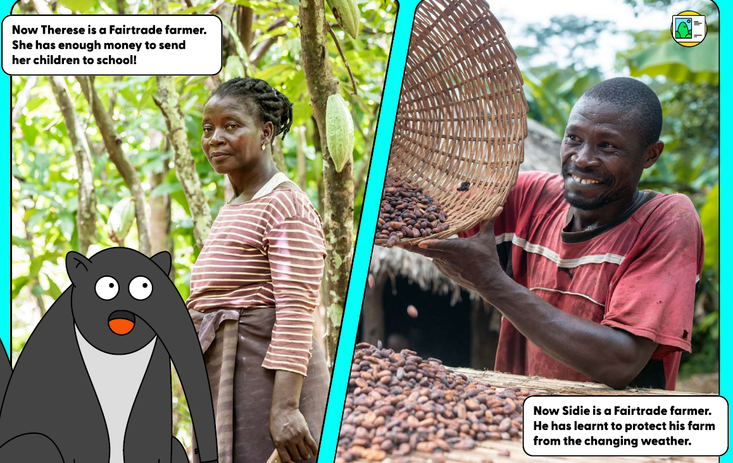

Slide 11
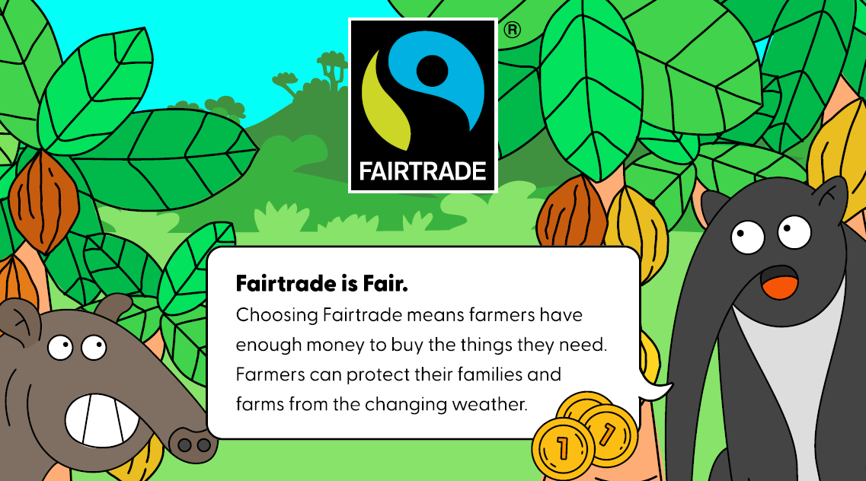

Slide 12
What have you found out about Fairtrade? What do you think about it?
Have you spotted any packets or food with the Fairtrade symbol on?

