Slide 1

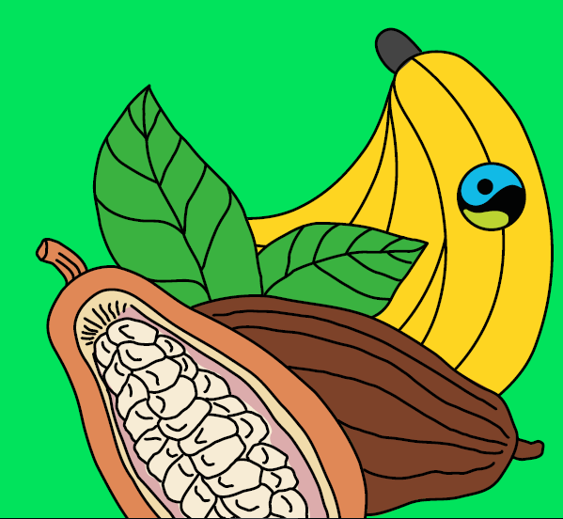

Wednesday 24th February 2021
Geography Fairtrade Fortnight
(22nd February-7th march 2021)
Cocoa climate

Slide 2
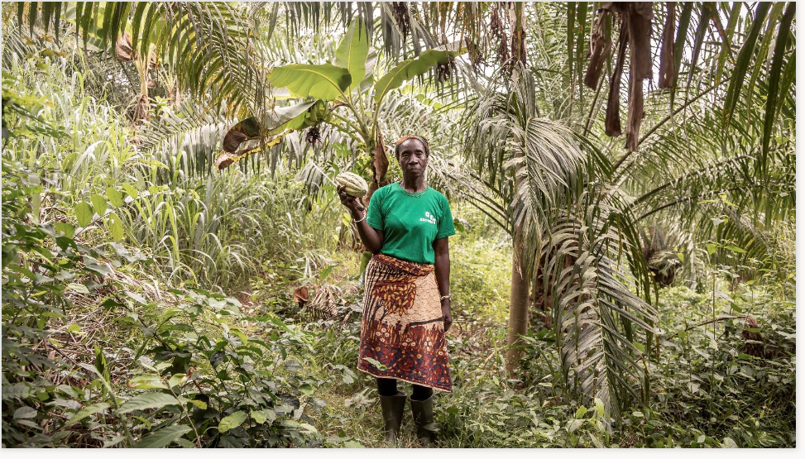
What type of farmer do you think this is?
What is growing on this farmer’s farm?
Where in the world is this?
What do you think the temperature is like in this photograph?
Could this photograph be in the UK? Why do you think this?

Slide 3
This is Madame Bazoua. She is a Cocoa farmer who lives in Cote d’Ivoire in West Africa

Slide 4
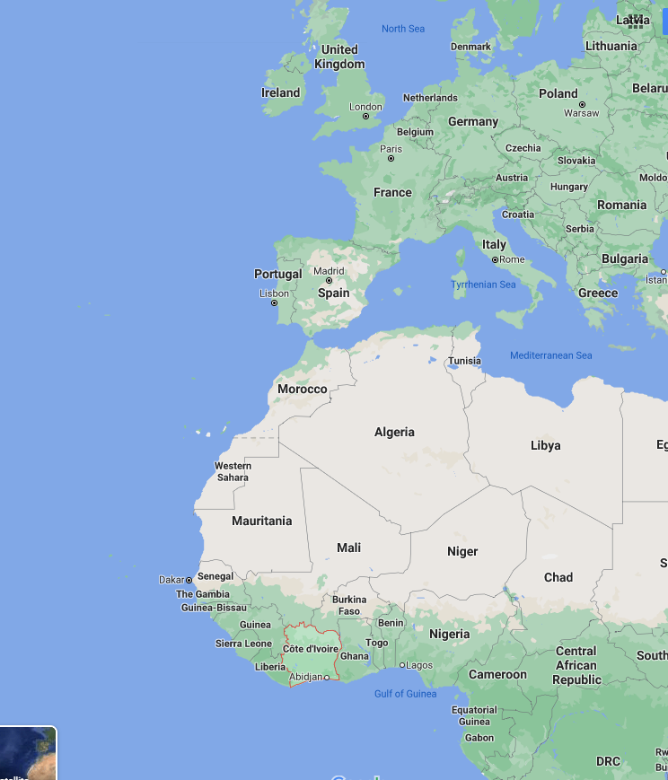
Can you find
Cote d’Ivoire on a map?
https://www.google.com/maps/place/C%C3%B4te+d'Ivoire/@27.2884412,-54.7819404,3z/data=!4m5!3m4!1s0xf961387b049a067:0x1f91e627cb9ee40!8m2!3d7.539989!4d-5.54708

Slide 5
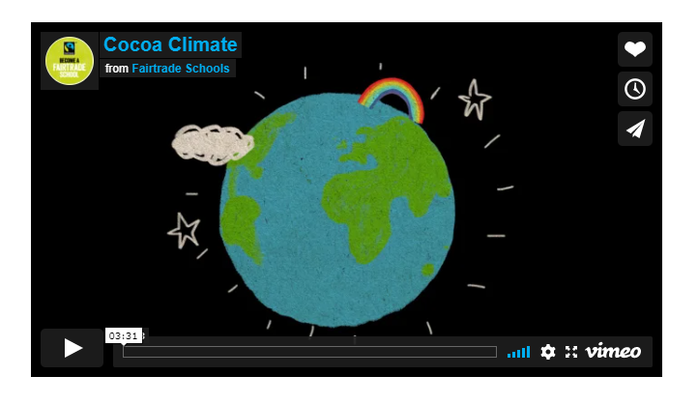
Can you watch this video to find out about the cocoa climate? (Click the link in blue to take you to the video)
https://schools.fairtrade.org.uk/teaching-resources/cocoa-climate-a-lesson-plan-for-primary-schools/
This link is also on the remote learning page

Slide 6
In the video we found out about the United Kingdom (UK) and the Cocoa growing region of Africa.
What are the main differences between these two climates?
What are the similarities?
What can farmers grow in each of the different places?

Slide 7
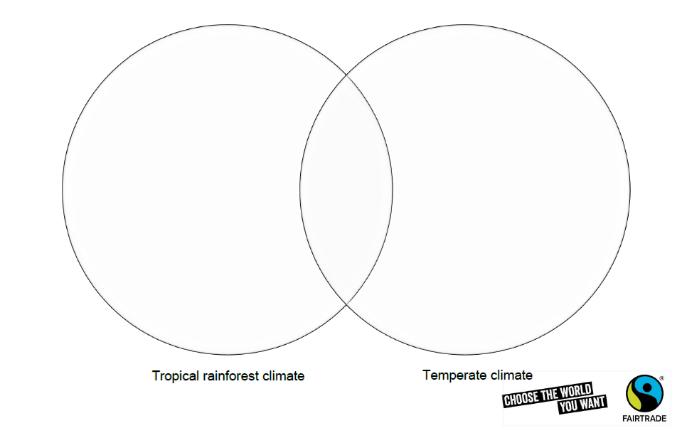
You might want to record your work like this or you might want to write a list, or talk through your ideas with someone at home.
What is the same about the climate in the UK and Africa?

Slide 8
Tropical and temperate climates
The United Kingdom (UK) Temperate climate | Cote D’Ivoire Africa Tropical climate
This means our weather is usually cool, wet, winters and warm, wet summer. We have four different seasons. The weather can change often, one day it can be sunny and hot the next can be rainy. | Experiences high temperatures all year round and lots and lots of rain. In fact, in some places with a tropical climate, you can set your watch by the daily rainstorm, it's so regular!
What's a tropical climate like? This climate zone

Slide 9
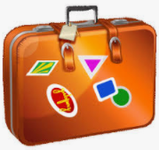
Challenge tasks:
Can you think about these questions:
How does the change in weather affect farming?
How does it affect it in the UK?
How does it affect it in Africa?
What would you pack in a suitcase if you were to visit each place?

Slide 10
If you want to find out more about temperate and tropical climates click the link below to do more research. https://www.oddizzi.com/teachers/explore-the-world/weather/climate-zones/temperate/

