Slide 1
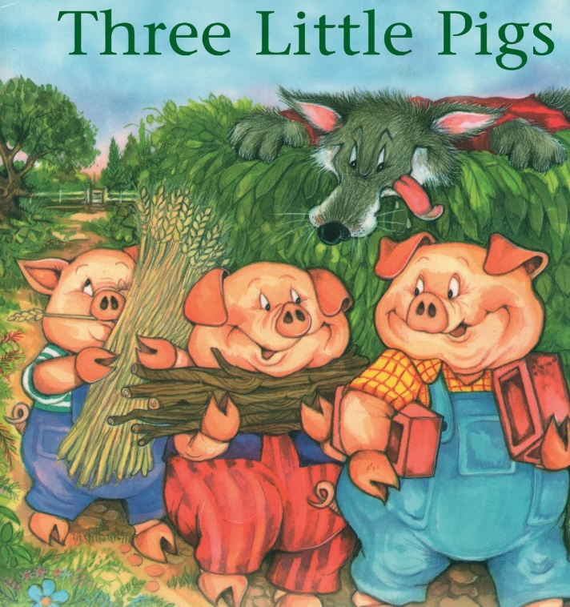
Friday 25th February 2021
English tasks.

Slide 2
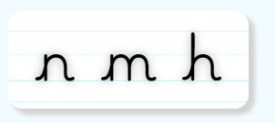
Handwriting
Can you practise the letters n, m and h.
Look on the letterjoin website to see how to form them correctly.
https://letterjoin.co.uk Then click on easy letters fifth set
Username: lj8943
If you are using a laptop the password is: home
If using an ipad or tablet the password is: capital L (Make the shape of a capital L)

Slide 3
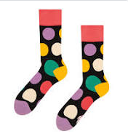
Can you knock my socks off with your neat writing?
Now that you have practised your letters on letterjoin can you practise on a piece of paper?
Can you send a picture of your writing to me?
s.hiley@worthvalleyprimary.co.uk

Slide 4
Traditional Tales
This half term our English tasks will be based on Traditional Tales.
A traditional tale is a story that has been told and re-told for many years. It becomes a story that almost everyone knows. Traditional tales are also sometimes called fairy stories or fairy tales.
Stories such as Cinderella, Goldilocks and the Three Bears and Jack and the Beanstalk are all traditional stories.

Slide 5
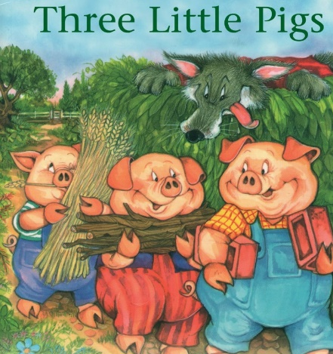
Reading and Writing Task
This week we are reading
The Three Little Pigs
Can you watch a film version of the story using the link below?
https://www.youtube.com/watch?v=QLR2pLUsl-Y

Slide 6
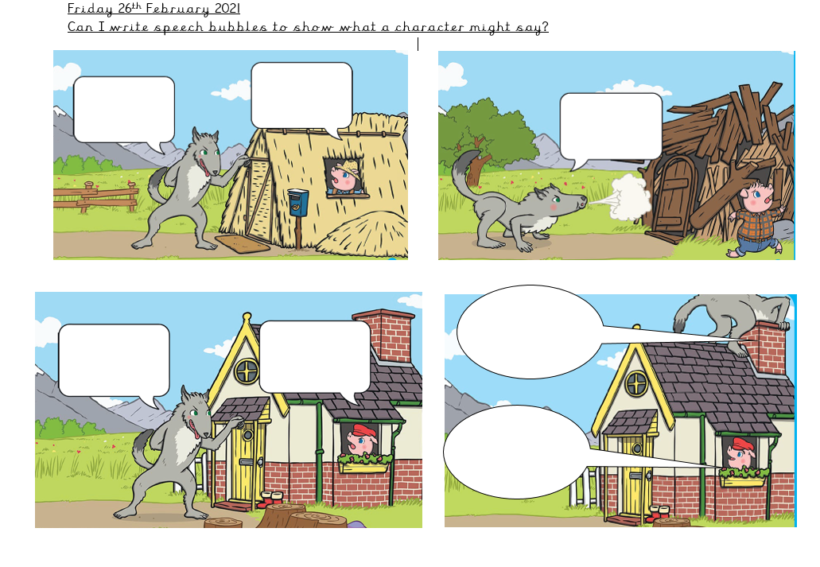
Writing Task:
Can you write speech bubbles to show what characters might say?
If you are doing this task at home you could just draw your own pictures of the characters and add your speech bubbles.

Slide 7
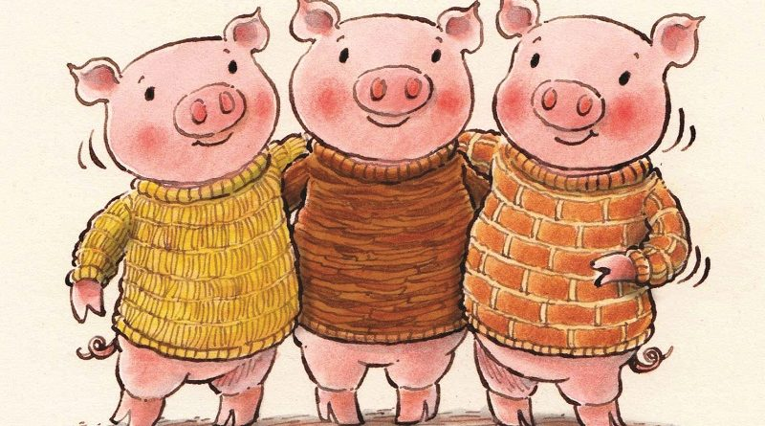
Remember I love to see your work so please email pictures to me at:
s.hiley@worthvalleyprimary.co.uk

