Slide 1
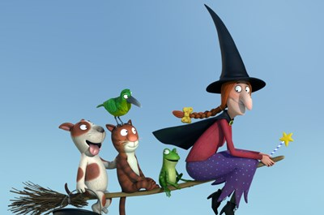
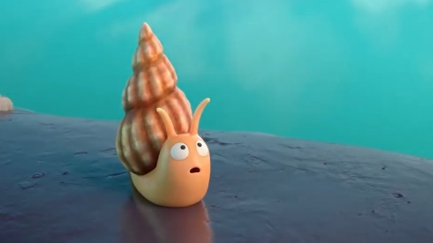
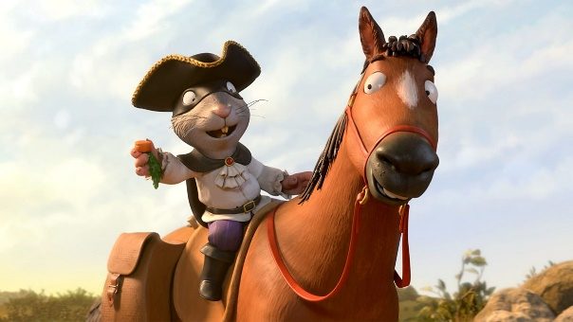
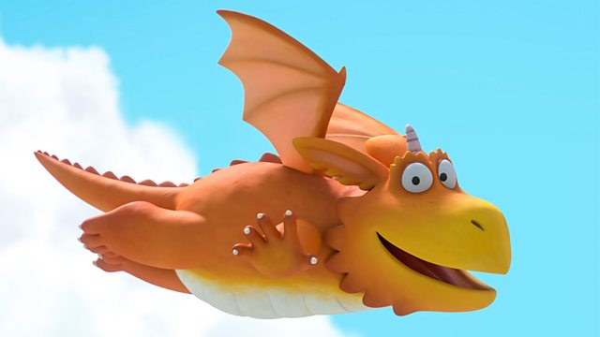
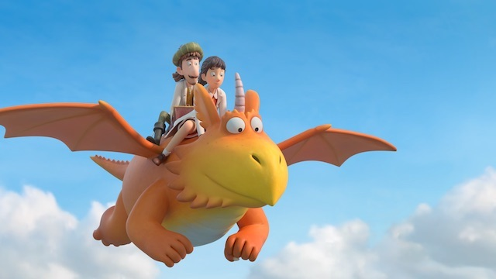
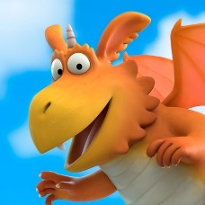
Friday 12th February 2021
English tasks.

Slide 2
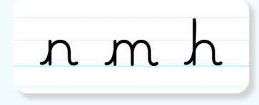
Handwriting
Please practise the following letters:
Look on the letterjoin website to see how to form them correctly.
https://letterjoin.co.uk Username: lj8943
If you are using a laptop the password is: home
If using an ipad or tablet the password is: capital L (Make the shape of a capital L)

Slide 3
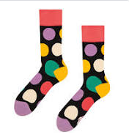
Can you knock my socks off with your neat writing?
Now that you have practised your letters on letterjoin can you practise on a piece of paper?
Can you send a picture of your writing to me?
s.hiley@worthvalleyprimary.co.uk

Slide 4
Writing Task
This half term we have focused on many different stories. We have watched;
Room on the Broom
The Snail and the Whale
The Highway Rat
Zog
Zog and the Flying Doctors

Slide 5
What we would like you to do is;
pick your favourite story from this half term and write about why you chose this story.
Write one thing that the main character says and your favourite part of the story.
Write down which story you would like to read next half term and why.
Draw a fantastic picture to go with your writing
There is an example on the next page.
If you have forgotten any of the stories, you can click on the link below, it will take you to the BBC iPlayer site, and you will see your favourite stories there.
https://www.bbc.co.uk/iplayer/search?q=julia+donaldson

Slide 6
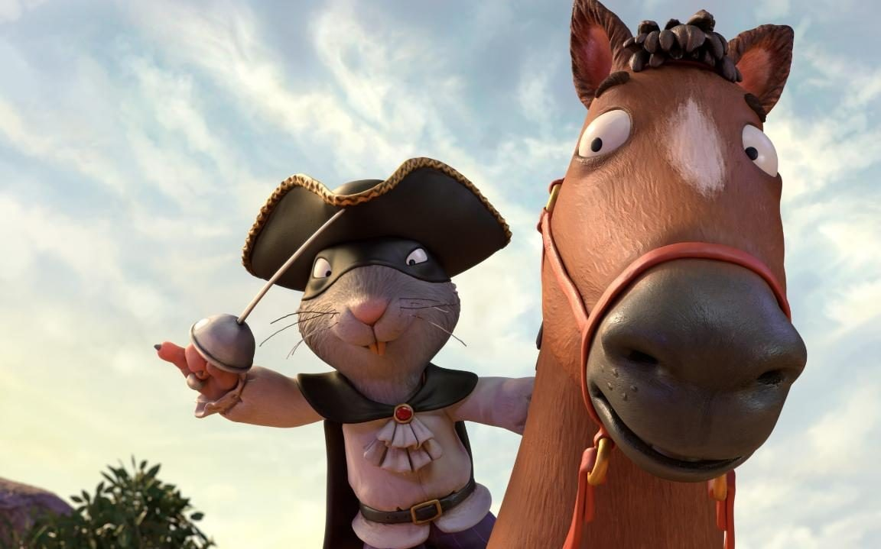
My favourite story was the Highway Rat. I loved the Highway Rat because he was very naughty and cheeky. In the end he was tricked by the duck and he had to sweep up the cake shop floor.
This made me laugh, I liked when the Highway Rat thought the echo in the cave was another person, that was silly.
The Highway Rat says; ‘’Give me your pastries and puddings! Give me your chocolate and cake! For I am the Rat of the Highway, yes, I am the Rat of the Highway and whatever I want, I take!’’
I think I would like to read the Smartest Giant in Town next term, because it is my favourite story the giant is so kind and he helps everyone.

Slide 7
Remember I love to see your work so please email pictures to me at:
s.hiley@worthvalleyprimary.co.uk
Or you can complete this on Purple Mash. I will send you a to do task for this.

