Slide 1
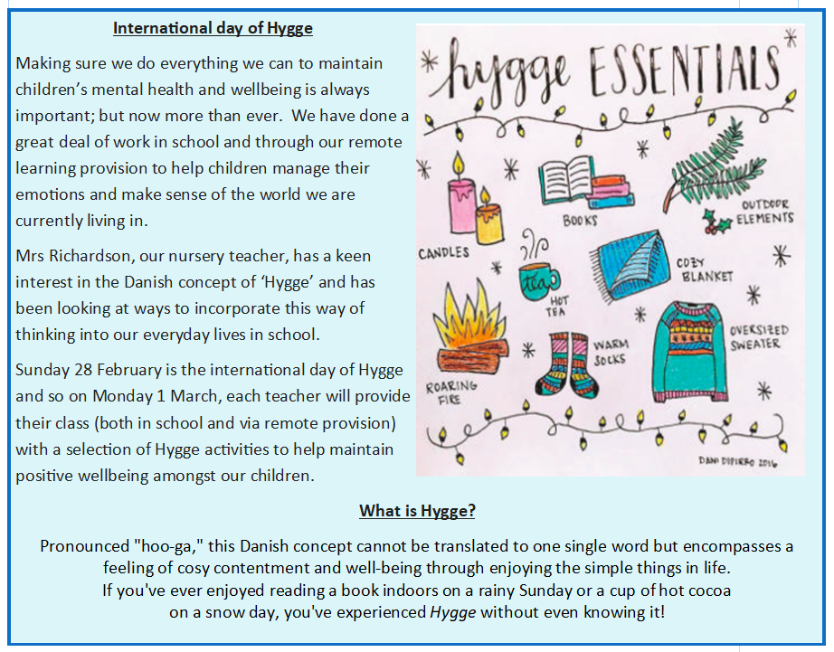
Monday 1st March 2021

Slide 2


Enjoy Hygge Day!
Go to Purple mash to find activity sheets
Read books or comics
Draw or paint
Play board games
Watch a favourite family film
Enjoy the fresh air with your family
Do whatever makes you feel happy and content!

Slide 3


Reading Together for Pleasure
Miss Lodge, kindly bought us this lovely book ‘The Book of Hope’ just before the Christmas holiday. We thought it would be nice to share everyday ,some of the words and pictures to provide you with a little bit of comfort, inspiration and entertainment!
Hope you enjoy hearing our voices.

Slide 4
