Slide 1
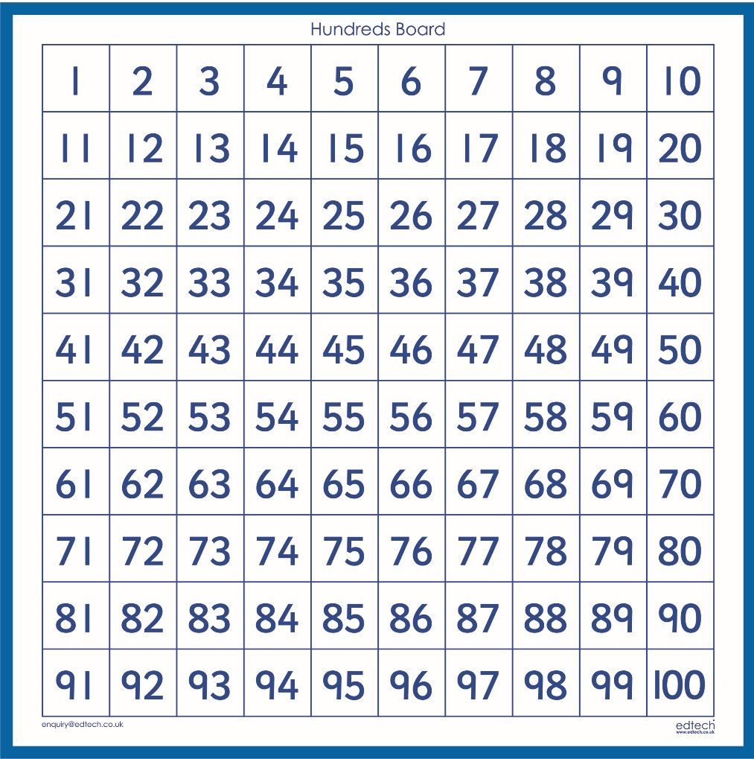
One more, One less
Today we are going to look at one more, one less than a number.
If you find this tricky you could always find the number on a number square first.

Slide 2
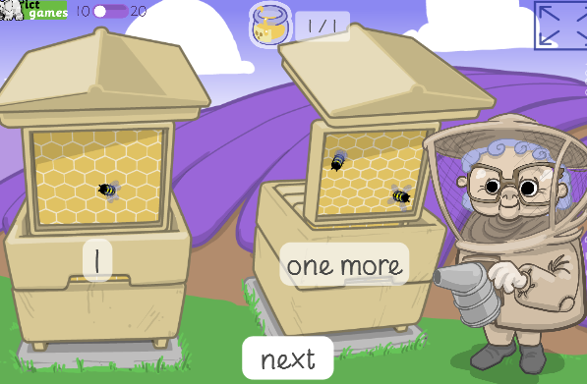
One more, One less
Play the game below
https://www.ictgames.com/mobilePage/beeMoreOrLess/

Slide 3

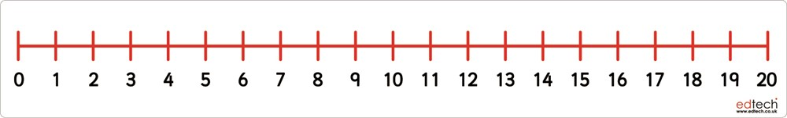
Can you tell me one more and one less than the numbers on the sweets?
4
5
6
8
12

Slide 4
Can you tell me one more and one less than the numbers on the sweets?
18
11
12
20

Slide 5
Challenge
Can you work with a grown-up.
Can the grown up say a number and then your challenge is to say a number that is one more or one less.
Maybe you could swap over and you could challenge your grown-up?!
You could do this verbally or write it down. ☺
Please email any work to steph.milner@worthvalleyprimary.co.uk

