Slide 1
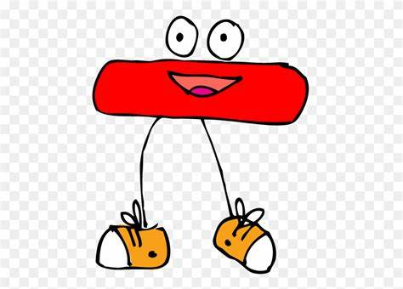
Subtraction
Thursday 25th February

Slide 2
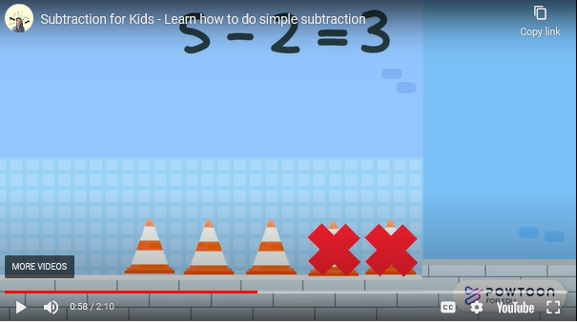
We are going to move onto subtraction today! Can you start by watching the video which shows the crossing out method. We have practiced taking away before Christmas so hopefully this will help to jog your memory!
https://www.bing.com/videos/search?q=subtraction+by+crossing+out&docid=608028367428583510&mid=32ED3CB5B1260A62A2E932ED3CB5B1260A62A2E9&view=detail&FORM=VIRE&adlt=strict

Slide 3
10 - 3 =
12

Slide 4
12 - 5 =
7

Slide 5
Your turn!
10 – 3 =
12 – 8 =
14 – 7 =
9 – 6 =
6 – 6 =
20 – 12 =
Write down the sum on a piece of paper and then work out the answer! You can cross out things to help you (like Miss Milner does) or even use raisins or pasta!
Send your subtraction sums to steph.milner@worthvalleyprimary.co.uk – I would love to see your work ☺

Slide 6

Challenge Using these cards and symbols – what sums can you make? E.g. 2 + 4 = 6 How many sums can you make?

