Slide 1

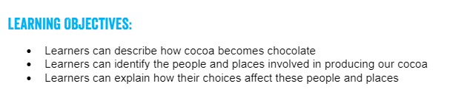
Thursday 25th February 2021
Mapping the journey of chocolate
Lesson 3
FAIRTRADE FORTNIGHT
22 FEBRUARY – 8 MARCH 2021

Slide 2
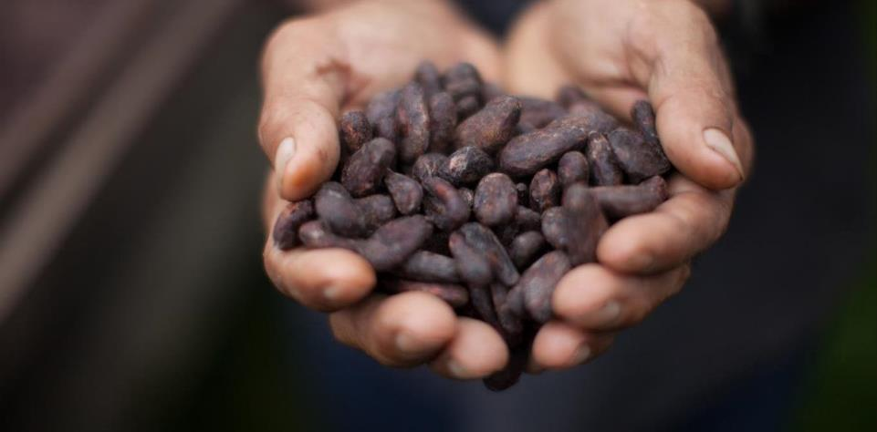
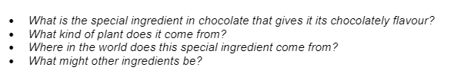
Mapping the journey of chocolate
Discuss what do you already know about chocolate?

Slide 3
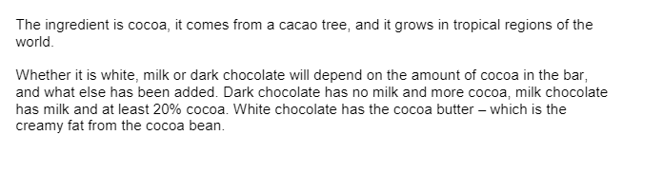
Mapping the journey of chocolate

Slide 4
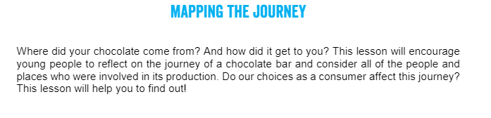

Everything you buy, every T-shirt, every pen, every bar of chocolate, has a story.

Slide 5
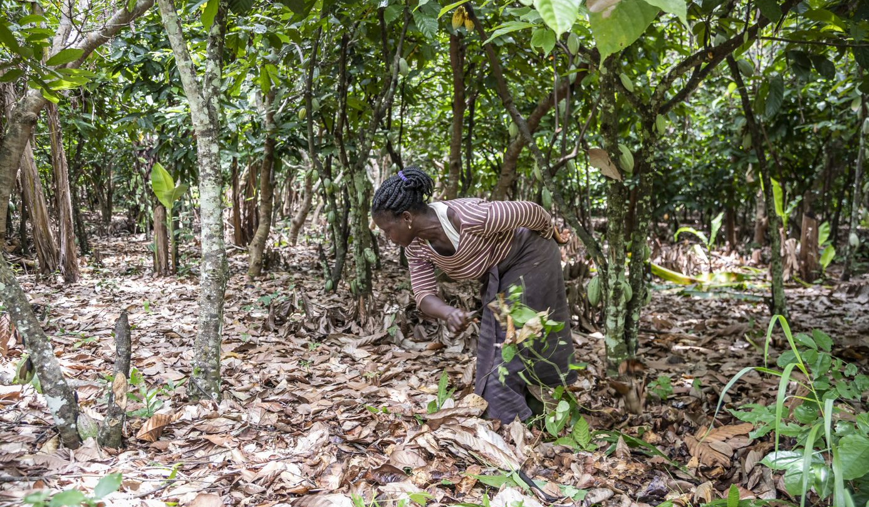

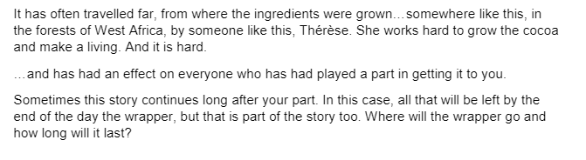
Where does it come from?
Notes:
I think the title of this needs to be more about incomes – maybe something like 'the reality of farmer poverty' or similar.. I like the layout here.

Slide 6
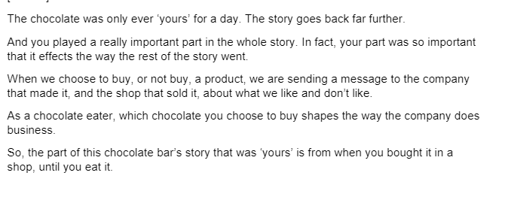
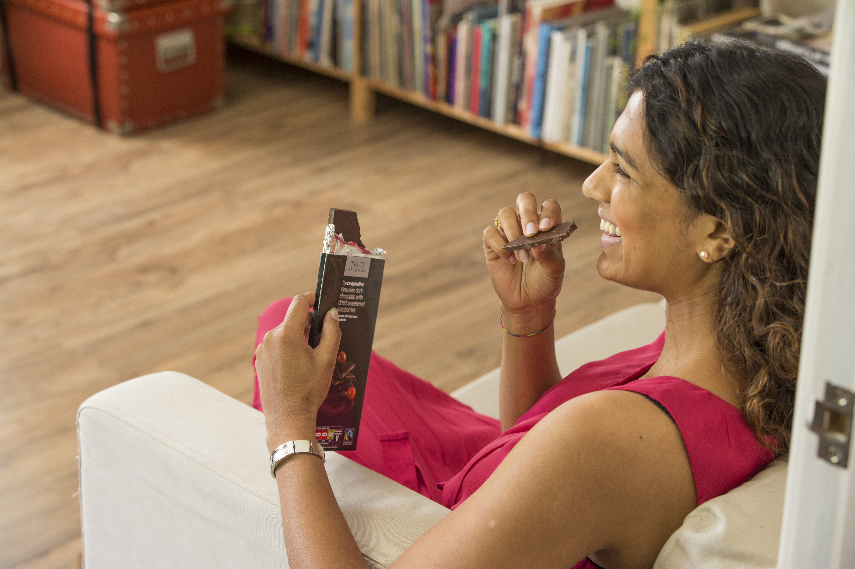
Where does it come from?

Slide 7

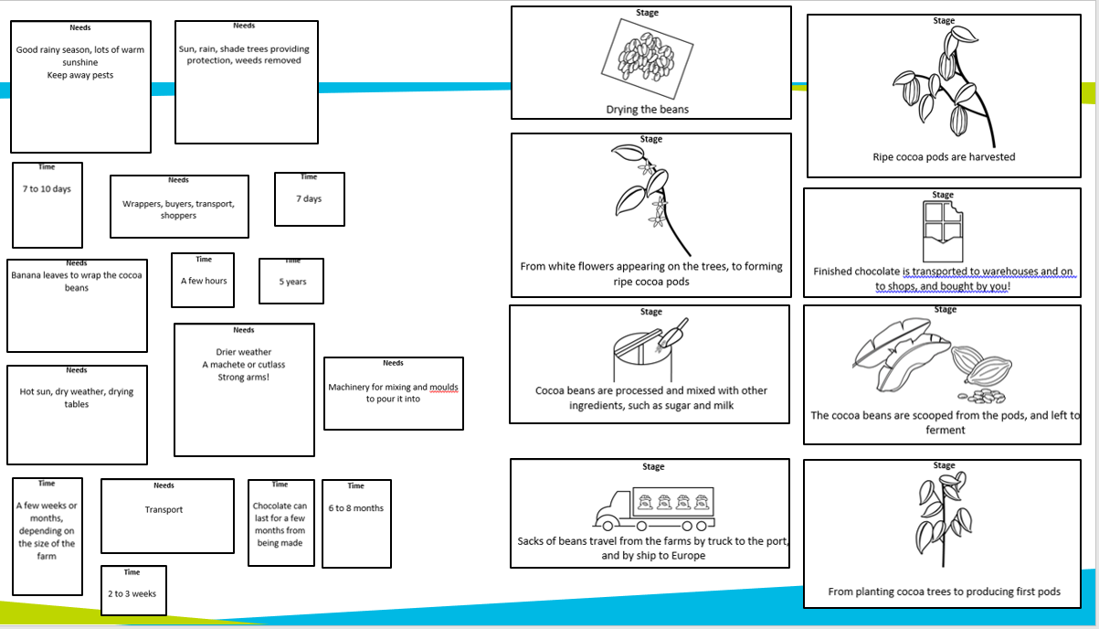
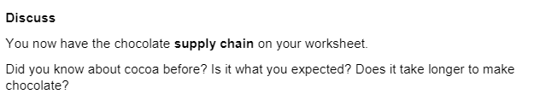
This is on the next slide.
Write a paragraph about what you have learnt from matching the stage to the time and need.

Slide 8
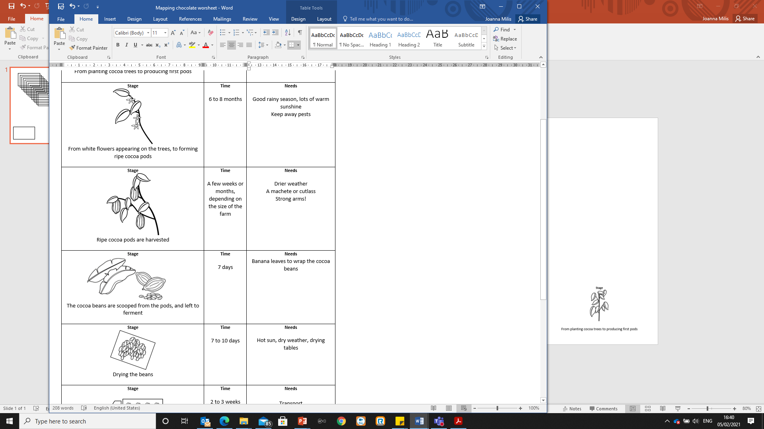
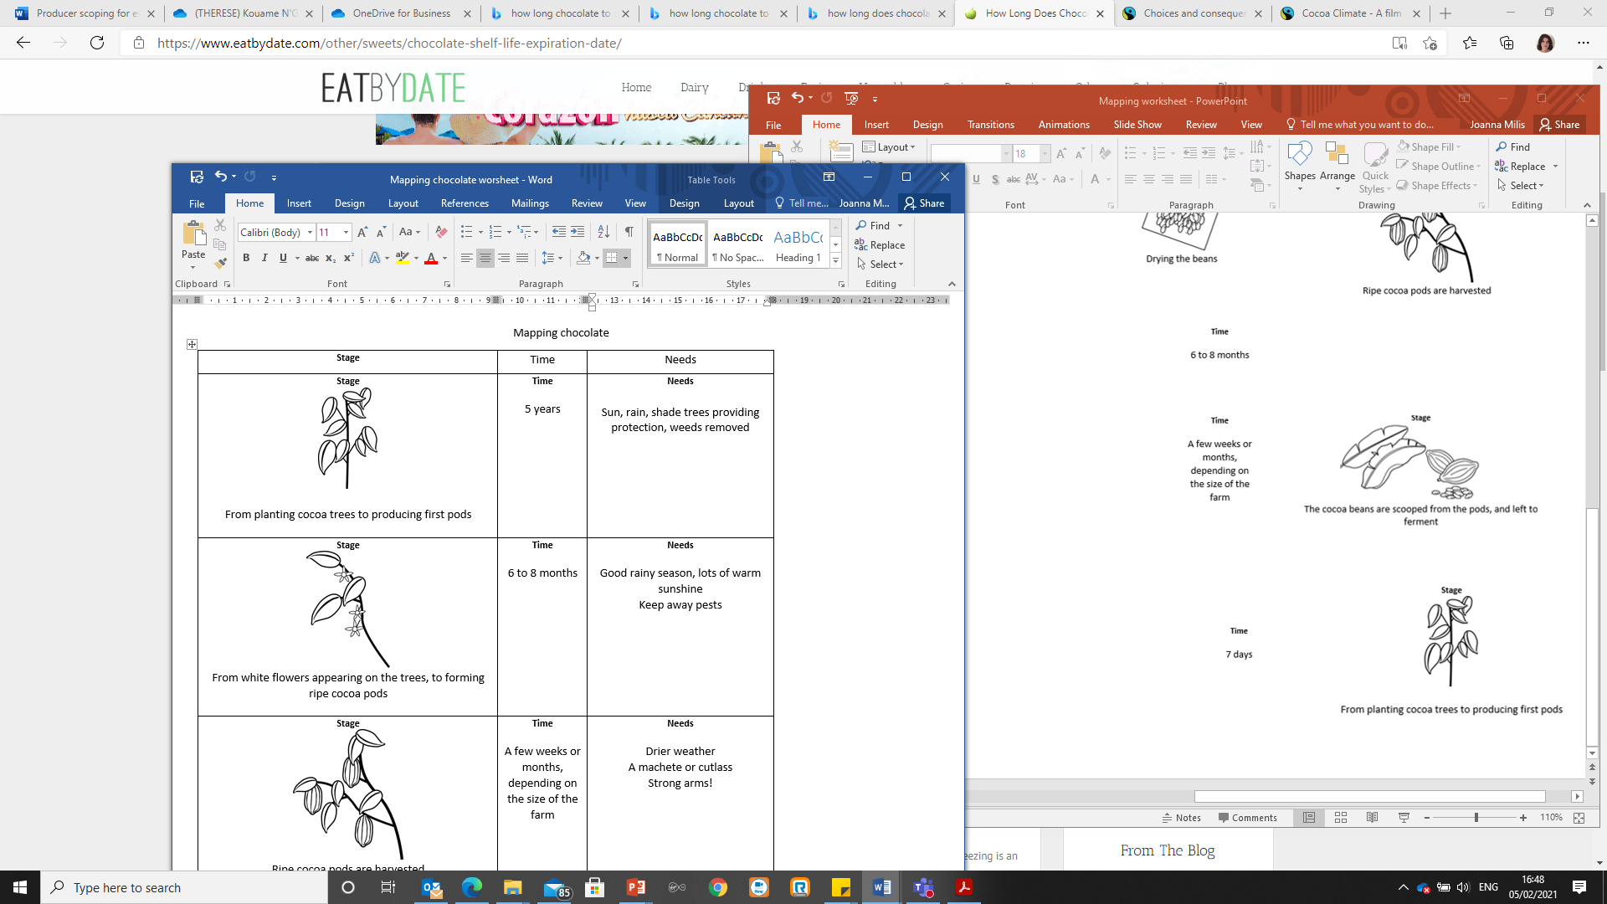
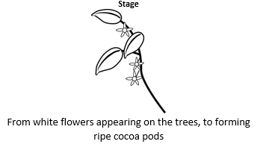
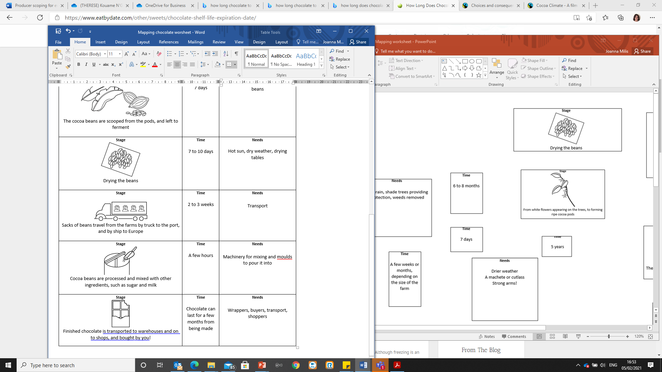
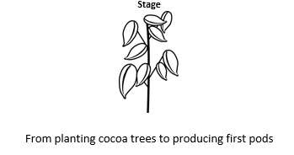

Slide 9
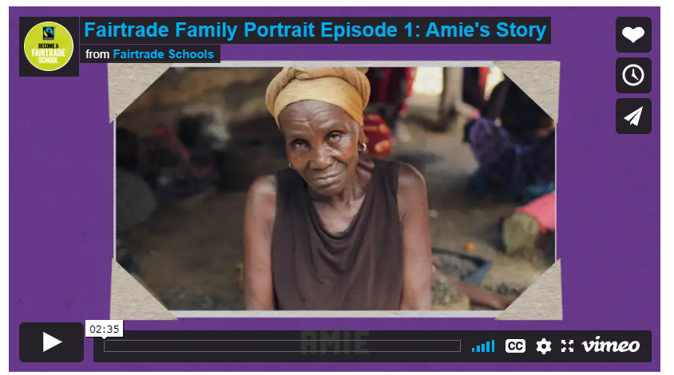
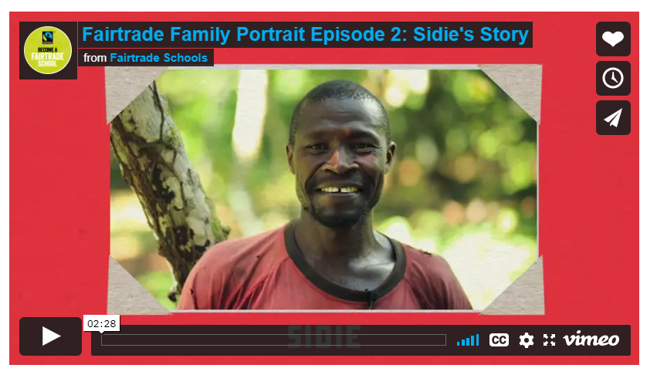
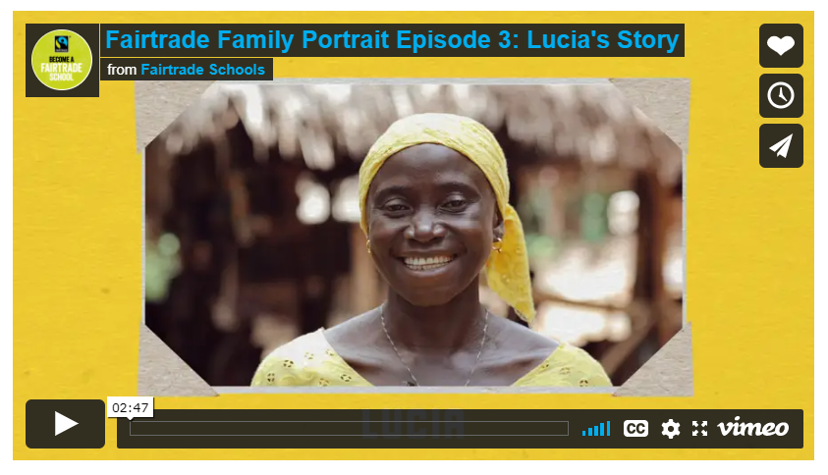
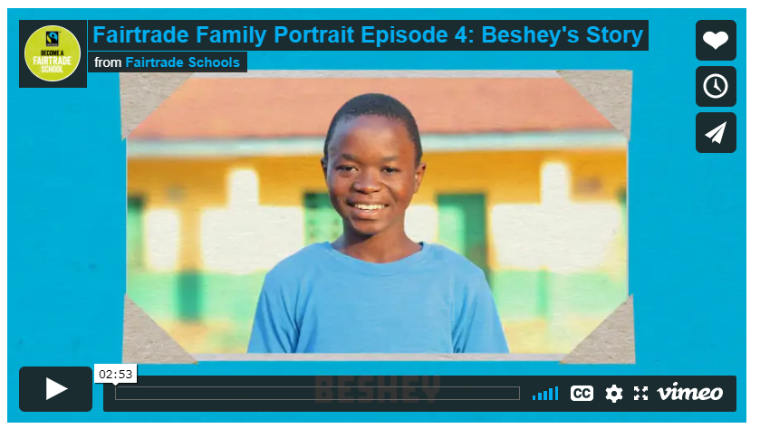
Next week we are going to look at how our actions have global consequences. You will see how you have the power to make a difference in the world through the choices you make every day.
You will need to understand what Fairtrade is and its benefits for farmers and workers around the world.
Watch the 4 film clip and make notes to use in next Tuesday’s lesson
Beshey's story
Amie's story
Sidie's story
Lucia's story

