Slide 1
Mapping the journey of chocolate
FAIRTRADE FORTNIGHT
22 FEBRUARY – 8 MARCH 2021

Slide 2
Everything you buy, every T-shirt, every pen, every bar of chocolate, has a story.

Slide 3
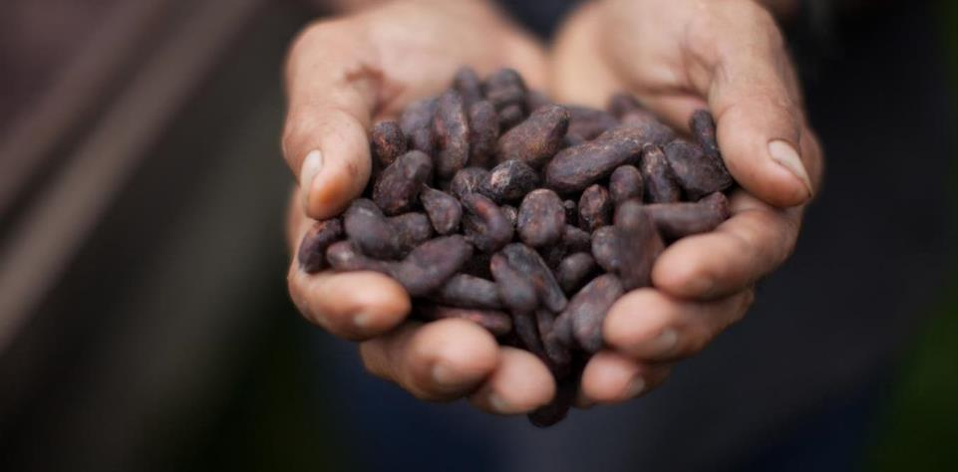
Mapping the journey of chocolate

Slide 4
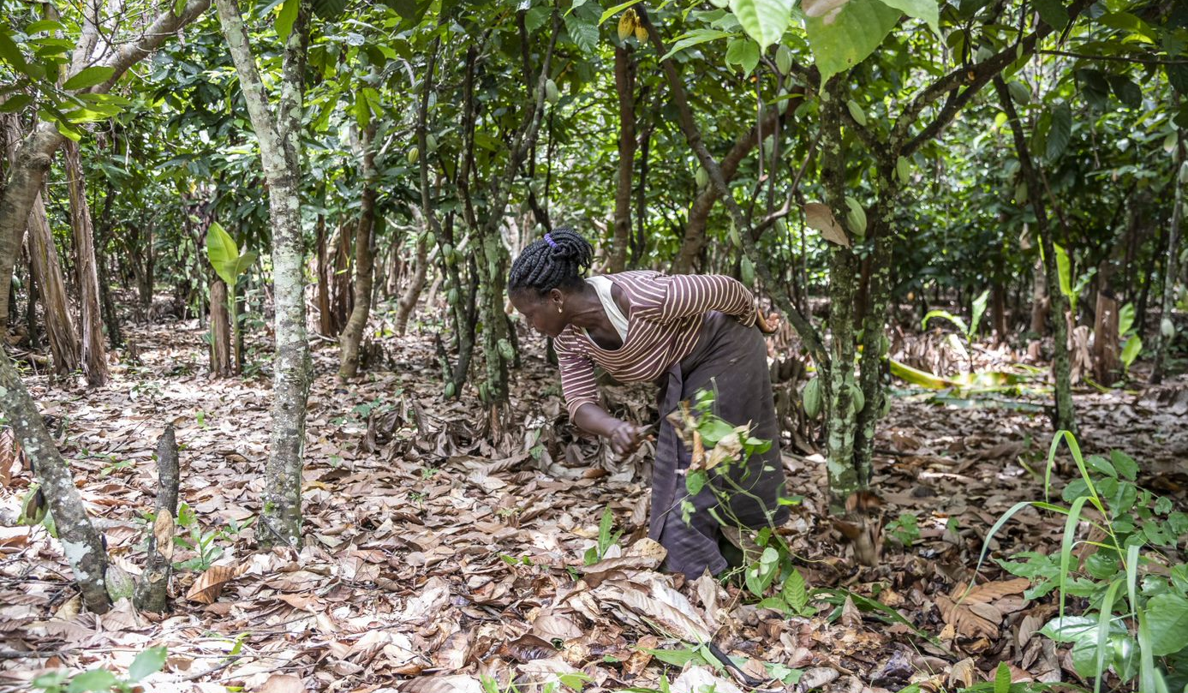
Where does it come from?
Notes:
I think the title of this needs to be more about incomes – maybe something like 'the reality of farmer poverty' or similar.. I like the layout here.

Slide 5
Where does it come from?

Slide 6
Your choices make a difference

