Slide 1

Maths 22/02/21
Practice on Times Tables Rockstars for 20 mins – click on the link:
ttps://play.ttrockstars.com/auth/school/student

Slide 2


Can I calculate multi-step word problems?
I’ve given you some word problems to calculate so you don’t forget how to do them!
Remember to use RUCSAC.

Slide 3
I.

Slide 4
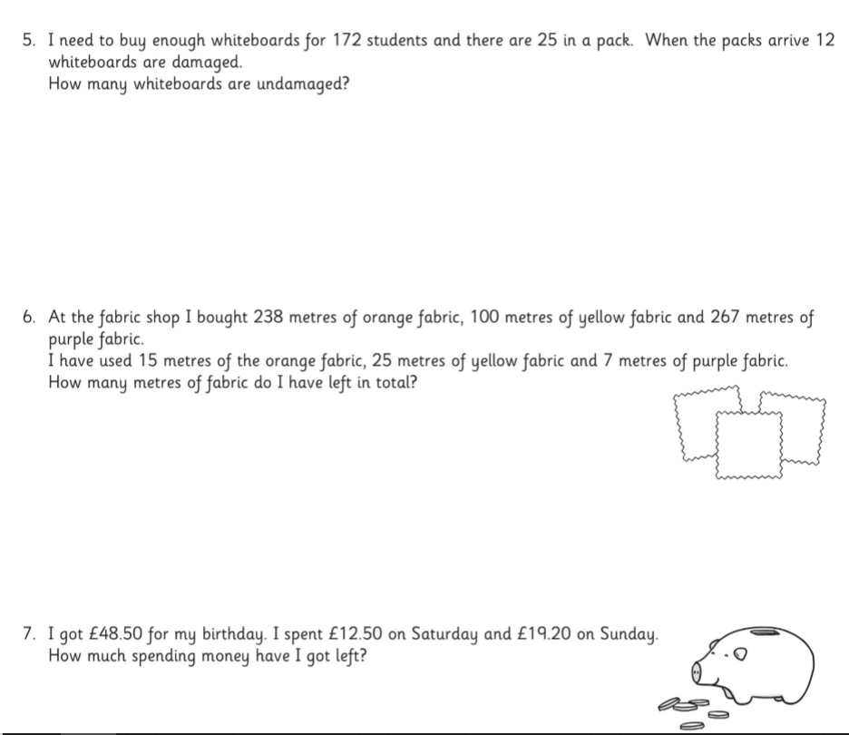
Go to the Purple mash to find the worksheet
on solving multi-step questions.

Slide 5
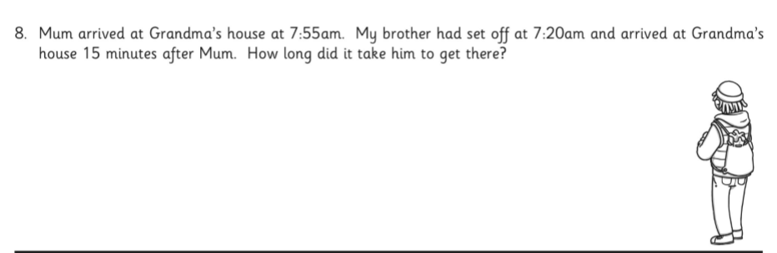
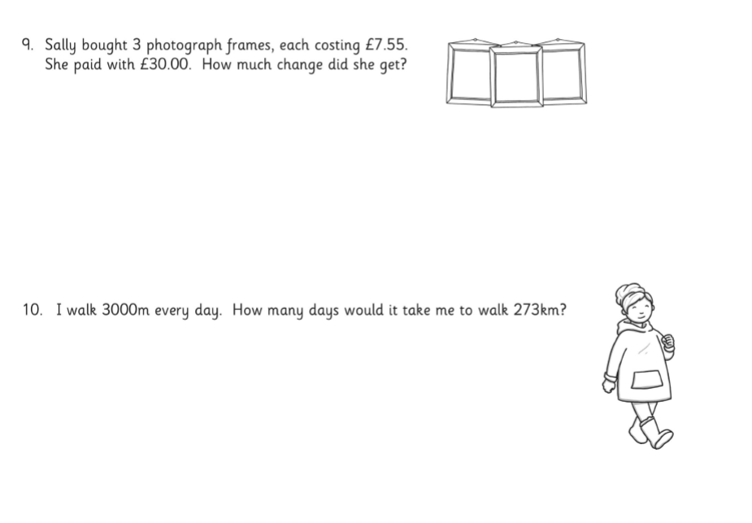

Slide 6
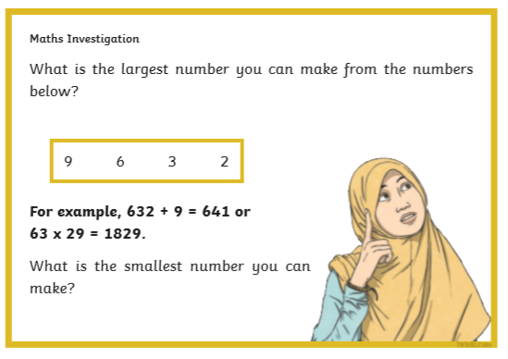
Extension Task

