Slide 1

Maths
2/03/21-4/03/21
Practice on Times Tables Rockstars for 20 minutes – click on the link:
ttps://play.ttrockstars.com/auth/school/student

Slide 2
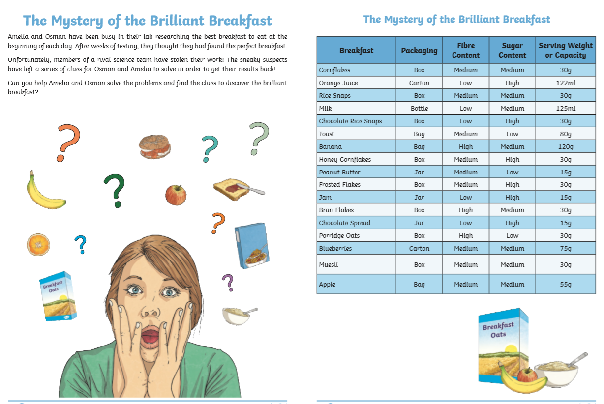

More puzzles to get your brains in gear for returning to school next week!
Tuesday Task 1 and 2
Wednesday Task 3 and 4
Thursday Task 5
Good luck!
The worksheets are on Purple mash

Slide 3
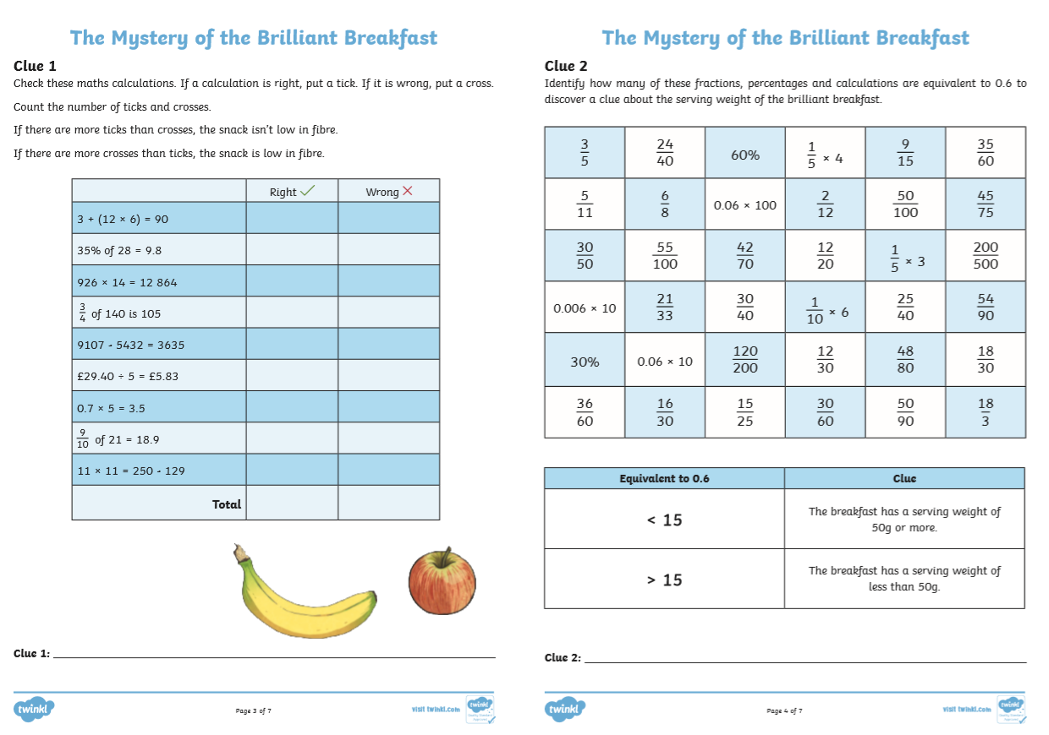
You can find all the tasks on Purple Mash

Slide 4
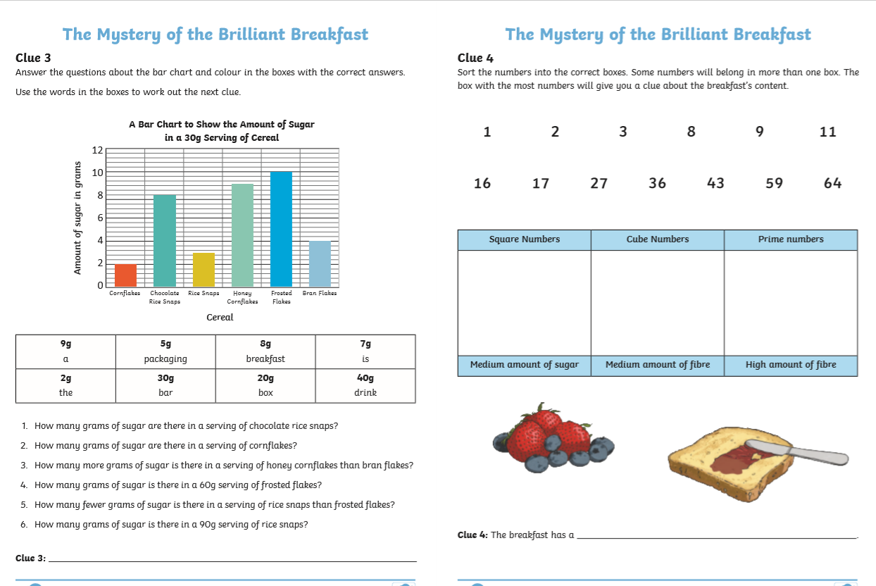

Slide 5
