Slide 1
Maths
23/02/21

Slide 2
Times Tables
If you can`t remember which personal times table you are working on, then please contact me.
For this week we will be practising the 7 times table as a whole class.
Use www.timestables.co.uk to have a go at this one, as well as https://ttrockstars.com/
Try the worksheets and games, just like we have done in class, as well as singing or chanting them to your family!
Spend 10 – 15 minutes on this exercise

Slide 3
Warm-up
Try the 5 questions on the following slide

Slide 4
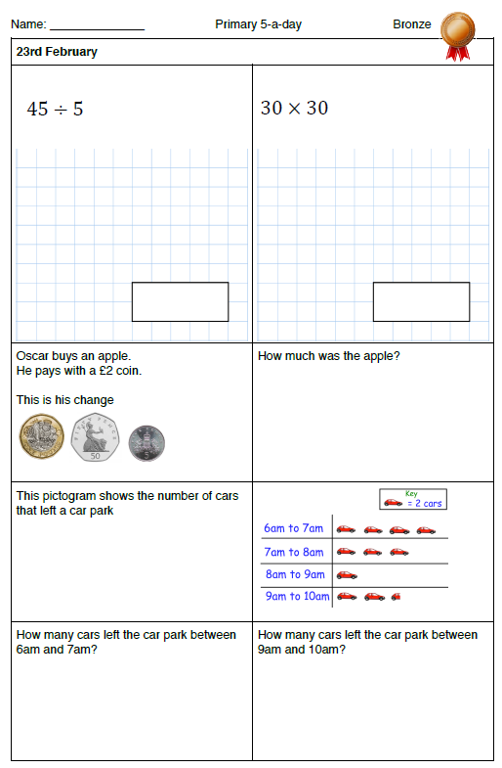

Slide 5
Main lesson
LC: Can I use place value, known and derived facts to multiply mentally?
Watch the following online lesson, having a go at the quizzes and tasks where the teacher asks you to https://classroom.thenational.academy/lessons/deriving-multiplication-facts-c9k32r
Then have a go at the 2Do Purple Mash task called Maths Tuesday

