Slide 1


Monday 08-02-21
Lets work together on this and then get a bit more practice.

Slide 2
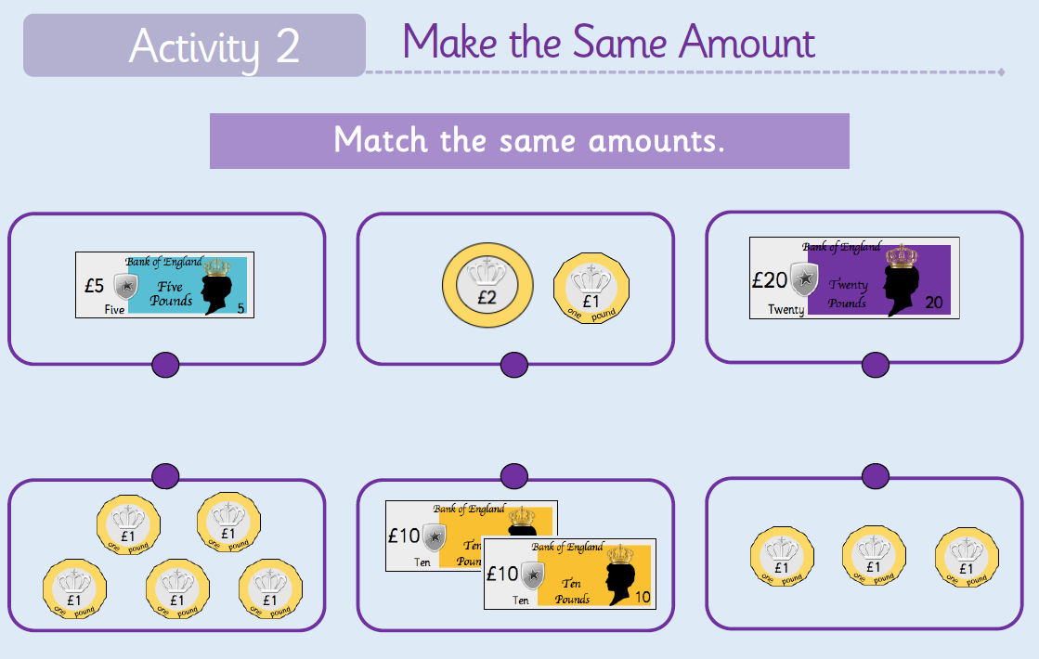

Slide 3
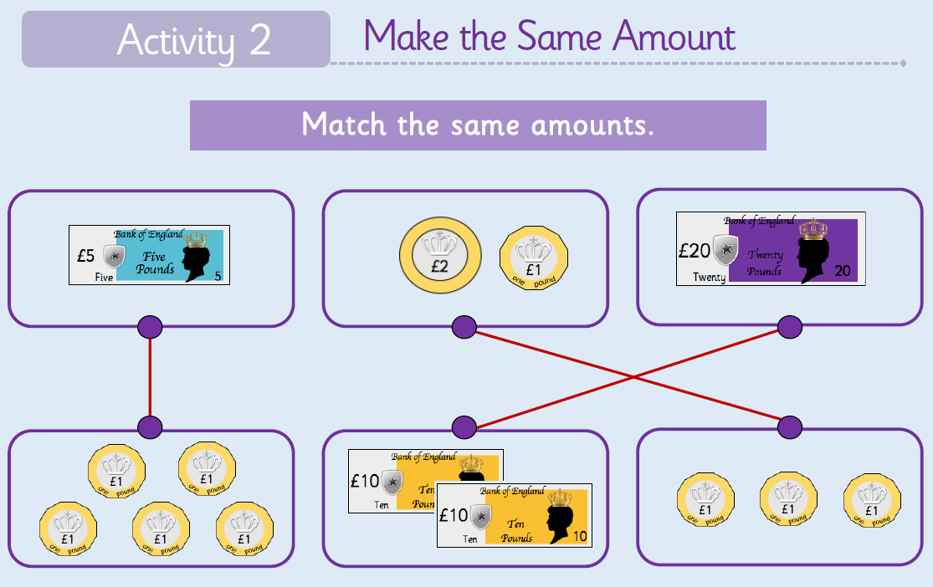

Slide 4


Slide 5
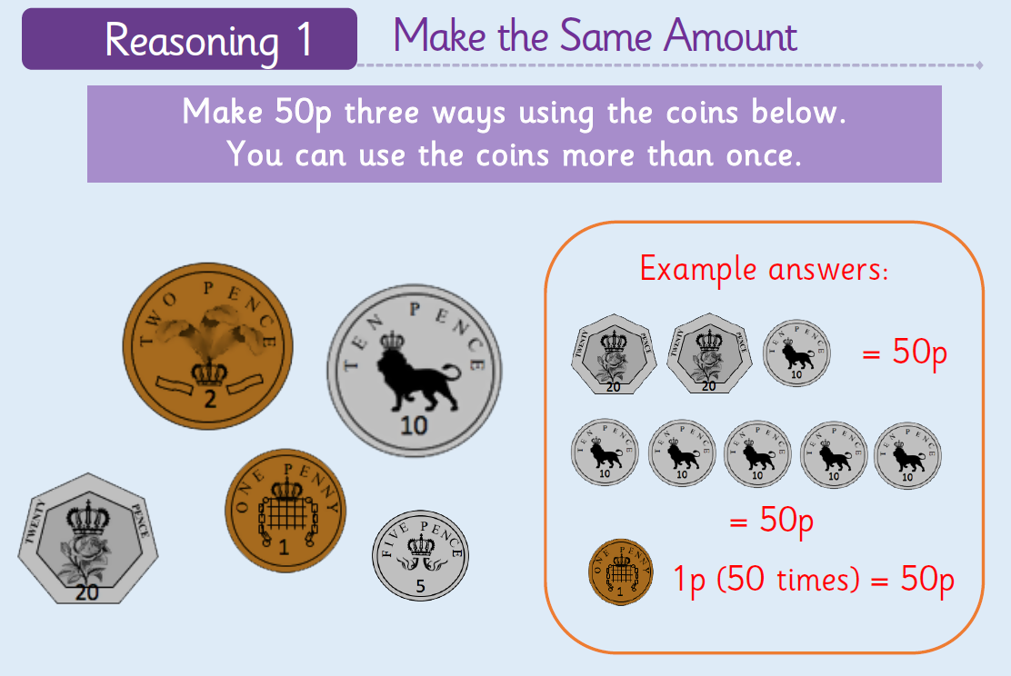

Slide 6

25p
25p

Slide 7
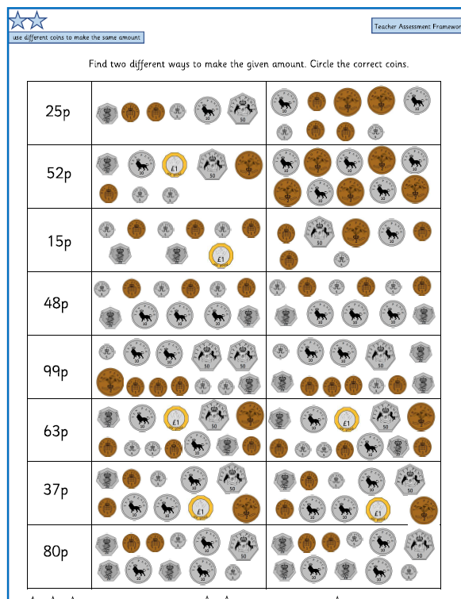

Slide 8



How to write on a PDF
Open PDF in Purple Mash
Click on TOOLS tab
Select COMMENT
Select from tool bar
Click where you need to write answer then type in box

Slide 9
The work sheets are on the School page as usual; but I have uploaded them onto purple mash as PDF file that if you follow the instructions you can write on.
Let’s have a go at using the editing tools on Purple mash. Look at the instructions on the next slide; and then go on the website and use the worksheet for today. You may need and adult to help you.
Top Tip write the instructions down so you don’t have to keep looking at the slide.
https://www.purplemash.com/sch/worth-bd22

