Slide 1
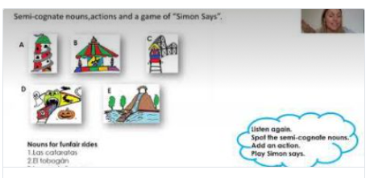
Spanish
Española
Friday 25.02.21
Click on the link for this week’s lesson
Funfair

