Slide 1
Spanish 01/03/2021
Hola!

Slide 2
Warm-up
Counting to 10 recap
https://www.youtube.com/watch?v=us2tNTl3ZR8

Slide 3
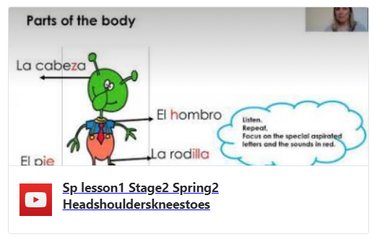
Spanish – parts of the body
https://youtu.be/u3FzMrJij7g

