Slide 1
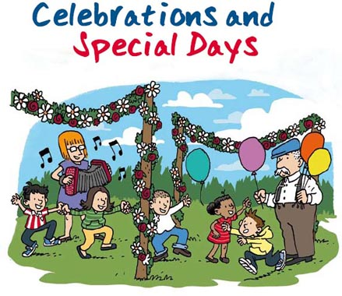

Slide 2
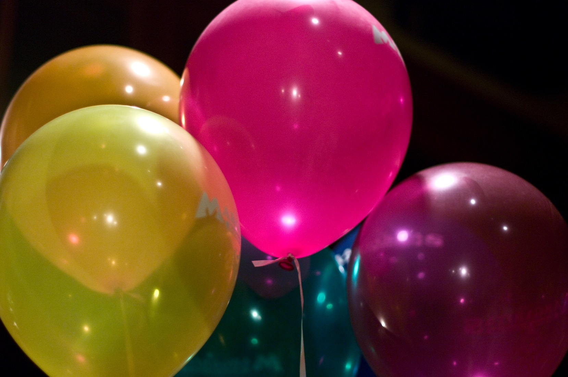
I’m sure that we can all think of special days when
we celebrate something very special

Slide 3
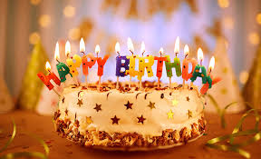
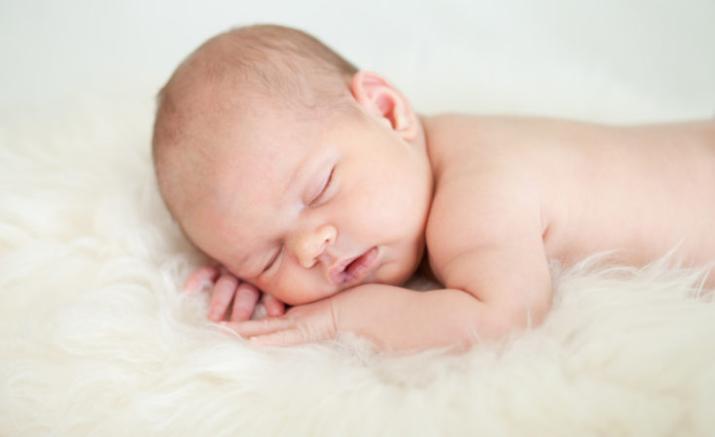
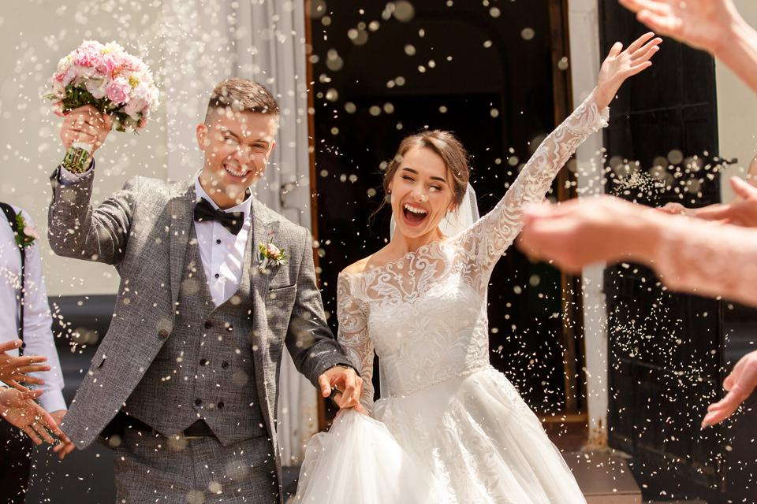
We have birthdays.
Birth of a baby.
Weddings.
Getting Star of the Week.

Slide 4
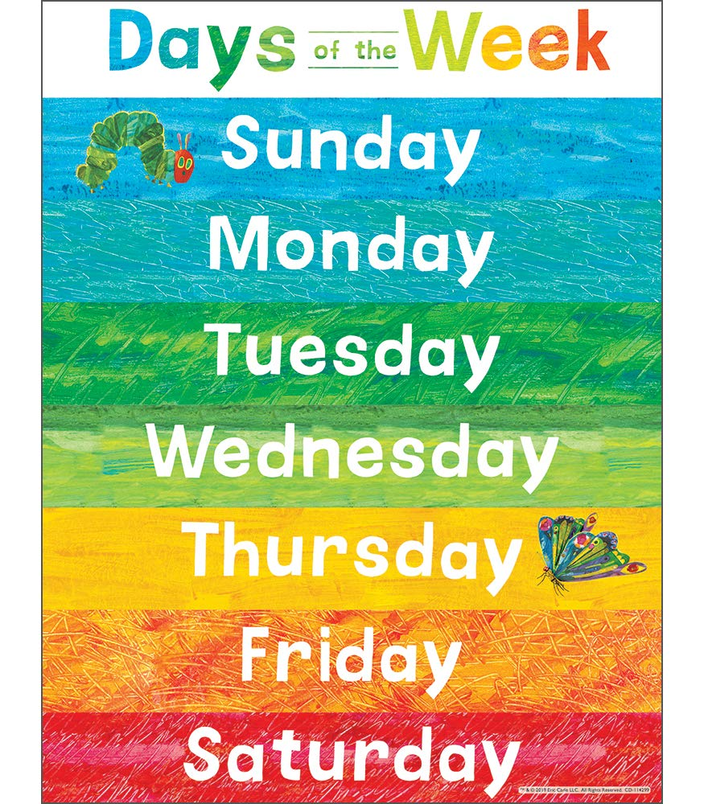
We don’t always have big celebrations but
I’m sure you can think of something you enjoy every day.

Slide 5
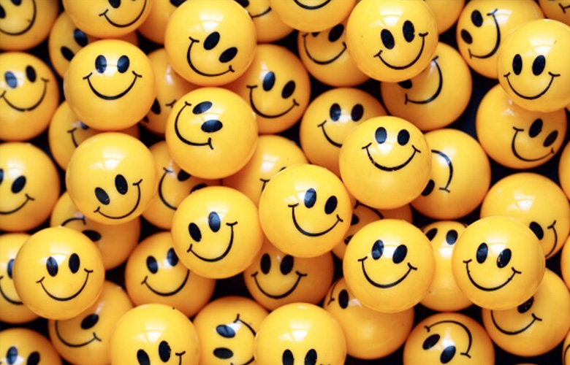
Which days do we come to school?
Stay at home?
How do you feel about certain days?
Do you have a favourite day of the week?

Slide 6
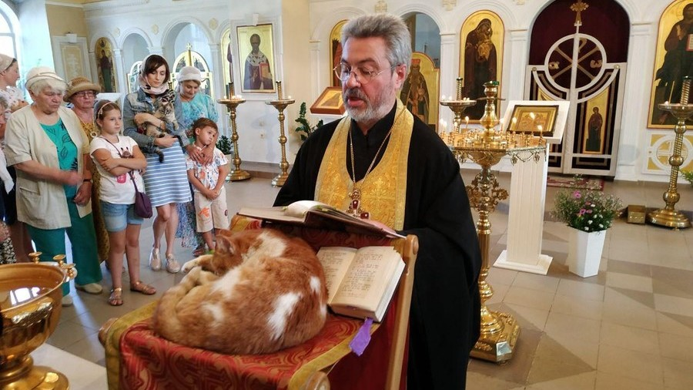
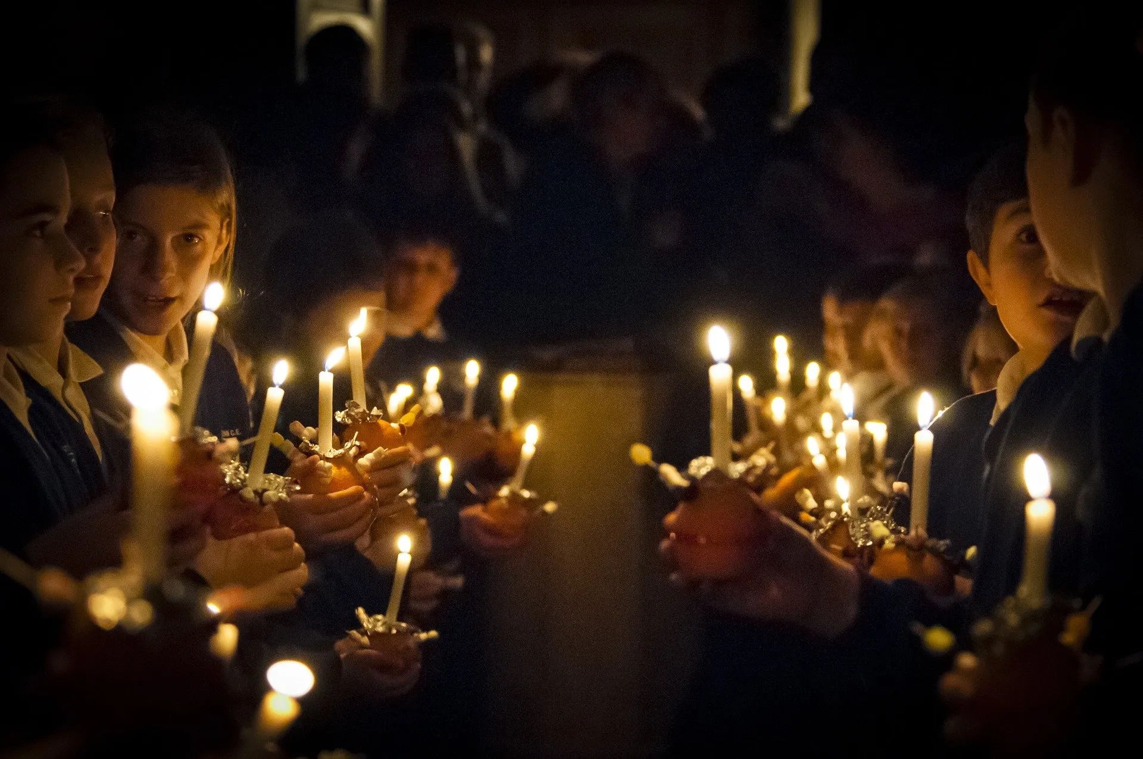
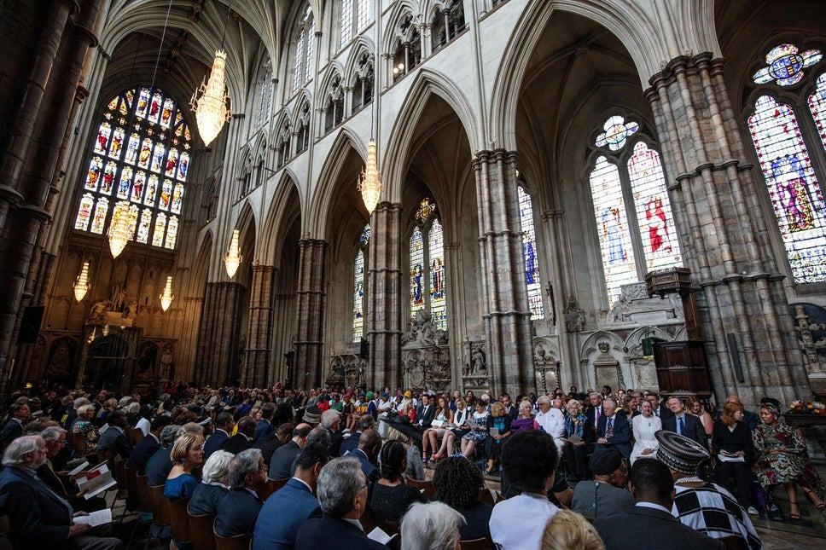
https://www.bbc.co.uk/programmes/p02mwx8r
Christians have Sunday as their special day. Why do you think Christians try to meet together on the same day?
Answer
Sunday is the day Jesus rose from the dead. This is why, in the past, Christians chose the first day of the week - a day to worship God, a day to feel happy, rest, meet other Christians.

Slide 7
https://www.bbc.co.uk/programmes/p02mwx8r
Christians have Sunday as their special day. Why do you think Christians try to meet together on the same day?
Sunday is the day Jesus rose from the dead. This is why, in the past, Christians chose the first day of the week - a day to worship God, a day to feel happy, rest, meet other Christians.

Slide 8
Your task is to think about your favorite
day of the week. What do you do on that day that makes it your favorite?
Draw a picture of you enjoying your favorite day and
write some sentences about it.
Send us the pictures.

