Slide 1
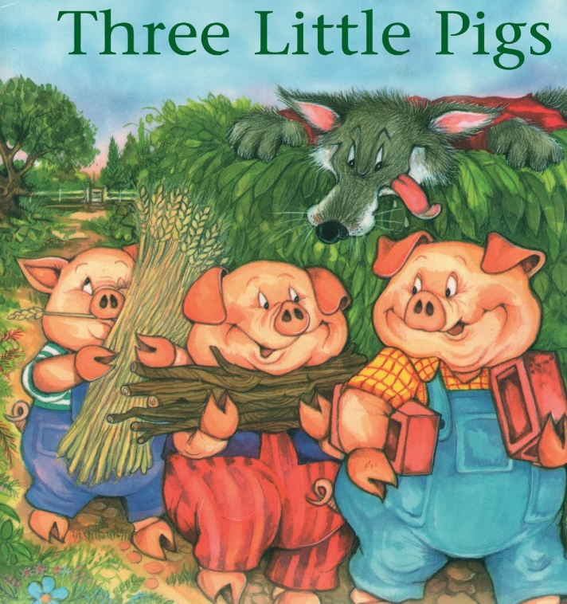
Thursday 25th February 2021
English tasks.

Slide 2
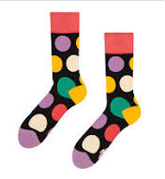
Can you knock my socks off with your neat writing?
Now that you have practised your letters on letterjoin can you practise on a piece of paper?
Can you send a picture of your writing to me?
Steph.milner@worthvalleyprimary.co.uk
Lara.Crawford@worthvalleyprimary.co.uk

Slide 3
Traditional Tales
This half term our English tasks will be based on Traditional Tales.
A traditional tale is a story that has been told and re-told for many years. It becomes a story that almost everyone knows. Traditional tales are also sometimes called fairy stories or fairy tales.
Stories such as Cinderella, Goldilocks and the Three Bears and Jack and the Beanstalk are all traditional stories.

Slide 4
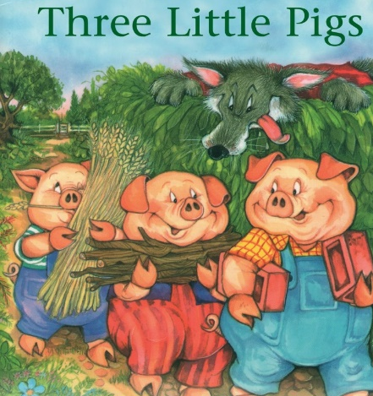
Reading and Writing Task
This week we are reading
The Three Little Pigs
Can you watch a film version of the story using the link below?
https://www.youtube.com/watch?v=QLR2pLUsl-Y

Slide 5
Writing Task:
Can you write a letter from the Big Bad Wolf?
Today we need to do a special job to help the Big Bad Wolf.
He has thought very carefully about his behaviour and knows that he wants to put things right. He wants to write a special letter to say sorry to the three little pigs but he does not know how to write!
Can we write one for him?

Slide 6
Remember to set your letter out clearly and correctly. Dear Three Little Pigs,
From
Big Bad Wolf.

