Slide 1
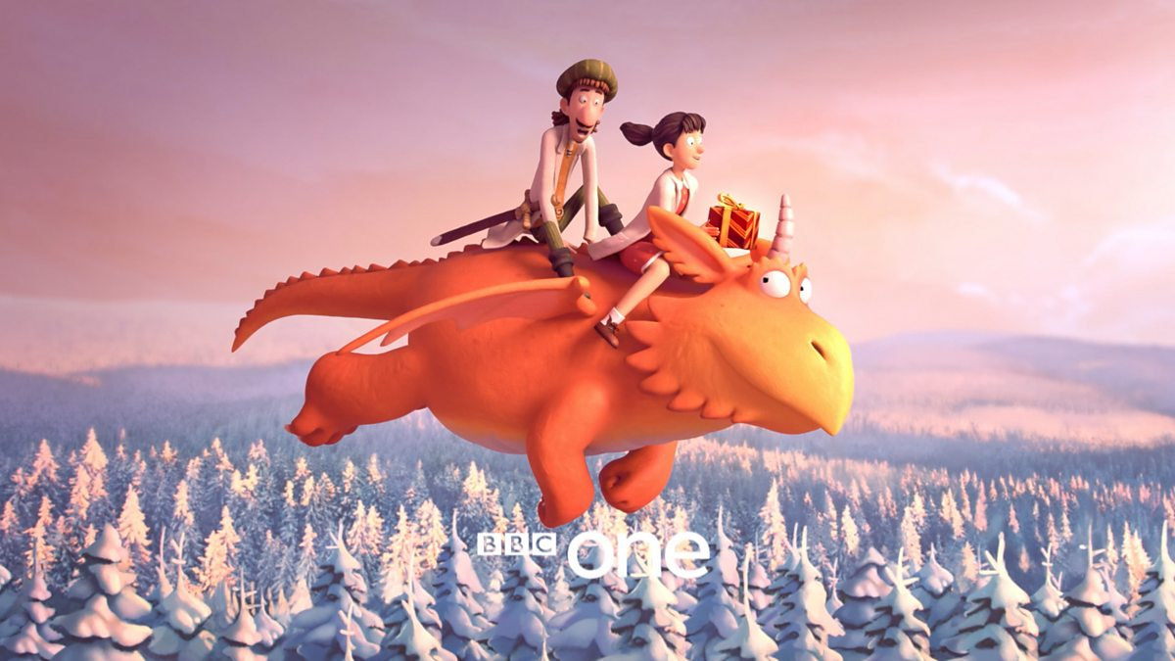
Thursday 11th February 2021
English tasks

Slide 2
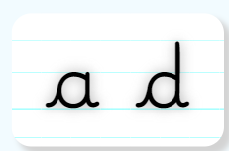
Handwriting
Please practise the following letters:
(Easy letters)
Look on the letterjoin website to see how to form them correctly.
https://letterjoin.co.uk Username: lj8943
If you are using a laptop the password is: home
If using an ipad or tablet the password is: capital L (Make the shape of a capital L)

Slide 3
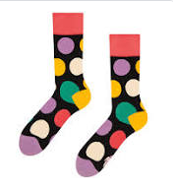
Can you knock our socks off with your neat writing?
Now that you have practised your letters on letterjoin can you practise on a piece of paper?
Can you send a picture of your writing to me?
s.hiley@worthvalleyprimary.co.uk

Slide 4
Writing Tasks
This week we are reading
Zog and the Flying Doctors
by Julia Donaldson.
If you would like to watch the film version of the story again the link is below:
https://www.bbc.co.uk/iplayer/episode/m000qq5j/zog-and-the-flying-doctors

Slide 5
Writing task
Today we need to do a special job for the characters in the story. They would like to say thank you to Zog and the Flying Doctors for caring for them and helping make them better.
Can you write a thank you letter?

Slide 6
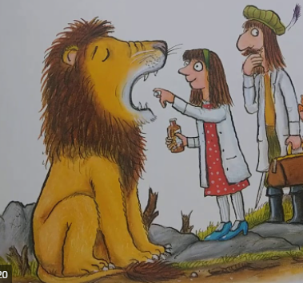
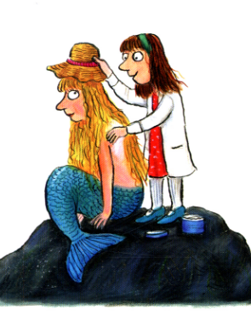
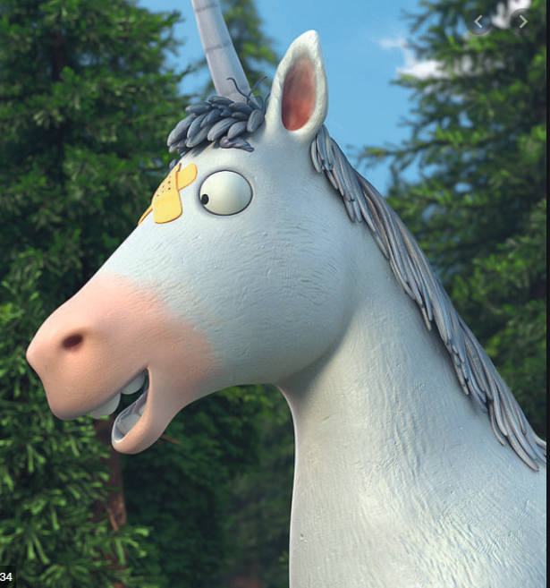
Ideas
What might the poorly characters want to say to Zog and the Flying Doctors? Your letter could be from one character or from them all.

Slide 7
Here is an example:
Dear Zog and the Flying Doctors,
I am writing this letter to say thank you so much for helping me to get better. I felt so sad and poorly that I thought I would never be able to roar or play again. Everyone else was too scared to help me because they think my teeth are very sharp and scary but you were very brave. Thank you for making my den nice and warm, this really helped me get better. You are the kindest doctors in the whole land. Keep up the super work.
From
The Lion x

Slide 8
Super writing checklist:
Capital letters to begin each sentence and for names
Finger spaces
Neat letters that are formed correctly
Exciting words
Full stops to end each sentence
Keep reading your work to check that it makes sense
Remember a letter starts with Dear……. and ends with From…….

Slide 9
Remember I love to see your work:
You can use Purple Mash to type your work. I have set you a ‘To Do’ for this task.
Or you can write on paper and send a picture to me on my email address:
s.hiley@worthvalleyprimary.co.uk

