Slide 1
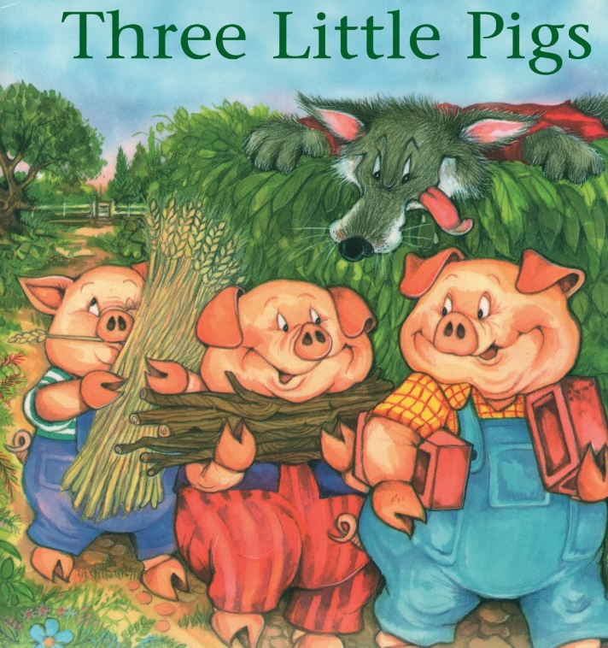
Tuesday 23rd February 2021
English tasks.

Slide 2
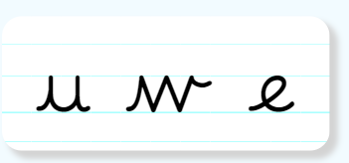
Handwriting
Can you practise the letters u, w and e.
Look on the letterjoin website to see how to form them correctly.
https://letterjoin.co.uk Then click on easy letters second set
Username: lj8943
If you are using a laptop the password is: home
If using an ipad or tablet the password is: capital L (Make the shape of a capital L)

Slide 3
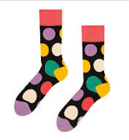
Can you knock my socks off with your neat writing?
Now that you have practised your letters on letterjoin can you practise on a piece of paper?
Can you send a picture of your writing to me?
s.hiley@worthvalleyprimary.co.uk

Slide 4

Traditional Tales
This half term our English tasks will be based on Traditional Tales.
A traditional tale is a story that has been told and re-told for many years. It becomes a story that almost everyone knows. Traditional tales are also sometimes called fairy stories or fairy tales.
Stories such as Cinderella, Goldilocks and the Three Bears and Jack and the Beanstalk are all traditional stories.

Slide 5
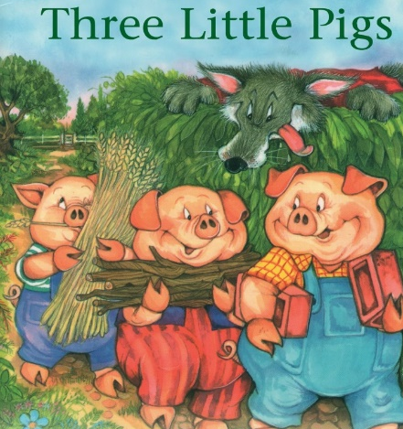
Reading and Writing Task
This week we are reading
The Three Little Pigs
Can you watch a film version of the story using the link below?
https://www.youtube.com/watch?v=QLR2pLUsl-Y

Slide 6

Writing Task:
Can you design a wanted poster for the Big Bad Wolf?
The Three Little Pigs need our help!
We need to catch the Big Bad Wolf. Can you make a wanted poster to help catch him so we can teach him how to be kind?
Remember you need to describe him carefully so that we catch the right person.

Slide 7
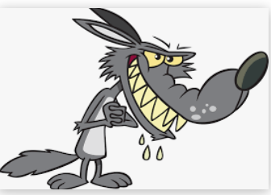
Writing task:
Can you use some of
these adjectives
in your description?
Razor sharp claws
Bushy tail
Grey fur
Two big, beady eyes
A wicked smile
dangerous
sneaky
clever
cunning
vicious
wicked
mean

Slide 8

You might want to set your wanted poster out like this:
A picture of the Big Bad Wolf so people know who they are looking for.
A detailed description of what he looks like and why he is ‘Wanted’ what has he done wrong?

Slide 9
Here is an example:
The Big Bad Wolf has large, pointed ears that stick out so that he can hear everything. His huge, beady eyes sparkle like diamonds especially when he spots his next delicious meal. What a greedy wolf he is! His stone, grey fur is fluffy and smooth and his enormous, bushy tail swings behind him when he walks.

Slide 10
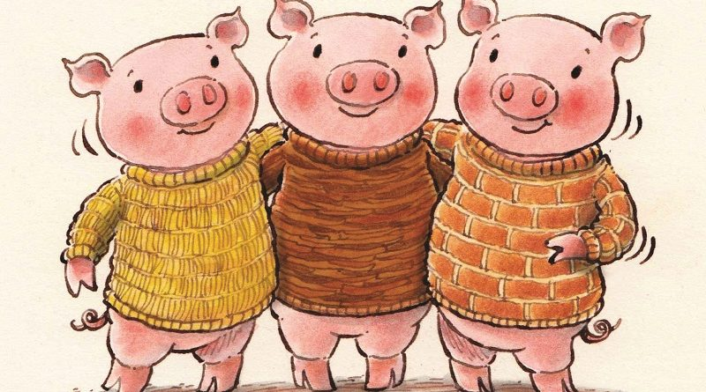
Remember I love to see your work so please email pictures to me at:
s.hiley@worthvalleyprimary.co.uk

