Slide 1
Wednesday 24-02-21
All these words are just different ways to say ADD and TAKE AWAY.
You see them in questions. Are they trying to trick us, YES. Are we going to let them, NO!
Take a go look at these word s and learn which means which.

Slide 2
Today we are going to have another go at addition using the column method.
Remember that we need to be very tidy to do this maths.
Watch the video And do the work sheet on your Purple mash 2Dos.
It’s tricky writing so many answers on the sheet, so why not write the question out on a piece of paper (very good practise) put in the answers and send a photo.
s.grant@worthvalleyprimary.co.uk
Autumn Week 8 Number : Addition and Subtraction.
Add 2 digit numbers crossing 10.
https://whiterosemaths.com/homelearning/year-2/week-8-number-addition-subtraction/

Slide 3
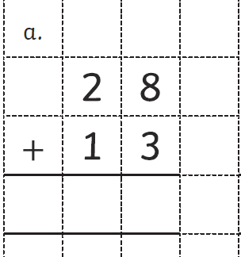
Remember how we write the sum of the
ones next to the calculation to help us
remember the answer 8 + 3 = 11
Now add up all the Tens.
Do nor forget the
Ten under the equals box.
T
0
T
0
11
1
1
1
1
The ten goes under the Tens column

Slide 4
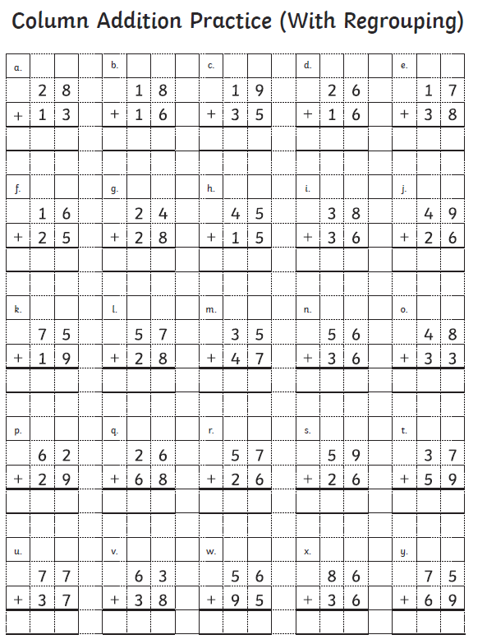

Slide 5
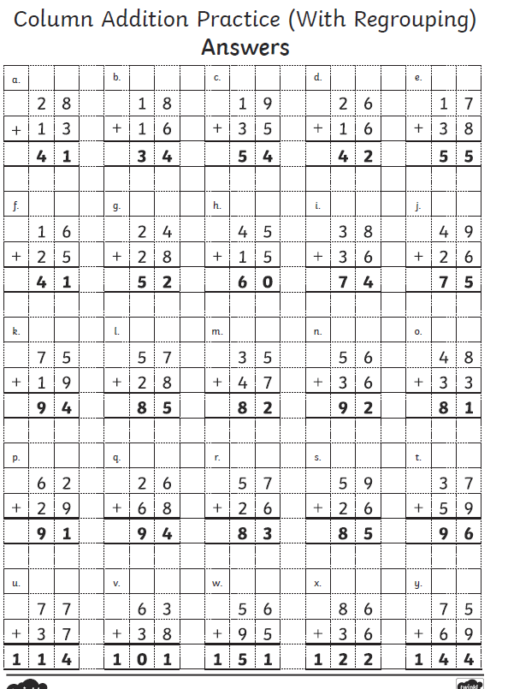

Slide 6
How to write on a PDF
Open PDF in Purple Mash
Click on TOOLS tab
Select COMMENT
Select from tool bar
Click where you need to write answer then type in box

Slide 7
The work sheets are on the School page as usual; but I have uploaded them onto purple mash as PDF file that if you follow the instructions you can write on.
Let’s have a go at using the editing tools on Purple mash. Look at the instructions on the next slide; and then go on the website and use the worksheet for today. You may need and adult to help you.
Top Tip write the instructions down so you don’t have to keep looking at the slide.
https://www.purplemash.com/sch/worth-bd22

