Slide 1

Maths 23/02/21
Practice on Times Tables Rockstars for 20 mins – click on the link:
ttps://play.ttrockstars.com/auth/school/student

Slide 2

Can I convert between grams and kilograms using decimals to 3 places?
.
We are returning to measurement this term.
You should be able to use the conversion skills you used last term to complete these questions.

Slide 3
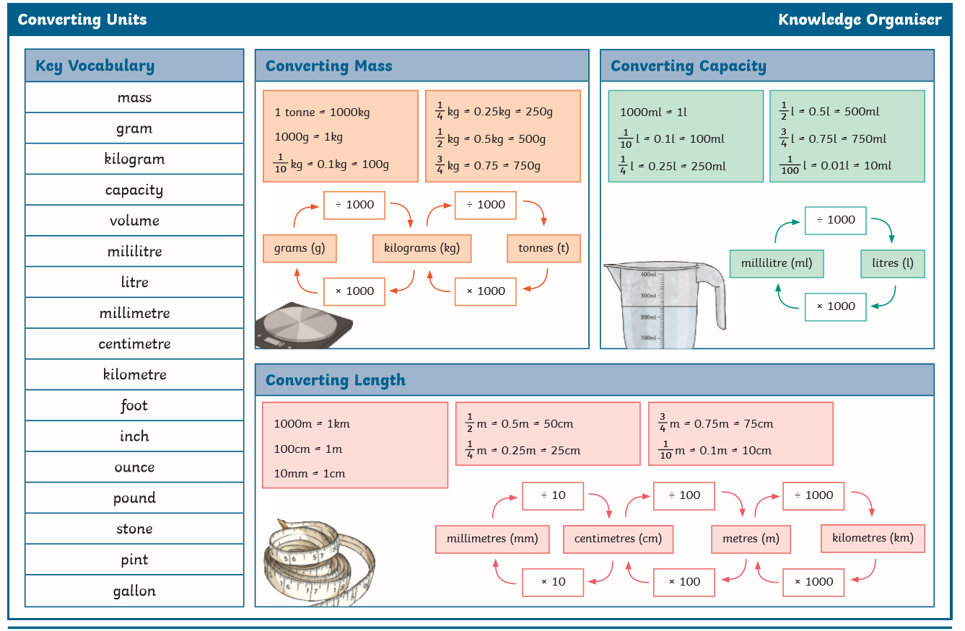
On the next 2 slides you will find conversion charts to refresh your memory

Slide 4
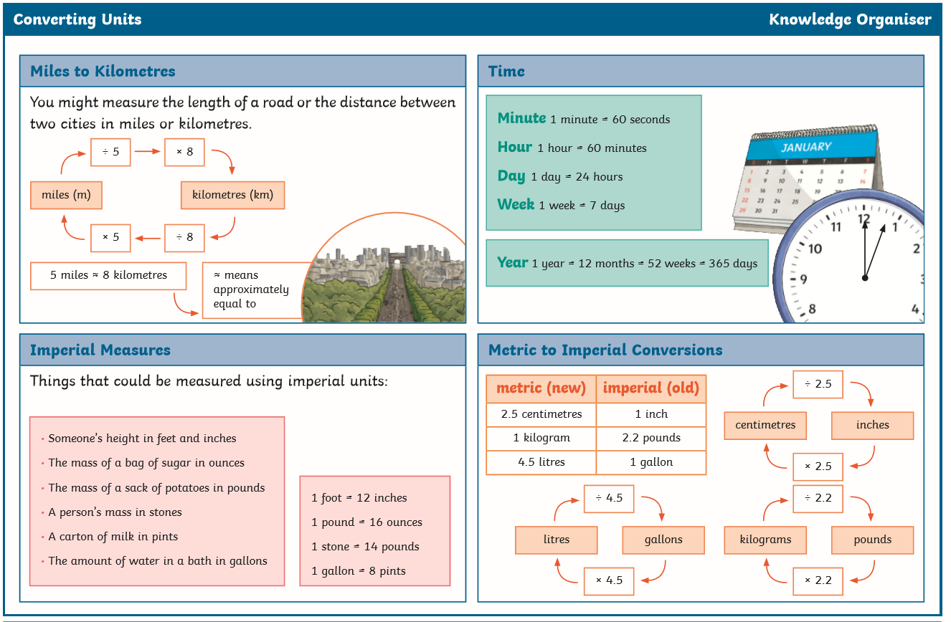

Slide 5
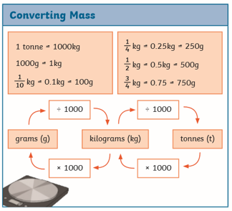
We will look at mass again first.
Make sure you have looked at the conversion charts to refresh your memory on how to convert between grams, kilograms and tonnes.
The following questions need to use decimal notation to 3 places.
e.g 0.1kg is to 1 decimal place
0.01 is to 2 decimal places
0.001 is to 3 decimal places

Slide 6
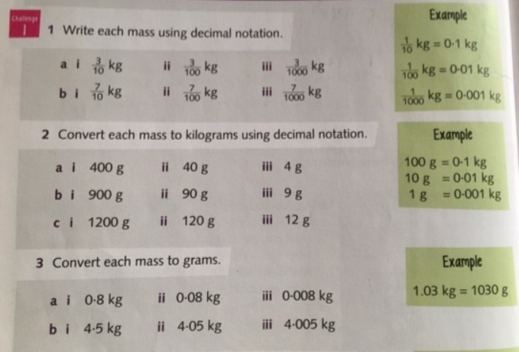
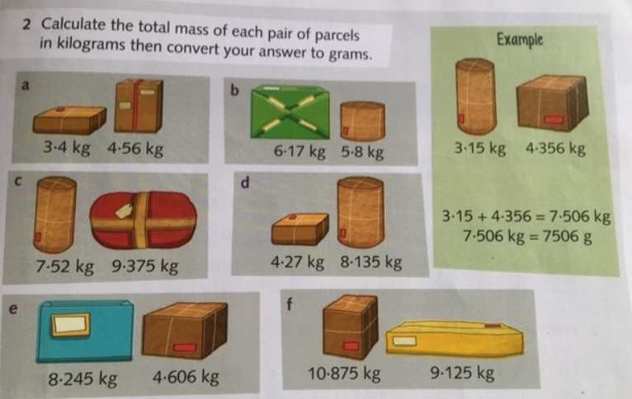
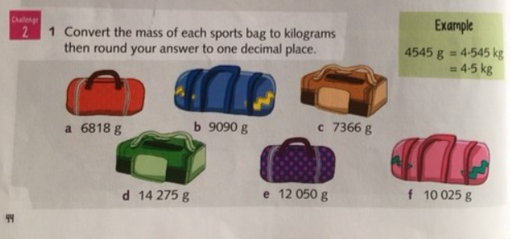
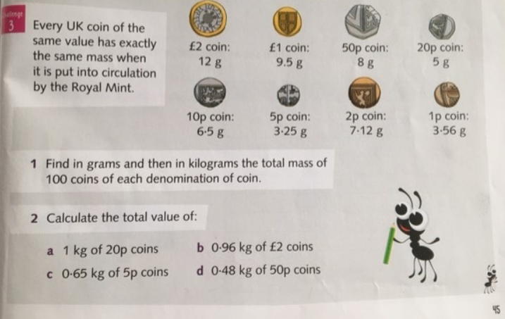
Read the questions carefully and use the examples in the green boxes to help you.
Go to the worksheets on purple mash for challenges and an extension question.
If you normally do A questions in class complete Challenge 1.
If you normally start on B questions complete Challenges 1 and 2.
The extension question is challenge 3.

