Slide 1
P.S.H.E.
Monday
01.03.21
Yoga for Wellbeing

Slide 2
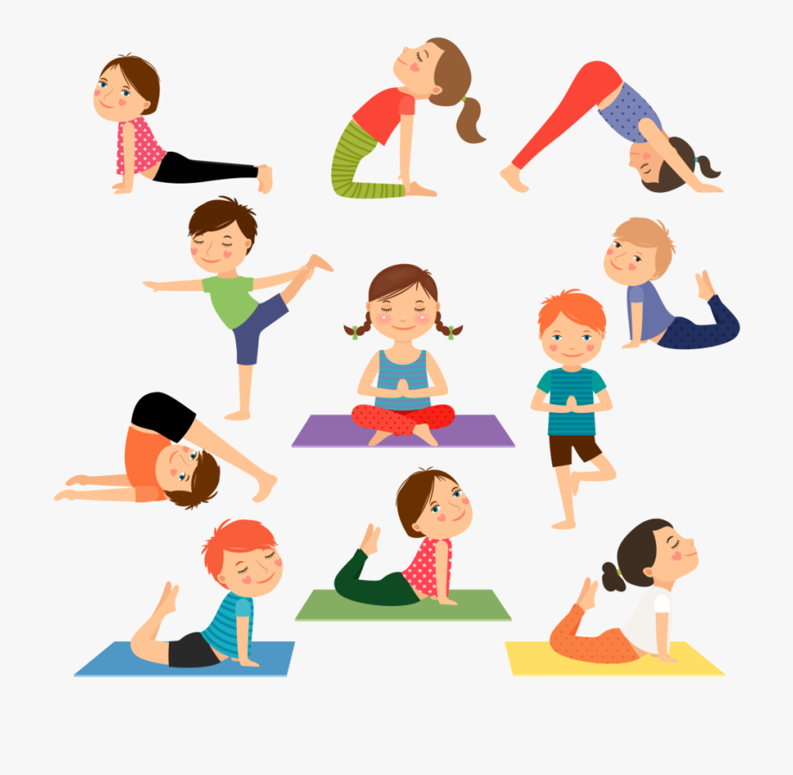
Yoga poses

Slide 3
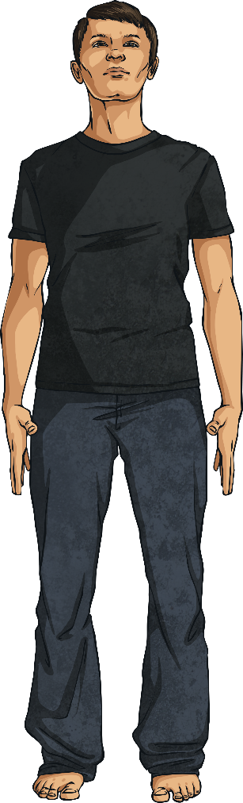
Mountain Pose
Tadasana
Benefits
Improves posture, strengthens core muscles and legs.
1
Stand tall with your weight balanced evenly on your feet.
Firm your thigh muscles and pull in your tummy.
Press your shoulders back and hang your arms beside your torso.
Breathe deeply and hold as long as needed (at least two breaths).
2
3
4

Slide 4
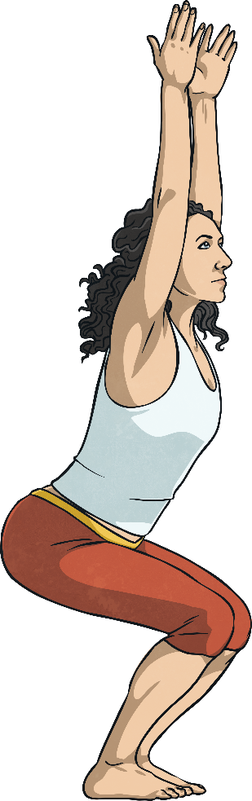
Chair Pose
Utkataasana
Benefits
Strengthens legs, stretches shoulders and chest.
1
Start in mountain pose. (Standing with your feet shoulder width apart and arms by your side).
Exhale, and bend your knees as if you were sitting in a chair.
Reach your arms towards the ceiling with your palms facing each other.
Hold this pose and breathe.
2
3
4

Slide 5
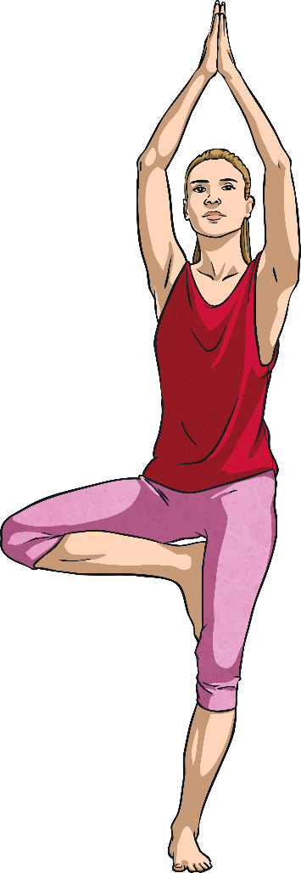
Tree Pose
Vriksasana
Benefits
Improves balance, strengthens thighs, calves and ankles, stretches legs and chest, develops concentration.
1
Begin in mountain pose. (Feet shoulder-width apart, hands at your sides.)
Lift your right foot, turning your knee out; place your foot on your leg wherever feels comfortable.
Press your hands together.
Raise your arms over your head and look up to your hands if possible.
Return hands to your chest and lower your right leg.
Repeat with left leg.
2
3
4
5
6

Slide 6
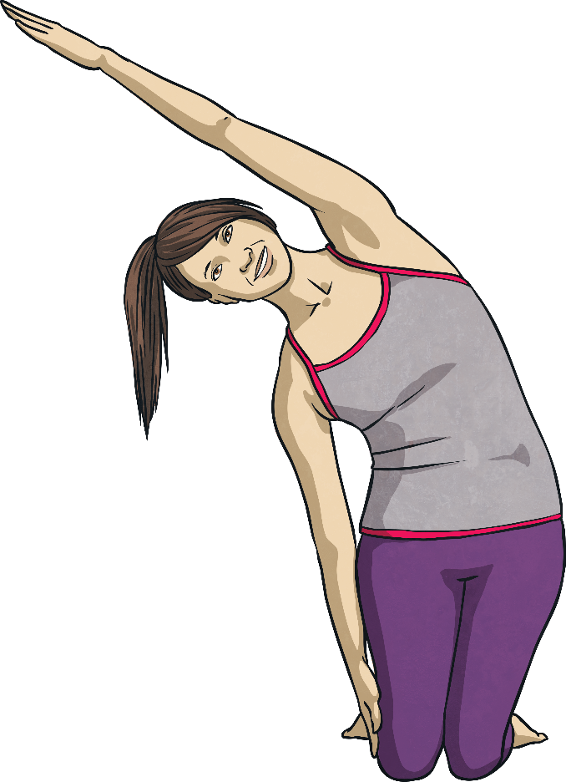
Rainbow Pose
Benefits
Stretches arms, abdominals, spine and chest; calms the mind.
1
Start on your knees. Raise both hands over your head.
Drop one hand by your side, exhale and arch your arm over your body.
Hold this position.
As you bring your dropped arm back over your head, straighten your body.
Repeat on the other side.
2
3
4
5

Slide 7
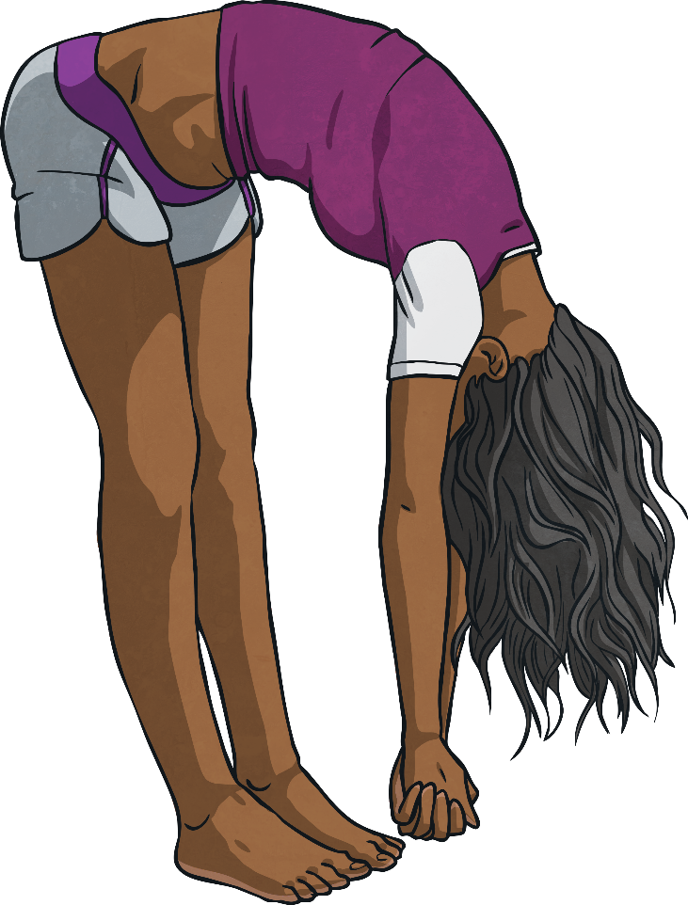
Elephant Pose
Benefits
Stretches legs and back, relieves stress and calms the mind.
1
Bend at the hips.
Let arms hang low then clasp fingers together.
Swing arms from side to side like a trunk. Swing your whole body from side to side to walk like an elephant.
2
3

Slide 8
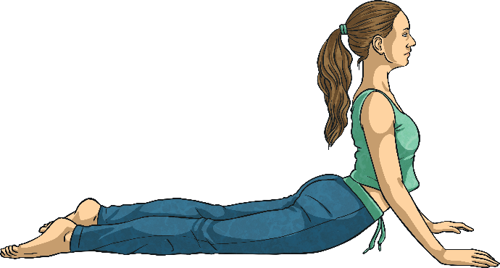
Cobra Pose
Bhujangasana
Benefits
Strengthens spine, backs of arms and legs; stretches shoulders, chest and belly, improves posture, helps relieve stress.
1
Begin by lying on your tummy.
While exhaling, lift your head and upper torso off the floor.
Gaze forward or slightly upward.
Hold this position, then release.
2
3
4

Slide 9
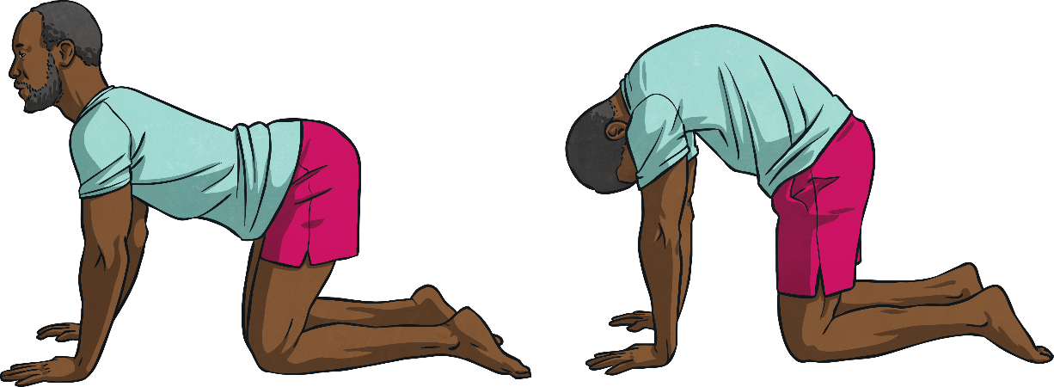
Cat Cow Pose
Marjaryasana Bitilasana
Benefits
Stretches torso and neck, gently massages spine and internal organs.
Start by kneeling on hands and knees. Make sure hands are below your shoulders and your knees below your hips.
Inhale and look up to the ceiling, allow your belly to sink toward the floor.
Exhale and round your back towards the ceiling and look at your belly.
Repeat.
1
2
3
4

Slide 10
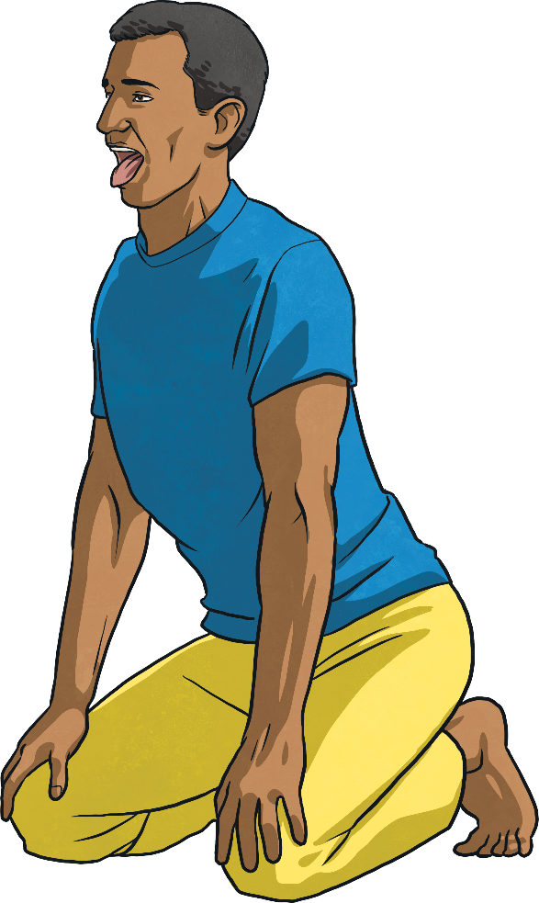
Lion Pose
Simhasana
Benefits
Stretches hips, thighs and ankles; calms the mind, relieves stress and fatigue.
1
Start on your knees, then sit back onto your heels.
Spread your fingers out and press your palms onto your knees.
Take a deep breath in through your nose.
Open your mouth, stretch out your tongue, open your eyes wide and let your breath out through your mouth.
Repeat a few times.
2
3
4
5

Slide 11
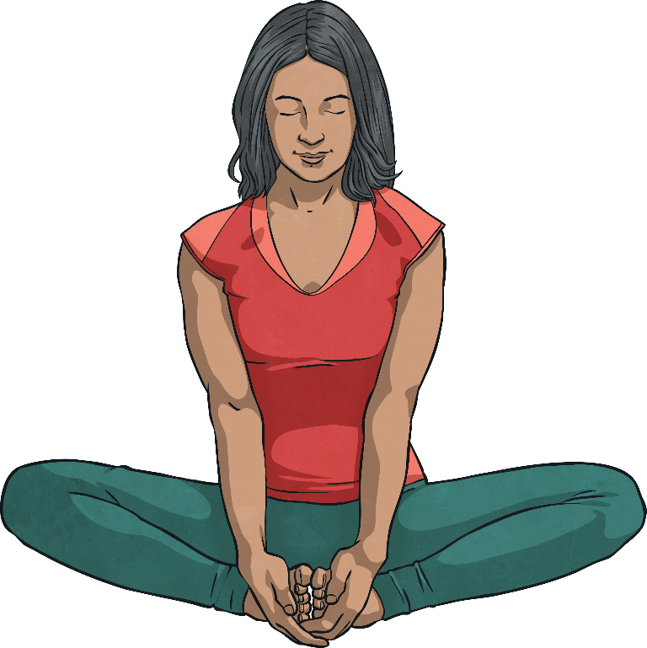
Butterfly Pose
Baddha Konasana
Benefits
Calms the body and mind, helps relieve stress, headaches and fatigue.
1
Begin by sitting with the soles of your feet together.
Wrap your hands around your feet, keep your back straight.
Gently bounce your knees to flap your butterfly wings.
2
3

Slide 12
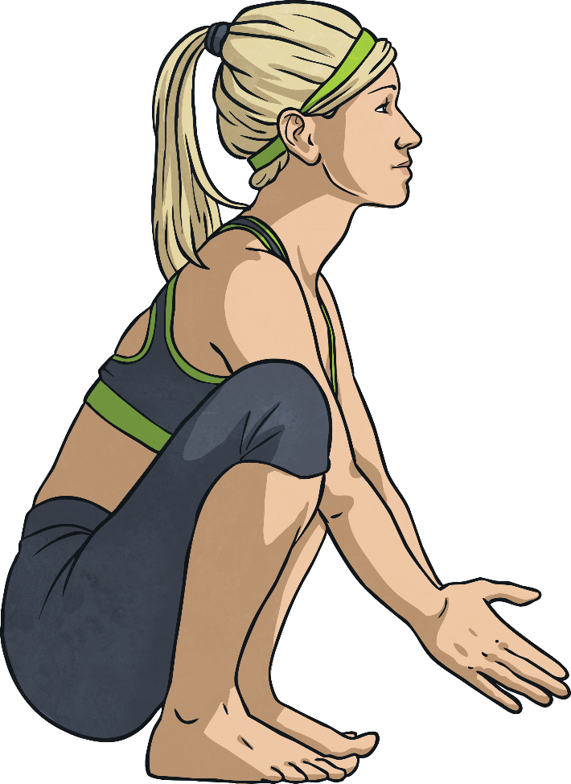
Frog Pose
Ardha Bhekasana
Benefits
Tones legs and increases hamstring flexibility.
Squat on the floor, balancing on your toes, knees spread wide, hands on the floor or out in front of you. Wherever makes you feel most balanced.
Look up and inhale. As you exhale, straighten your legs so you are in a standing position, lower your head towards your knees.
Return to the first position, then repeat.
1
2
3

Slide 13
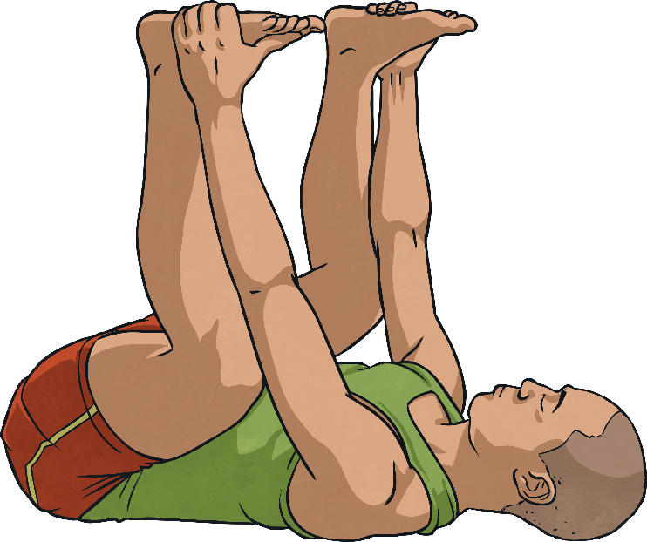
Happy Baby Pose
Ardha Bhekasana
Benefits
Gently stretches inner groin and spine, calms the mind and helps relieve stress and fatigue.
1
Lie down on your back.
Exhale, bend your knees into your belly and hold onto your feet.
Allow your body to gently rock side to side.
2
3

Slide 14
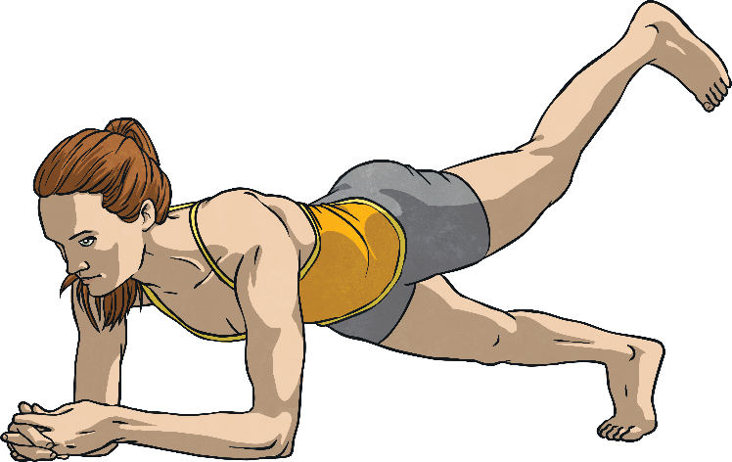
Three-Legged Dog Pose
Tri Pada Adho Mukha Svanasana
Benefits
Calms the mind, relieves stress, energizes the body, strengthens arms and legs, stretches upper and lower body, relieves headaches, back pain and fatigue.
Begin in downward-facing dog (hands and feet on the floor, bottom in the air in an upside-down V).
Lift one leg, hold, then lower with an exhale.
Repeat with the opposite leg.
1
2
3

Slide 15
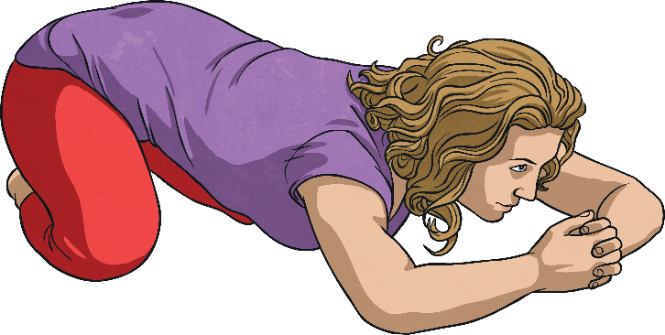
Bear Pose
Benefits
Stretches arms, legs, sides and chest; releases tension.
1
Begin on your knees, then sit back on your heels.
Spread your knees comfortably apart.
Bend forward, lowering your chest to the floor.
Bring your hands in front of you, locking your fingers together.
Exhale through your mouth, warming your hands.
2
3
4
5

Slide 16
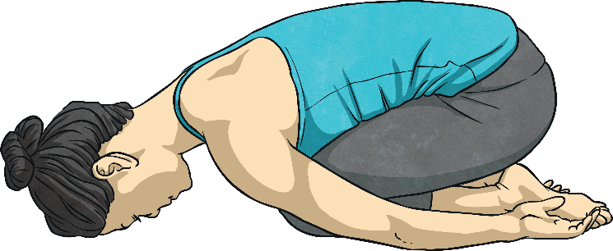
Child’s Pose
Balasana
Benefits
Stretches the hips, thighs, and ankles; calms the mind; relieves stress and fatigue.
1
Kneel on the floor, touching your big toes together.
Sit back on your heels and separate your knees hip-width apart.
Exhale, bringing your head down, and rest it on the floor in front of you.
Place your hands wherever they are comfortable by your head, your knees, etc.
Relax and breathe, holding this pose.
2
3
4
4

Slide 17
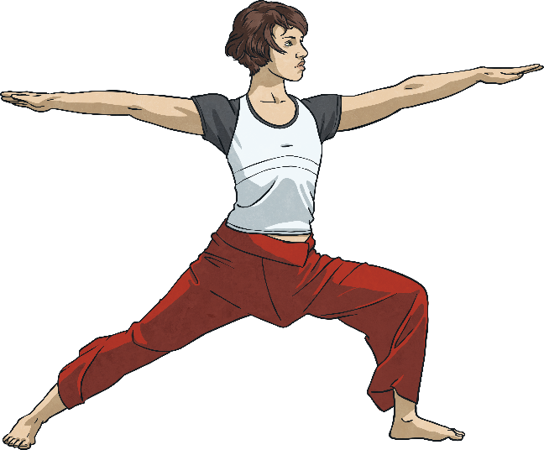
Warrior II Pose
Virabhradhrasana II
Benefits
Strengthens and stretches legs and core; stretches chest and shoulders; relieves backaches.
1
Stand with your feet wide apart. Turn your left foot out 90°.
Inhale, and lift your arms parallel to the floor.
Exhale and bend your right knee. Be careful not to extend your knee past your ankle.
Keep your torso tall, turn your head, and look out over your finger tips.
Inhale and straighten your legs and lower your arms. Repeat on the opposite side.
2
3
4
5

Slide 18
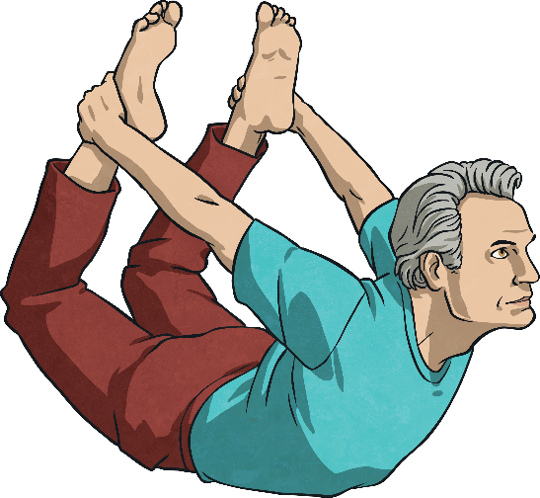
Bow Pose
Dhanurasana
Benefits
Stretches entire front of the body, strengthens back muscles and improves posture.
1
Begin on your belly, with your hands by your body, palms up.
Exhale and bend your knees. Reach back with your hands and take hold of your ankles.
Inhale and lift your heels towards the ceiling and your thighs away from the floor. Your chest will lift away from the floor.
Gaze forward. Hold this position, and release as you exhale.
2
3
4

Slide 19
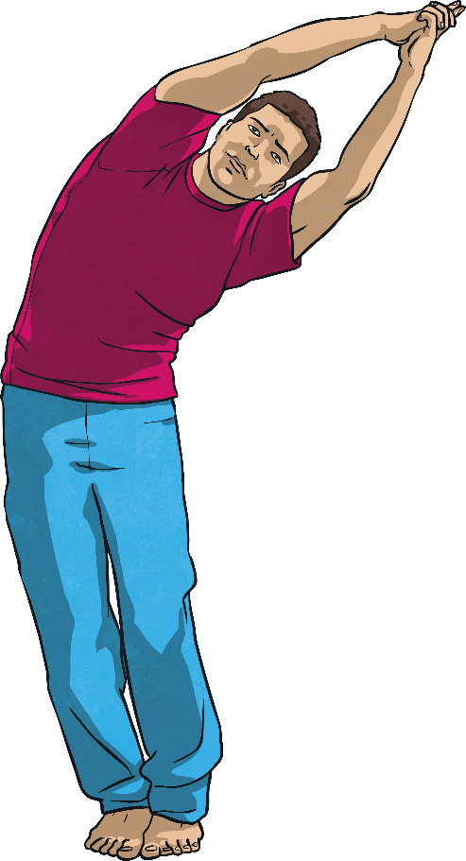
Crescent Moon Pose
Benefits
Stretches arms, abdominals, spine and chest; calms the mind.
1
Inhale and raise your hands over your head, pressing palms together.
Exhale and tip your body to one side.
Inhale and return to standing straight.
Repeat on opposite side.
Exhale and lower your arms.
2
3
4
5

Slide 20
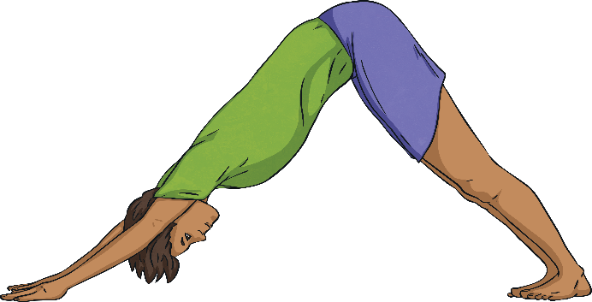
Downward Dog
Benefits
Stretches the shoulders, hamstrings, calves, arches and hands; calms the mind.
1
Start on your hands and knees, with your knees slightly apart, directly under the hips.
Your hands should be shoulder-width apart, and slightly in front of your shoulders.
Curl your toes under, straighten your knees and lift your hips.
Keep your head between your arms.
Hold this pose and breathe.
2
3
4
5

