Slide 1

P.S.H.E.
Monday
22.02.21
Yoga for Wellbeing

Slide 2
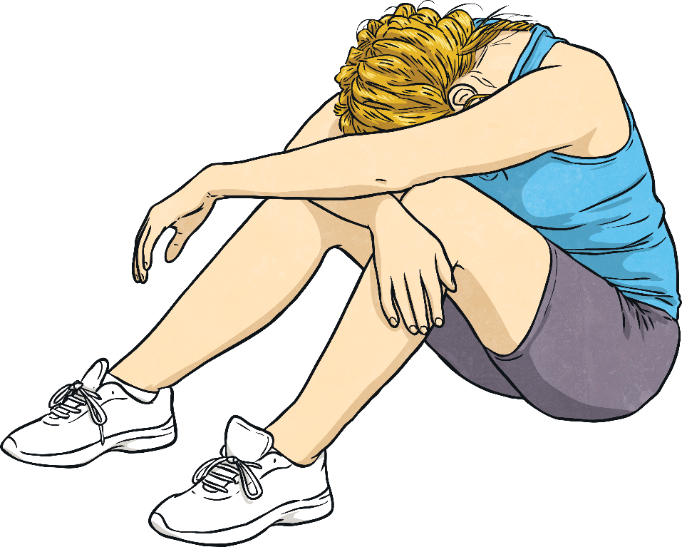
Feeling Low, Feeling Better
Sometimes we feel low.
Sometimes our worries can feel too big. It can feel like you’re in a deep dark hole and you don’t know how to get out.
What sort of things make you feel low? Share your idea if you’d like to.

Slide 3

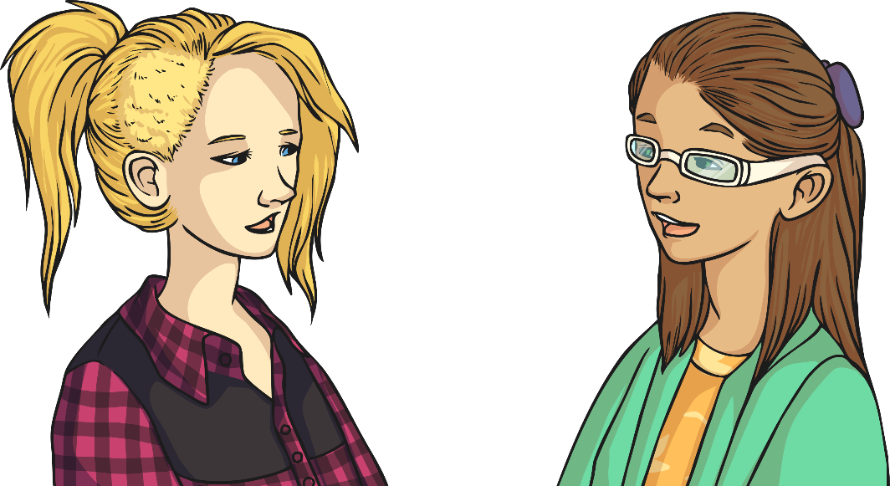
Feeling Low, Feeling Better
There’s always a little light!
Even when life is tough there are things we can do to try to help. There is always hope. This might feel like a tiny little light. This could happen when someone smiles at you and you feel a little lift.
How does your body feel when you are unhappy?
How does it feel when you are happy?
Who is it that makes you feel happy inside?
What do they do that makes you feel good?

Slide 4
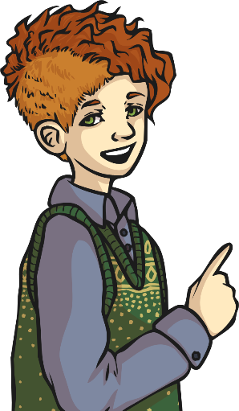
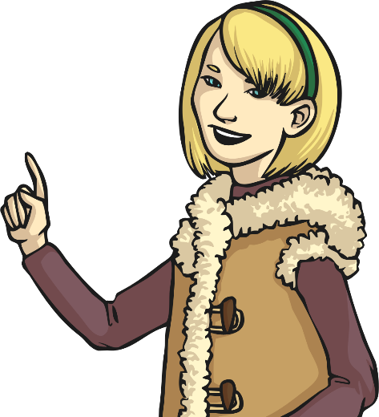
Atlas or Cupid?
Today we are going to practise yoga to try to help us feel good. We are going to start by warming up.
You’re going to move around freely but you need to ask an adult to give you instructions to follow to move in different ways. (instruction ideas are on the next slide)
You can move your body in your own unique way, following the instruction they give you.

Slide 5
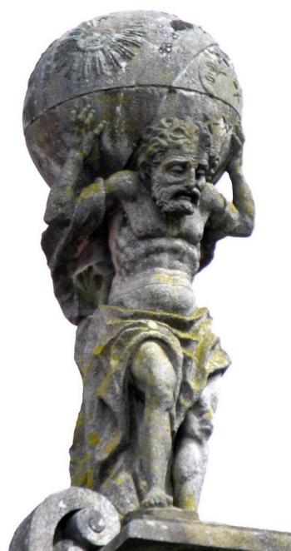
Atlas or Cupid?
Move like Atlas
Atlas was an Ancient Greek god. He had to carry all the worries of the world on his back. This is a picture of him. He’s tired out and sad.
Imagine all your worries, and all the worries of your friends, your family, your pets and your friends’ pets – on your back. Your body feels heavy and exhausted.
Listen for your adult or siblings instructions. They can pick from these movements randomly…
walk, run, skip, sway, turn, jump, side-step, dance
…so listen carefully for when the movement changes
Move around the room or outside in a bigger space like Atlas.

Slide 6
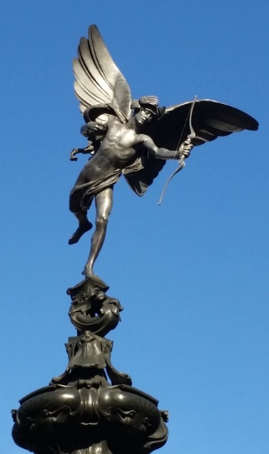
Atlas or Cupid?
Move Like Cupid
Cupid was the Ancient Roman god of love and joy. He is well-known for being playful and he can fly.
Imagine you can fly, your body is as light as air.
Imagine you are filled with joy and affection.
Listen for your adults or siblings instructions. They can pick from these movements randomly…
walk, run, skip, sway, turn, jump, side-step, dance
…so listen carefully for when the movement changes
Move around the room or outside in a bigger space like Cupid.

Slide 7
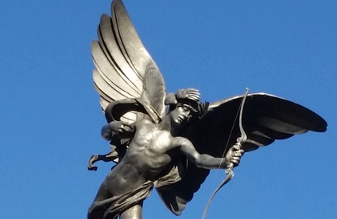

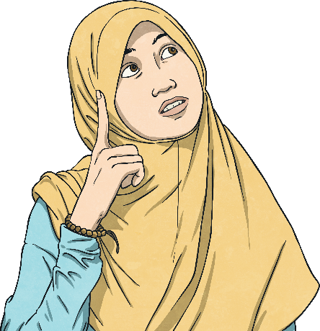
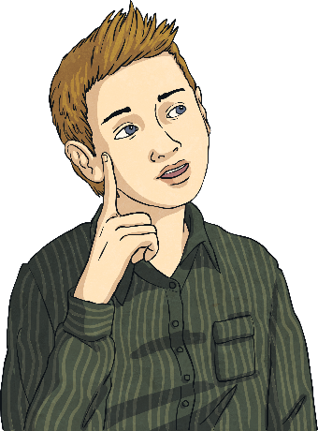
Atlas or Cupid?
Which was easier? Why do you think that was?
Which was more fun and why?
Do you normally move more like Cupid or Atlas? Why do you think that is?

Slide 8
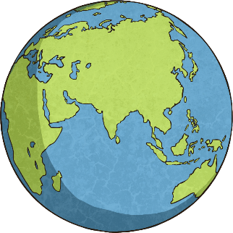
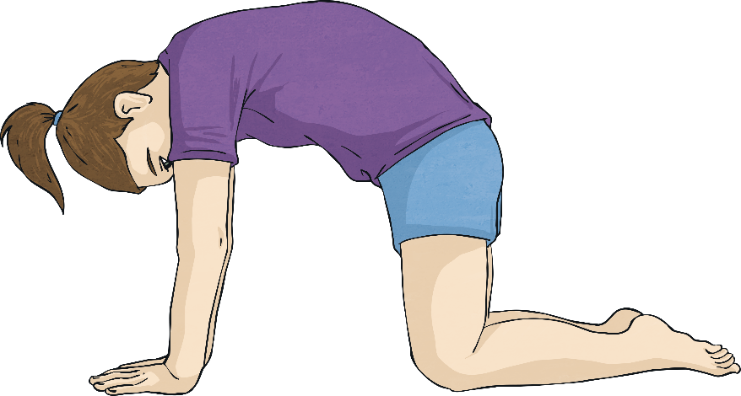
Heavy and Light
Lift the Stone
Start on all fours.
Imagine a world of worries is on your back.
Try to be strong like Atlas and lift the worries.
Arch your back up towards the sky.
Draw your head in a little.
Lift your tummy up.
Now come back down.
Move in and out of the pose using
your breathing to guide you.
Breathe in one way, and the other way.
Enjoy feeling strong!

Slide 9
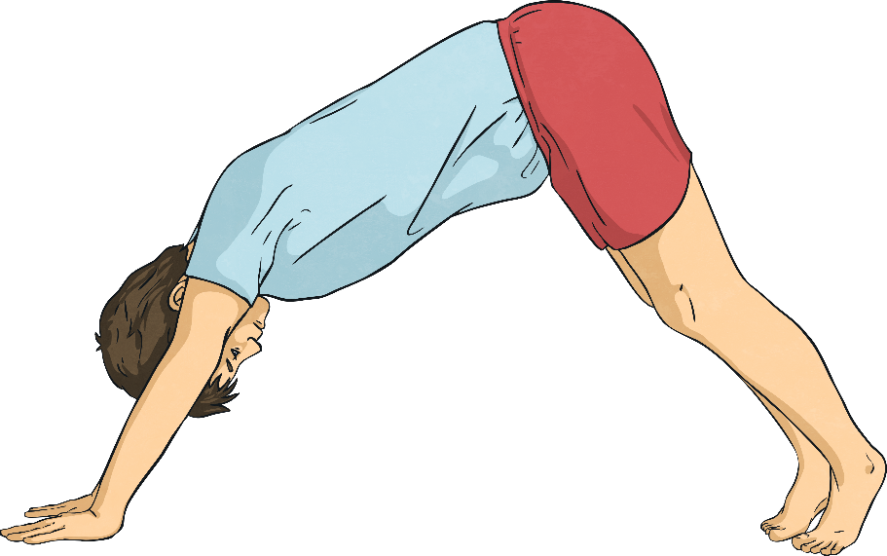
Heavy and Light
Lift It Higher
Atlas is getting stronger.
From all fours, press into your hands and feet to lift your hips.
Keep your knees a little bent.
Lift your hips up. Lift the world of worries up.
You’re strong, you can do it!
Now come back onto all fours.
Repeat this 3-5 times.
Remember to keep your breathing steady and smooth.

Slide 10
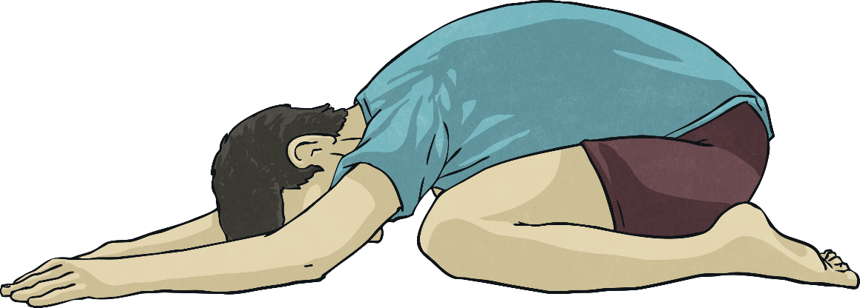
Heavy and Light
Resting
You have lifted a lot of worries! Now rest your head down onto the floor.
Let your body get heavy.
Rest.
When you let your body get extremely heavy, sooner or later, your body starts to feel lighter.
When your body has rested enough, come back to kneeling.

Slide 11
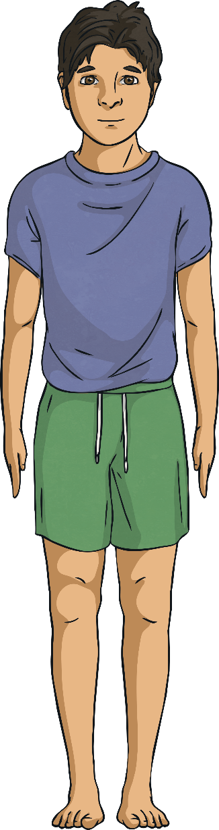
Heavy and Light
Stand Like Cupid
We’re going to come up standing now…
Stand tall and happy.
Feet are a little apart, hands by your sides.
Can you make your chest feel as light
as Cupid’s?
If we are just light like Cupid we might float away so we need some nice heavy feet.
These feet need to be happy like Cupid and heavy like Atlas. These heavy feet need to be very happy and strong to hold us up.
Can you make your feet heavy and happy?

Slide 12
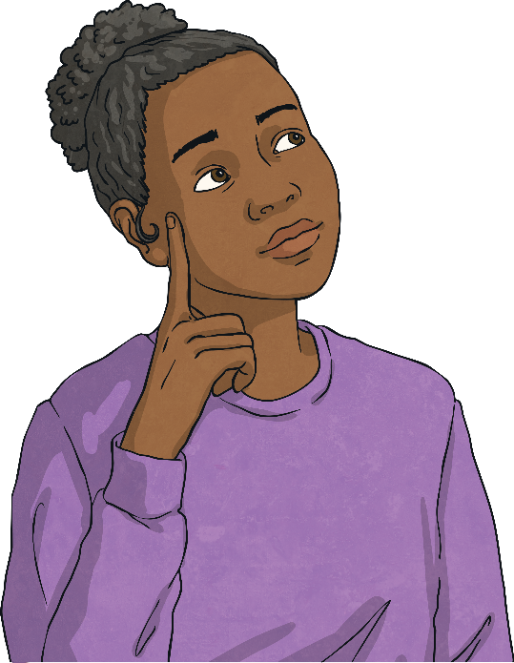
Heavy and Light
Finding Balance
In life, we are always balancing with our bodies and our minds.
Here is an example of how we might balance our feelings:
‘I would like another sweet, but my friend would like one too, should I share?’
Can you think of another way that we find balance in our minds?

Slide 13
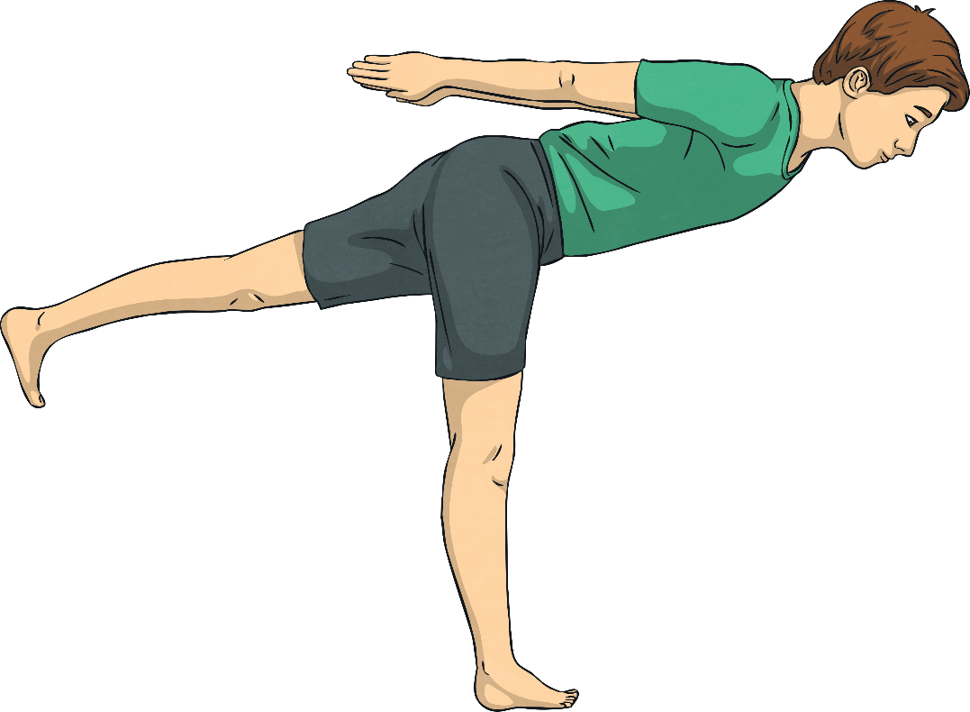
Heavy and Light
Fly Like Cupid
Feet on the floor.
Make one foot heavy and grounded like Atlas.
Let your hands come out to the sides.
Now put on your Cupid wings and let your chest come forwards. Let your other leg float up at the back.
Keep thinking of that little light inside
you to keep you flying high.
Where will you fly to? What will you see? Who will
you visit?
Bring your foot back down and then
repeat on the other side.
Do this 1-3 times on each side.

Slide 14
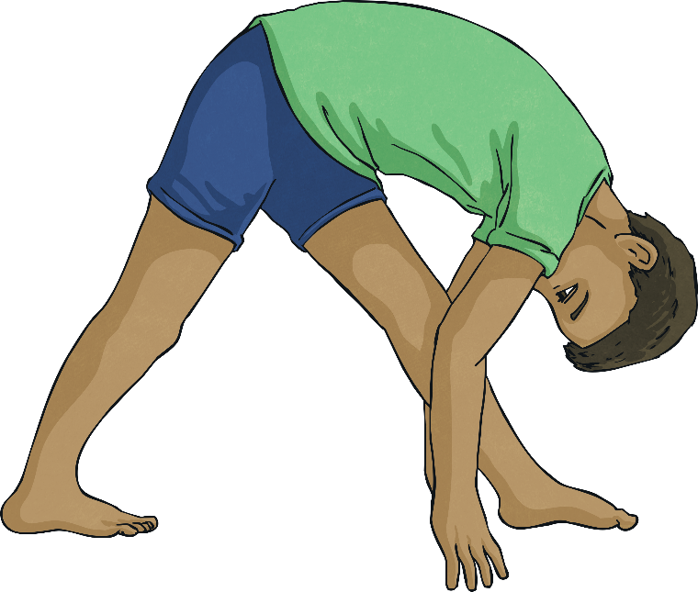
Heavy and Light
Bending Forwards
Everyone gets sad and low sometimes, even people who look happy all the time…even Cupid!
Cupid is feeling sad, he has been in a storm, his wings are battered and he’s feeling lonely. He feels a bit like Atlas.
Bring one foot forwards.
Both feet face the front of your mat.
Take your hands onto your thigh or shin.
Relax your head down.
If your back is comfortable, you can bring your hands lower.
Let’s send Cupid some love and happiness.
Click the buttons to move forwards and back as desired.
Second Part

Slide 15
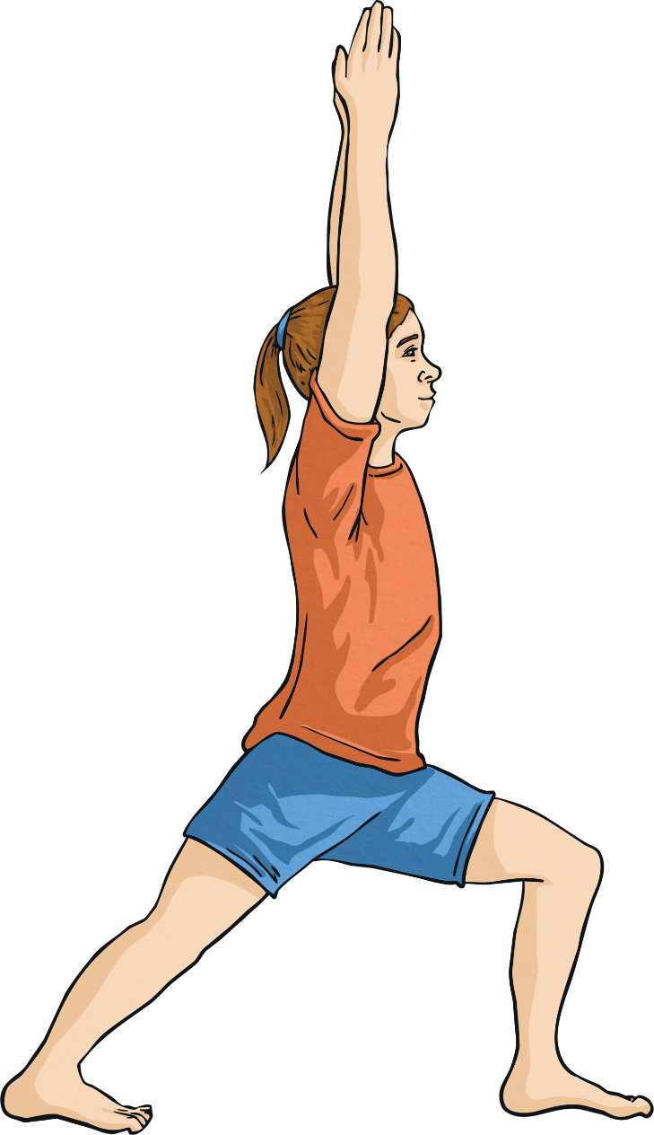

Heavy and Light
Cupid Flies Again!
As you start to feel your happiness coming back,
start to come up.
Press down through your feet and lift your chest up.
Bend your front knee.
When you feel strong and resilient sweep your
hands up overhead.
Grow your wings back and make them super strong.
Strong Atlas feet on the floor.
Light, happy heart and wings.
Now step back to standing, hands by your sides.
Repeat on the other side.
Repeat this sequence 3-5 times.

Slide 16
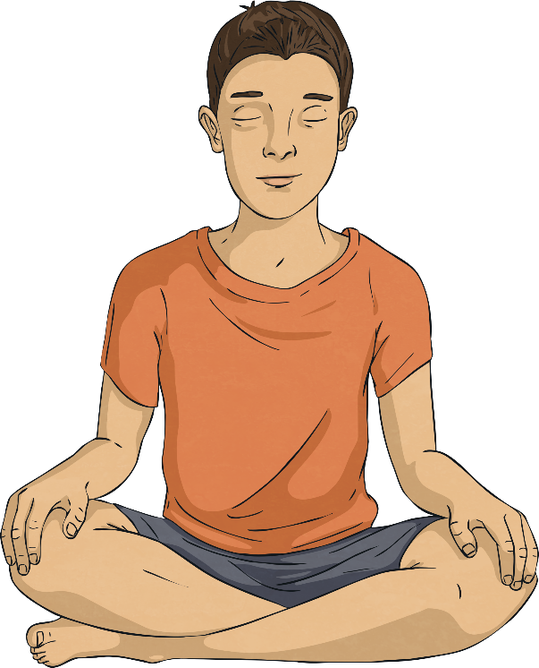
Heavy and Light
Cupid Flies Again!
Sit comfortably, cross legged.
Rest your hands on your knees and lengthen your back.
Now take both hands onto one knee.
Can you twist round to see the wonderful wings you’ve grown!
Stretch round, take a good look at the colour or colours and how they gleam.
Now take both hands onto your other knee.
Look round to your wings on this side, can you see how lovely the feathers are?

Slide 17
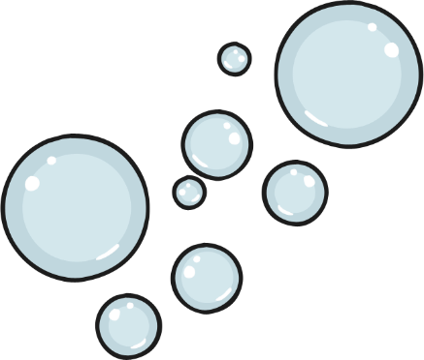
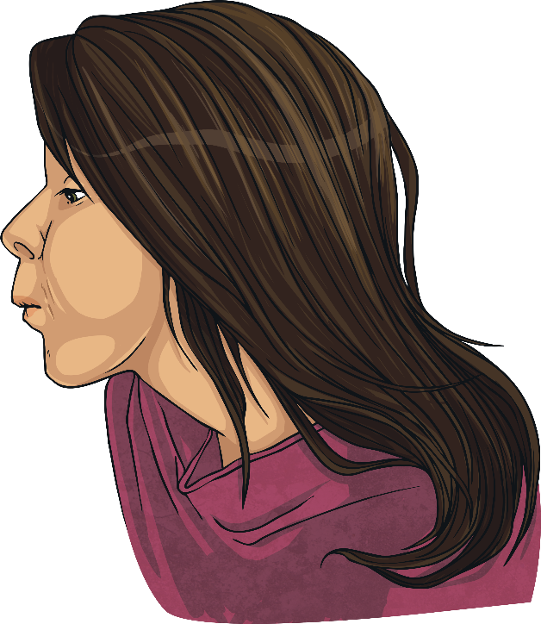
Think Happy, Feel Happy
Worry Bubbles
This way of breathing will help you feel calmer.
Imagine that each breath out is going to make your worries a little further away. We’re not trying to make them disappear. Just move them a little further away.
Imagine each breath out makes bubbles.
In each bubble is a worry.
Each worry bubble floats away
and you feel lighter and
happier inside.
Keep breathing out worry bubbles,
gently and smoothly.

Slide 18


Think Happy, Feel Happy
Happy Breathing
This breathing exercise can help you to feel happier inside.
Imagine when you breathe in that you breathe in happiness.
Not noisy, bouncy happiness but quiet, sleepy happiness.
Imagine your tummy gets gently warm and glows like a soft sun.
With each breath, your tummy glows more and you feel happier inside.

Slide 19
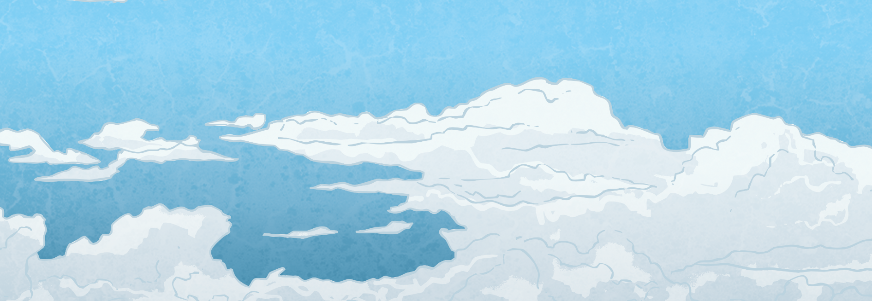
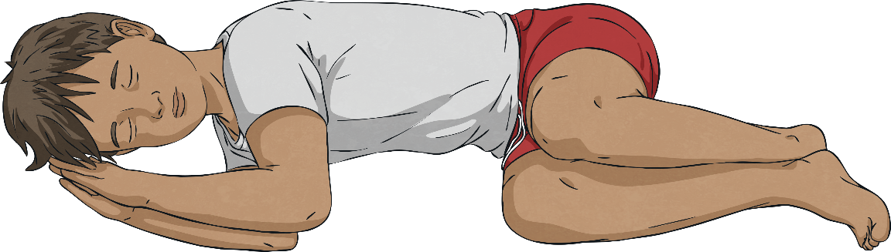
Think Happy, Feel Happy
Relaxing in the Clouds
After doing yoga, we let our mind and body relax.
We’re going to rest for 3-5 minutes.
Let your whole body soften and relax.
Find a space where you’re not touching anyone.
Relaxing your: toes… legs… hips… tummy… back… shoulders... head... hands... arms... face
Lie on your back or your side.
Your whole body is relaxing.
Close your eyes.
Get quiet and let your body become soft.
You are lying on a beautiful bed of the softest clouds.
All is well.

Slide 20

Think Happy, Feel Happy
Meditating
We’re going to sit quietly for a minute. Focus your eyes and mind on
the picture or let your eyes close.
Keep bringing your mind back to peaceful, loved and happy.

Slide 21


How Do You Feel?
You can use what you’ve learnt any time you feel low.
You can be heavy and strong like Atlas.
You can be light and happy like Cupid.
You can blow your worries away.
How do you feel after having done some yoga?
Is that different to how you felt at the beginning?
What else could you do to help yourself when you feel low?
Which bit did you find most helpful?

Slide 22
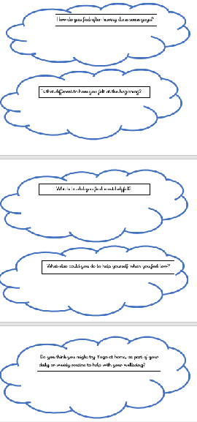
How Do You Feel?
Fly like Cupid.
Feel strong like Atlas.
Have a wonderful day!

