Slide 2
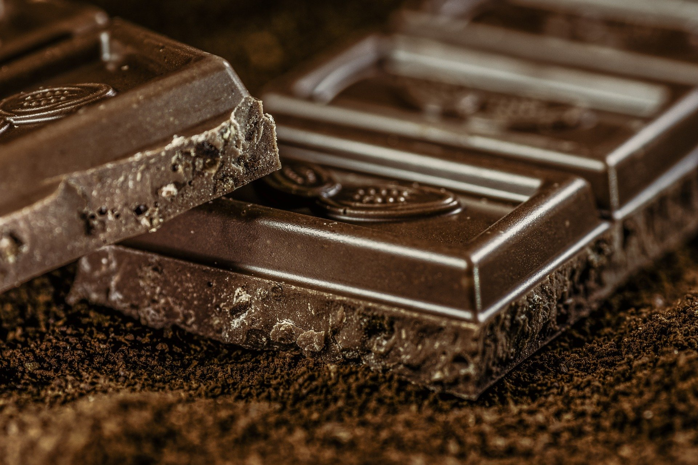
What is fair?
Who should have a piece of chocolate?

Slide 3
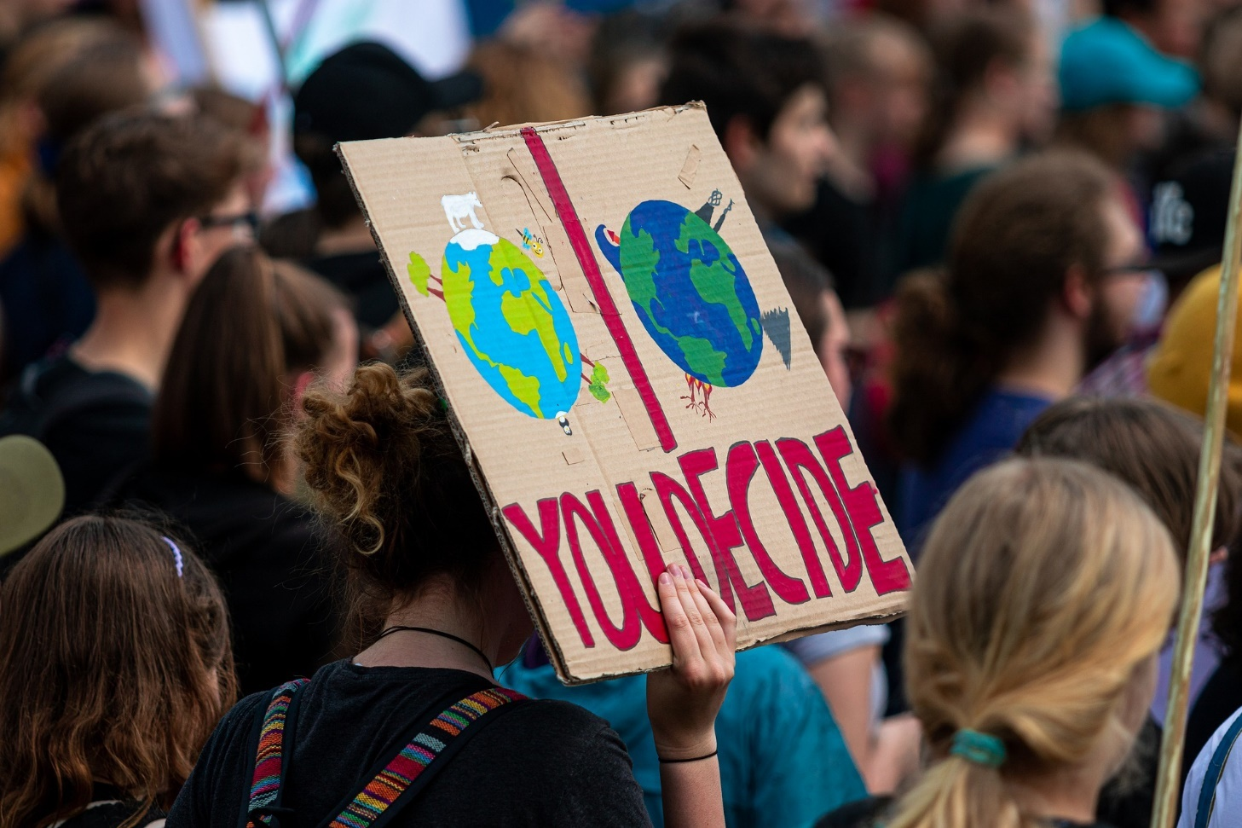
Lots of things are unfair.

Slide 4
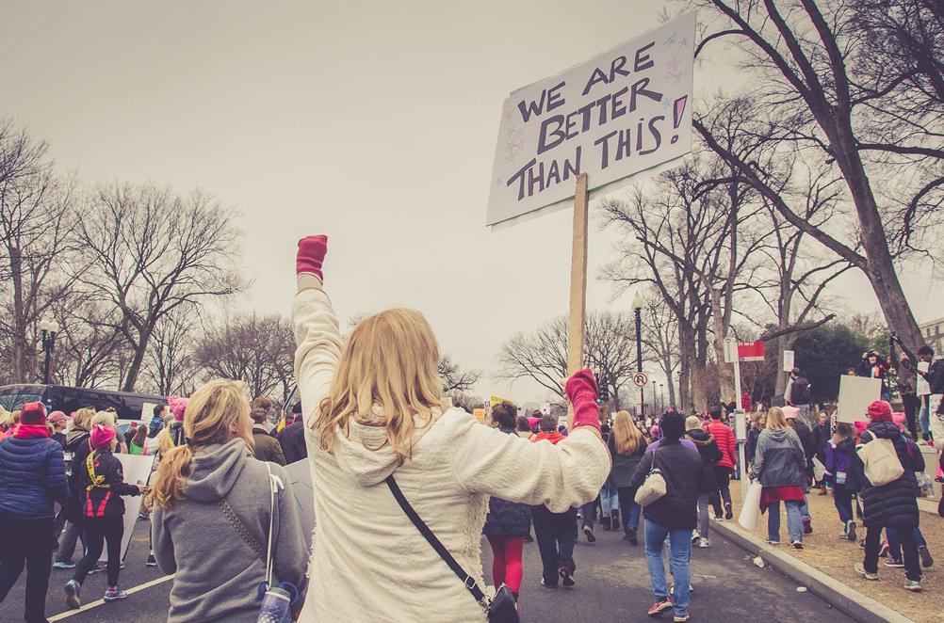
Everyone has something unfair happen to them. It is part of life.

Slide 5
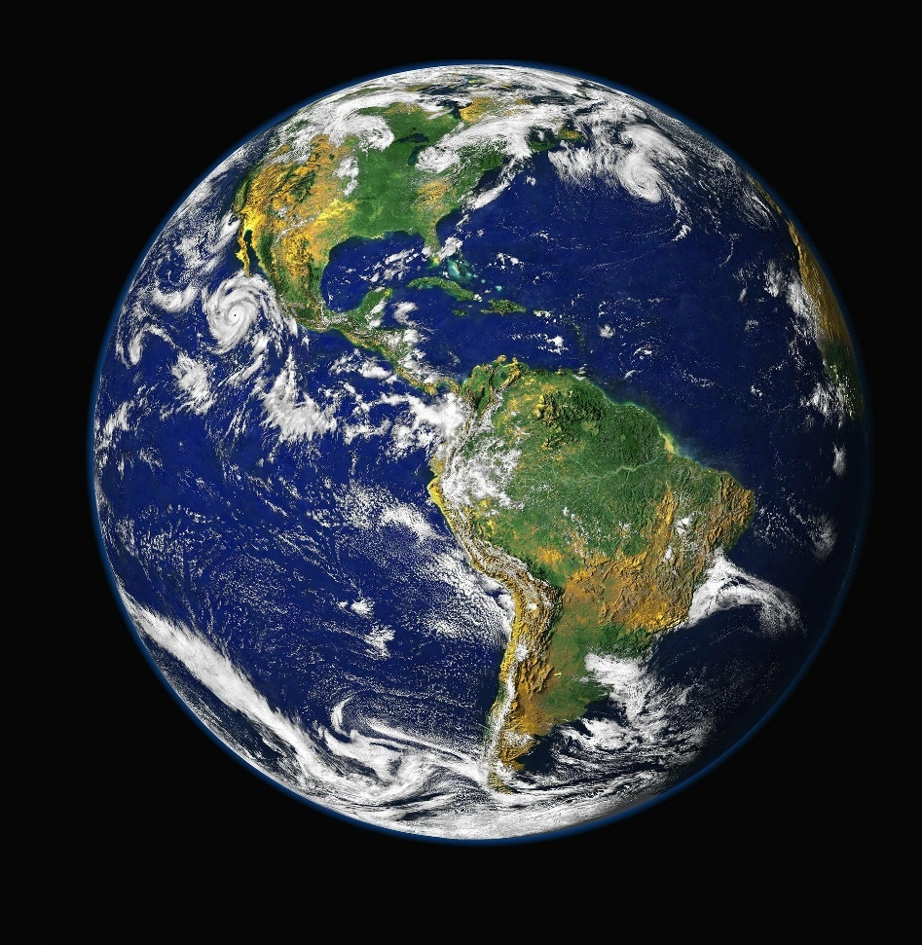
The world is not fair.

Slide 6
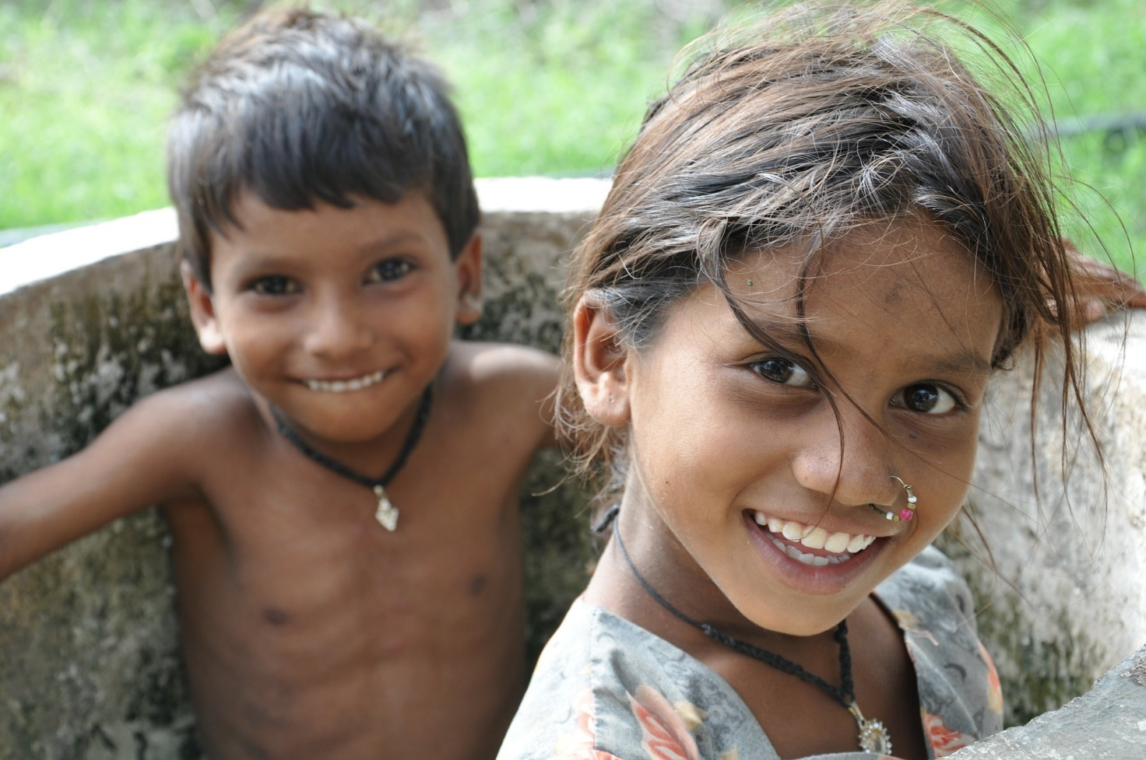
Where you are born can affect how rich or poor you are.

Slide 7
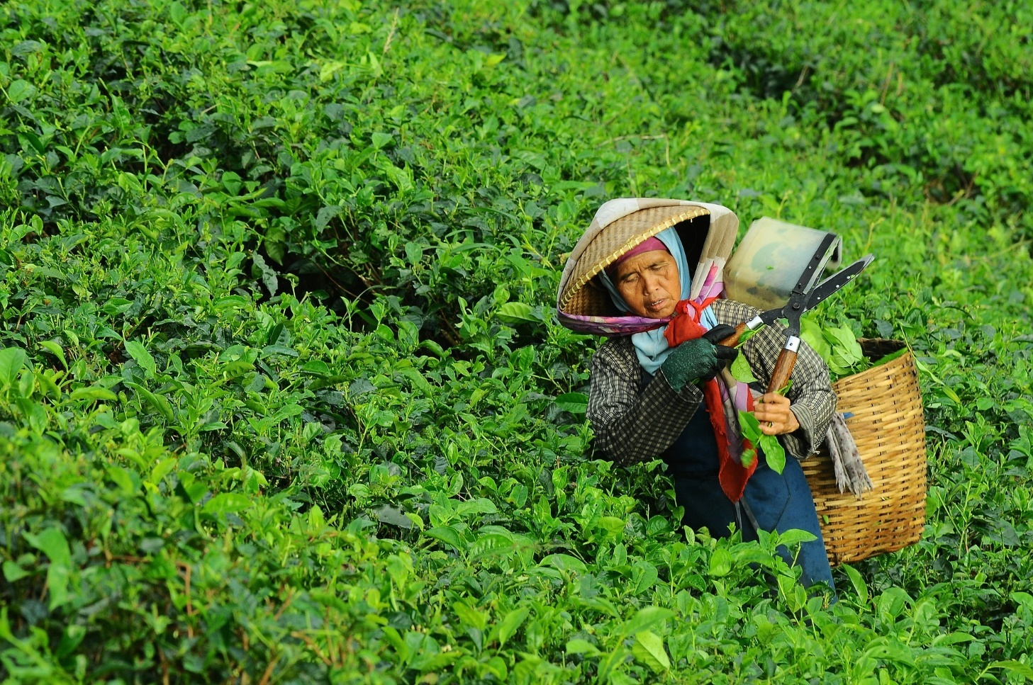
When a person is born poor they grow crops to live. But no one will give them a fair price.

Slide 8
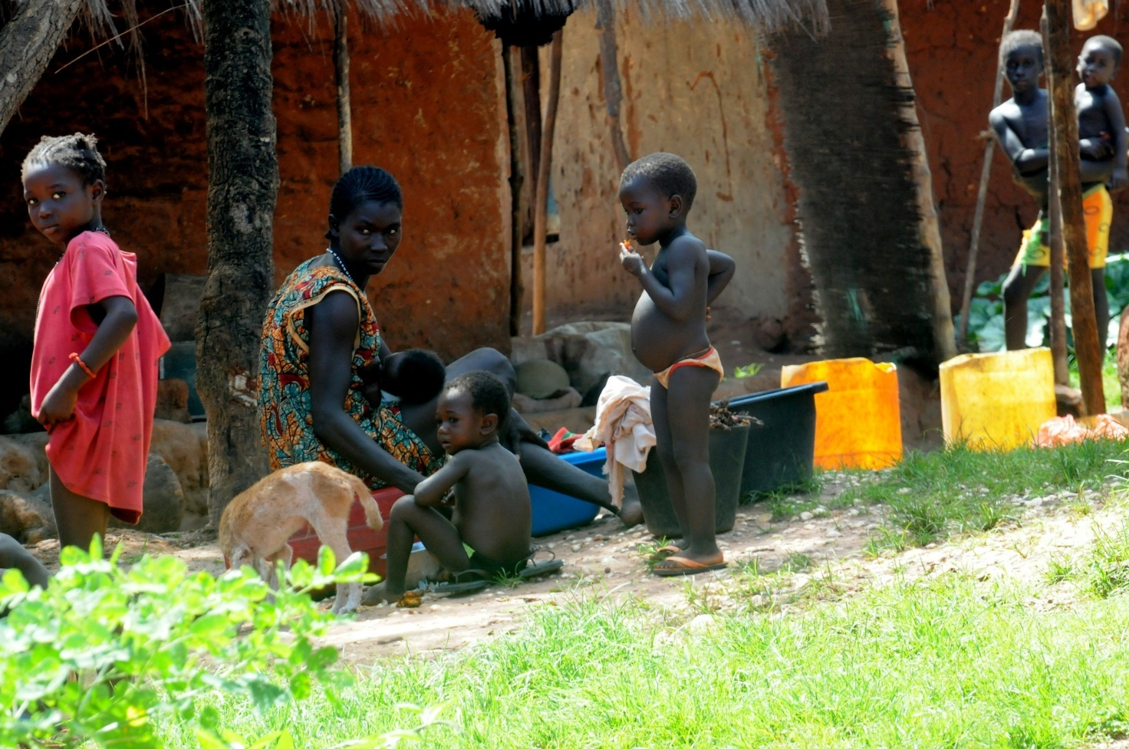
They will always stay poor unless someone gives them a fair price.

Slide 9
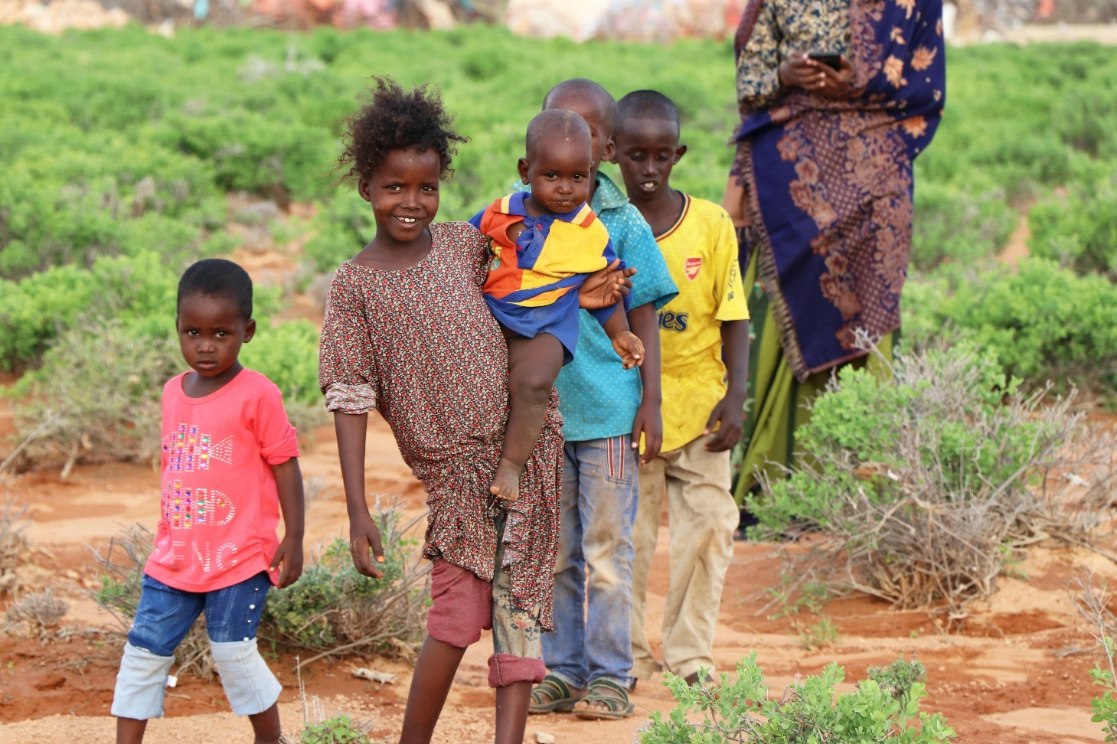
Fair trade is about making the world more fair.
It is about giving a fair price for things that we buy so poor people do not stay poor whilst we get richer.

Slide 10
Fairtrade is about:
Better prices for crops.
Better working conditions (workers are treated well and children are sent to school).
Keeping farming sustainable (keeping farming going at a certain level for a long period of time).
Fair terms of trade (selling goods) for farmers and workers in poorer countries.
Extra money is usually put into things that help the local community such as bicycles to get to work or wells to provide water.

Slide 11
If something is traded fairly this symbol will be on it.

Slide 12
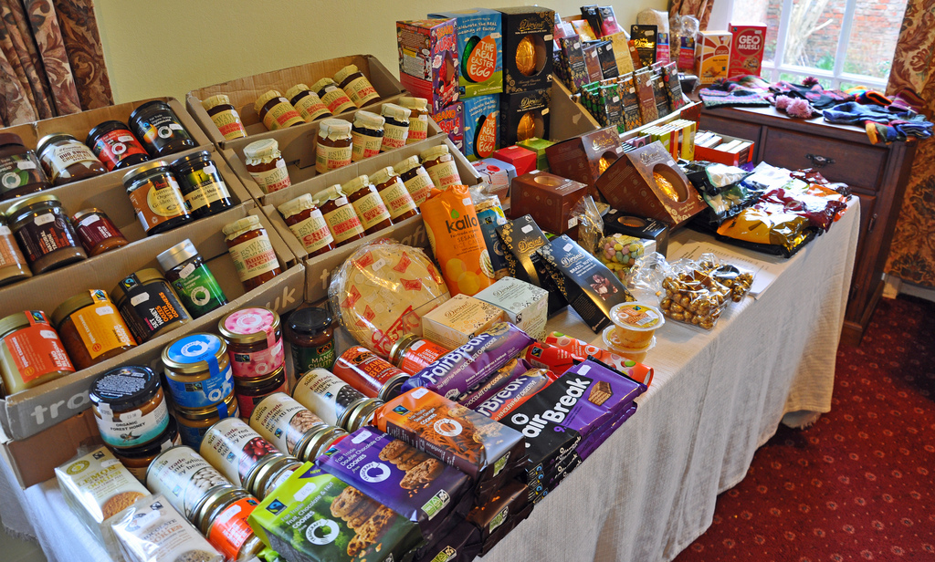
Can you spot any fair trade logos?
Photo courtesy of gbcarmelite (@flickr.com) - granted under creative commons licence - attribution

Slide 13
What is traded fairly?
Where does it come from?
Coffee
Bananas
Chocolate
Sugar
Tea
Honey
Cotton
Africa
Asia
Latin America
Wine
Fruit
Flowers
Gold
Handicrafts
Nuts
Have you eaten any of these foods today?

Slide 14
Fairtrade Fortnight
Fairtrade Fortnight is a unique campaign that aims to transform the banana industry to ensure the people in the supply chain and the millions of struggling banana farmers and workers, get a fair deal.
1 in 3 British bananas are fair trade but there is still a serious problem at the heart of the banana business.
Many banana farmers and workers have had their earnings cut as banana prices go down in the UK.
Supermarkets want to pay as little as possible for bananas to offer us the lowest prices but this puts pressure on workers and farmers.
Fairtrade wants to make pricing work for both consumers and farmers. It is time for the government to help end these unfair prices.

Slide 15
What can you do to help?
Buy bananas and other products that have the Fairtrade symbol on them. If you do this, you know that a fair price has been paid to the workers. Over 4,500 different Fairtrade products are now available to UK shoppers.

