Slide 1
English
Wednesday
03.03.21

Slide 2
Handwriting
Practice harder words – LETTERJOIN – Students – Password lj8943 (finger swipe is in the shape of a letter L) https://www.letterjoin.co.uk/tablet_login/

Slide 3
Reading
Reading today is set out in groups, if your unsure which group your child is in please email me.
Group 1 – 2 short comprehensions – read the text and answer the questions.
Group 2 – a short comprehension – read the text together and answer questions.
Group 3 –a short comprehension – read the text together and answer questions.
The work is on a word document so please type answers on to it and send it back via Purple mash.
https://www.purplemash.com/login/
Any problems please email me,
r.metcalf@worthvalleyprimary.co.uk

Slide 4
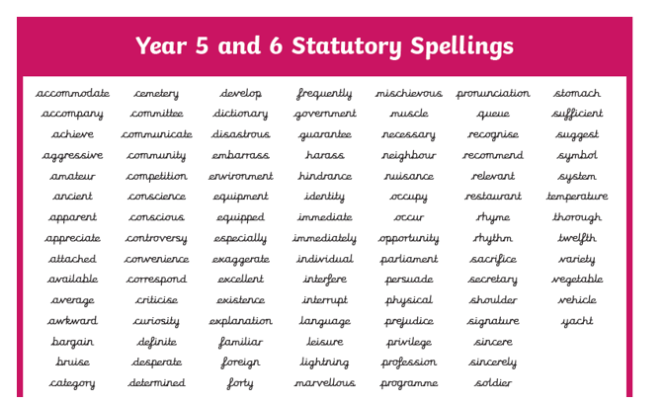
Spellings
Create a mini story using 8 words from the list above. For example: I frequently fall over while physical exercise with Jem which often results in bruises. She is so mischievous and move likes lightning when chasing her ball. On average she spends half her walk chasing the ball, which we often lose, but she is always determined to find it before we go home. She is always led by her stomach as she is easily persuaded with a variety of treats.

Slide 5
Add a fronted adverbial to the sentences on the worksheet.
Grammar
A list of fronted adverbials are on the next slide. Fronted adverbials are always followed by a comma.

Slide 6
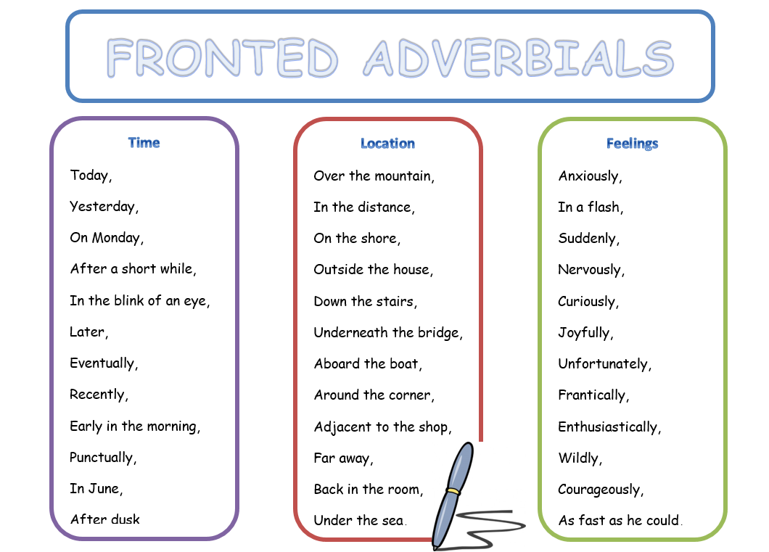

Slide 7
Writing task:
Create a story map based on the original story. You are going to write the sequel story where the son is now a father himself. You will need to write in the first person. Your story is going to be called ‘Farther 2’.
The following questions will help you form your ideas: Remember you are the new son who is born at the end of the story. I’ll upload the story to listen again. What did you dream of achieving? Why were you not successful? Where did you go away to? What legacy will be left to your grandchild?

