Slide 1
English 05/03/2021

Slide 2
Reading Activity Please see the next slides for your group`s activity
Let me know if you can`t remember which Reading group you are in
You will need a pencil or pen, and paper

Slide 3
Groups 1+2
2Do Purple Mash
How To Make a Pirate Stew

Slide 4
Groups 3+4
2Do Purple Mash
Son of the Sea
Read the text carefully again
Then answer questions set B

Slide 5
Spellings
This week we are focusing on common exception words. These are words that aren`t necessarily spelt how you would think they should be.
Each spelling group have been given their own list of words, but feel free to learn other groups` spellings too!

Slide 6
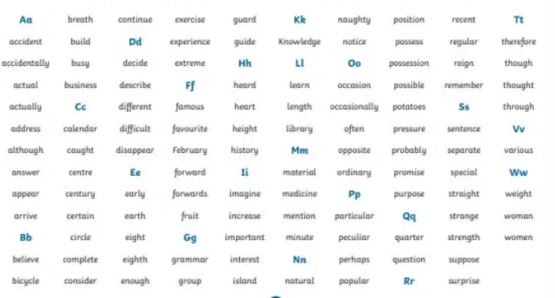
Handwriting and Spellings Group 3

Slide 7
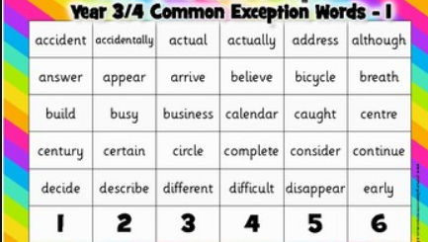
Handwriting and Spellings Group 2

Slide 8
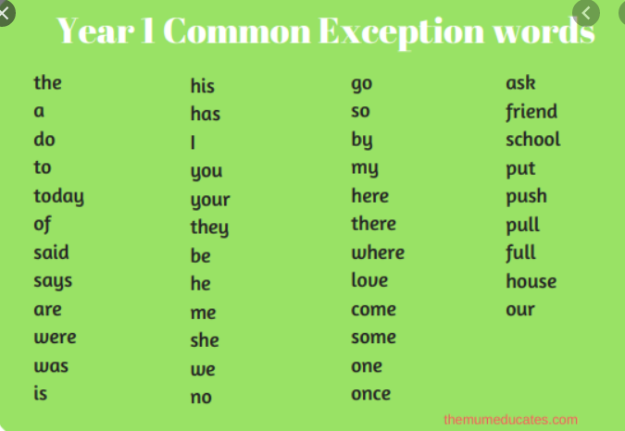
Handwriting + Spellings Group 1

Slide 9
Handwriting
Use the spelling sheets to practise your handwriting. You will not be able to trace the word, unless you can print the sheets off, but you will be able to copy it.
Practise at least 8 words per day on lined paper and then have a go at writing sentences with those words in
Remember, it is quality joined writing that we are looking for, with your proper tripod grip
You can also practise other letters and words via https://www.letterjoin.co.uk using the username lj8493 and the password L (capital l)

Slide 10
Grammar
2Do Purple Mash
Different conjunctions

Slide 11
Writing
LC: Can I write my own explanation leaflet?
We have been learning how to write an explanation leaflet over the past 2 weeks
We have also been researching how Rome was formed
Now we are going to put the 2 things together!
Can you design and write your own leaflet to explain how Rome was formed, using all the features you now know about…paragraphs, time connectives, cause and effect words and fronted adverbials.

