Slide 1
English 04/03/2021

Slide 2
Reading Activity Please see the next slides for your group`s activity
Let me know if you can`t remember which Reading group you are in
You will need a pencil or pen, and paper

Slide 3
Groups 1+2
Read the text below entitled Week 7
Answer the questions Week 7 and Week 8

Slide 4
Week 7 - text
Russia is a huge country. It stretches from eastern Europe all the way to the Pacific Ocean. In fact, it is only 55 miles from the United States at one point. They are separated by a narrow stretch of water called the Bering Strait. This sometimes freezes over in the middle of winter, so it should be possible to walk from one country to the other. In truth, this could not really happen for two reasons. First, the two countries are not very friendly towards each other. Second, the strong sea currents mean the ice is not stable enough to cross safely.

Slide 5
Week 7 - questions
1. According to the text, which ocean does Russia meet?
_________________________________________________________________
2. How far is Russia from the USA at its nearest point?
________________________________________________________________
3. Which stretch of water separates Russia and the USA?
_________________________________________________________________

Slide 6
Week 8 - text
Russia is a huge country. It stretches from eastern Europe all the way to the Pacific Ocean. In fact, it is only 55 miles from the United States at one point. They are separated by a narrow stretch of water called the Bering Strait. This sometimes freezes over in the middle of winter, so it should be possible to walk from one country to the other. In truth, this could not really happen for two reasons. First, the two countries are not very friendly towards each other. Second, the strong sea currents mean the ice is not stable enough to cross safely.

Slide 7
Week 8 - questions
1. What sometimes happens to the Bering Strait in the middle of winter?
_________________________________________________________________
2. What might it be possible to do in the middle of winter?
_________________________________________________________________
3. What makes the ice unstable?
_________________________________________________________________

Slide 8
Groups 3+4
2Do Purple Mash
Son of the Sea
Read the text carefully
Then answer questions set A (leaving set B for tomorrow)

Slide 9
Spellings
This week we are focusing on common exception words. These are words that aren`t necessarily spelt how you would think they should be.
Each spelling group have been given their own list of words, but feel free to learn other groups` spellings too!

Slide 10
Handwriting and Spellings Group 3

Slide 11
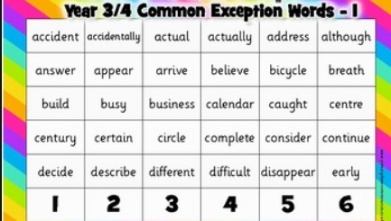
Handwriting and Spellings Group 2

Slide 12
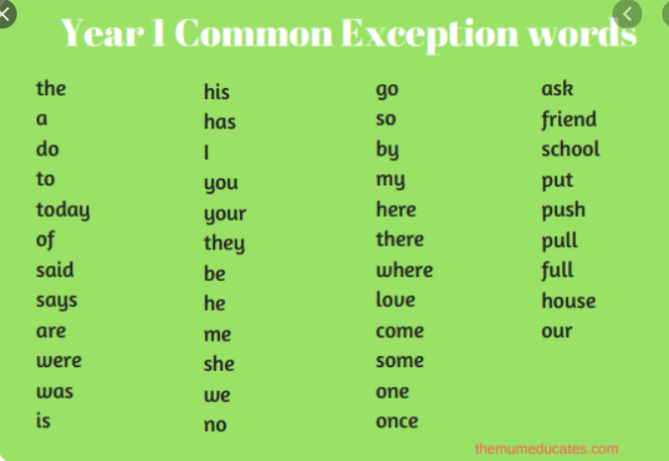
Handwriting + Spellings Group 1

Slide 13
Handwriting
Use the spelling sheets to practise your handwriting. You will not be able to trace the word, unless you can print the sheets off, but you will be able to copy it.
Practise at least 8 words per day on lined paper and then have a go at writing sentences with those words in
Remember, it is quality joined writing that we are looking for, with your proper tripod grip
You can also practise other letters and words via https://www.letterjoin.co.uk using the username lj8493 and the password L (capital l)

Slide 14
Grammar
Subordinating conjunctions
Read through the following slides and have a go at the tasks included

Slide 15
.
GPS
Y3 G2c: Can identify and use subordinating conjunctions
(e.g. when, before, after, while, because)
Commissioned by The PiXL Club Ltd.
November 2019
This resource is strictly for the use of member schools for as long as they remain members of The PiXL Club. It may not be copied, sold nor transferred to a third party or used by the school after membership ceases. Until such time it may be freely used within the member school.
All opinions and contributions are those of the authors. The contents of this resource are not connected with nor endorsed by any other company, organisation or institution.
PiXL Club Ltd endeavour to trace and contact copyright owners. If there are any inadvertent omissions or errors in the acknowledgements or usage, this is unintended and PiXL will remedy these on written notification.
© Copyright The PiXL Club Limited, 2019

Slide 16
Subordinating conjunctions

Slide 17
Tell me… Examples…
Tell me what a subordinating conjunction is.
…a conjunction that introduces a subordinate clause (a group of words containing a verb that depends on the main clause to make sense).
Examples of subordinating conjunctions:
because, when, as

Slide 18
Subordinating conjunctions
To help you remember the subordinating conjunctions, use A WHITE BUS!
A
WH
I
T
E
B
U
S
as
after
although
while
whilst
when
if
though
even though
because
before
until
unless
since
These are some of the most commonly used subordinating conjunctions… there are others!

Slide 19
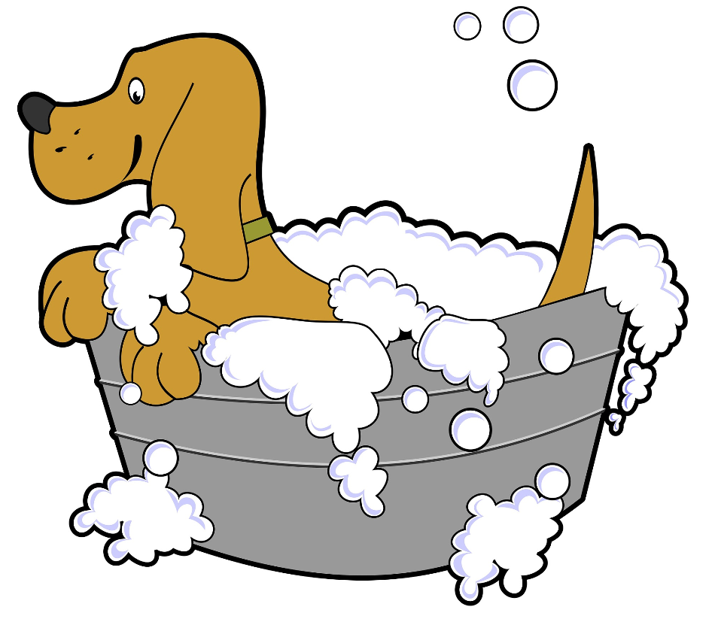
Subordinating conjunctions
Subordinating conjunctions introduce a subordinate clause (a group of words containing a verb that depends on the main clause to make sense).
main clause
subordinate clause
We bathed the dog
because she was very muddy.
subordinating conjunction

Slide 20
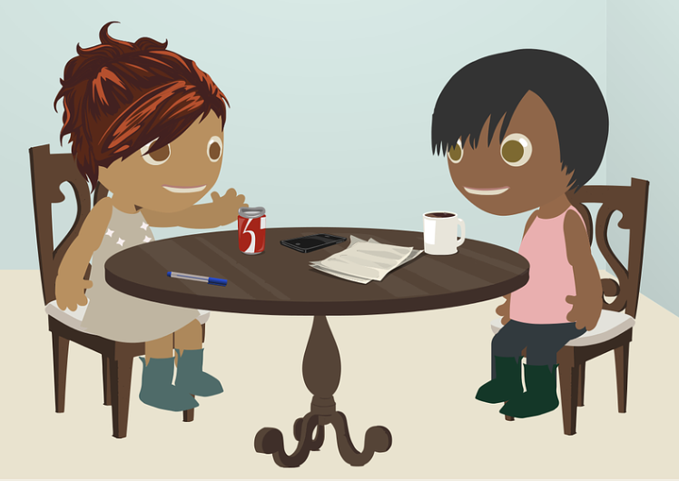
Subordinating conjunctions
A subordinate clause can appear before or after a main clause. This means that a subordinating conjunction can be at the start of a sentence or somewhere in the middle.
subordinate clause
main clause
Before we played a game,
we did our homework.
subordinating conjunction

Slide 21
Subordinating conjunctions
Sentences can contain more than one subordinating conjunction.
Although it was very icy outside, we walked to the cinema as we were desperate to see the new film.
The teacher said we can eat our lunch outside if we work hard unless it starts to rain.

Slide 22
Practise
Underline the subordinating conjunction in each sentence below.
Jay won the race though he only just beat Priya!
When we looked outside, we saw a delivery driver.
I got dictionary as I wasn’t sure how to spell a word.
Until we found the light switch, no one could see anything!
Remember: subordinating conjunctions introduce a subordinate clause. Top tip: use A WHITE BUS!

Slide 23
How did you do?
Underline the subordinating conjunction in each sentence below.
Jay won the race though he only just beat Priya!
When we looked outside, we saw a delivery driver.
I got dictionary as I wasn’t sure how to spell a word.
Until we found the light switch, no one could see anything!
Remember: subordinating conjunctions introduce a subordinate clause. Top tip: use A WHITE BUS!

Slide 24
Practise
Circle both subordinating conjunctions in the passage below.
Before mobile phones were invented,
you had to use a home phone if
you wanted to ring somebody.
Remember: subordinating conjunctions introduce a subordinate clause. Top tip: use A WHITE BUS!

Slide 25
How did you do?
Circle both subordinating conjunctions in the passage below.
Before mobile phones were invented,
you had to use a home phone if
you wanted to ring somebody.
Remember: subordinating conjunctions introduce a subordinate clause. Top tip: use A WHITE BUS!

Slide 26
Practise
Insert a subordinating conjunction to correctly complete the sentence below.
Lots of people were late to the concert ____________ there had been a big traffic jam.
Remember: subordinating conjunctions introduce a subordinate clause. Top tip: use A WHITE BUS!

Slide 27
How did you do?
Insert a subordinating conjunction to correctly complete the sentence below.
Lots of people were late to the concert e.g. because/as there had been a big traffic jam.
Remember: subordinating conjunctions introduce a subordinate clause. Top tip: use A WHITE BUS!

Slide 28
Reflection
Remember to use these tips to help you identify and use subordinating conjunctions correctly.
Subordinating conjunctions introduce a subordinate clause (a group of words containing a verb that depends on the main clause to make sense).
To help you remember the subordinating conjunctions, use A WHITE BUS!
Sentences can contain more than one subordinating conjunction.

Slide 29
Writing
LC: Can I organise paragraphs around a theme?
Today we are looking at writing a conclusion to our explanation report
Have a look at the different texts below to see how a conclusion is written and what type of language is used
Note how the conclusion can be a summary and also add extra information or an opinion

Slide 32
Writing
Have a go at writing your own conclusion to How Rome was formed?
This should be just 1 paragraph long, containing a summary of your research and maybe some additional information

