Slide 1
English 03/03/2021

Slide 2
Reading Activity Please see the next slides for your group`s activity
Let me know if you can`t remember which Reading group you are in
You will need a pencil or pen, and paper

Slide 3
Groups 1+2
2Do Purple Mash
Romulus and Remus 1

Slide 4
Group 3
2Do Purple Mash
Romulus and Remus 2

Slide 5
Group 4
2Do Purple Mash
Romulus and Remus 3

Slide 6
Week 11 - text
So, you’ve found a musical instrument that you want to play; how long it will take for you to become good at it? This question, you won’t be surprised to learn, will have various answers. First, it depends on how good you want to be. If you want to play music professionally, you will probably have to practise for thousands of hours to reach the right standard. But remember, music should be a pleasure, and there is nothing wrong with just getting to a level that gives you enjoyment, providing, of course, that it’s not too painful for everyone else!

Slide 7
Week 11 - questions
This question, you won’t be surprised to learn, will have various answers.
Why does the author say you won’t be surprised to learn?
__________________________________________________________________
2. Find and copy the word in the second sentence that means different.
______________________________________________
3. According to the text, what does the answer to the question in the first sentence depend upon?
________________________________________________________________

Slide 8
Week 12 - text
So, you’ve found a musical instrument that you want to play; how long it will take for you to become good at it? This question, you won’t be surprised to learn, will have various answers. First, it depends on how good you want to be. If you want to play music professionally, you will probably have to practise for thousands of hours to reach the right standard. But remember, music should be a pleasure, and there is nothing wrong with just getting to a level that gives you enjoyment, providing, of course, that it’s not too painful for everyone else!

Slide 9
Week 12 - questions
… If you want to play music professionally …
In this context, what does professionally mean? Circle one
badly all the time quite well for a living
2. For how long will you probably have practised to be able to play professionally?
______________________________________________
3. According to the text, music should be what?
______________________________________________

Slide 10
Spellings
This week we are focusing on common exception words. These are words that aren`t necessarily spelt how you would think they should be.
Each spelling group have been given their own list of words, but feel free to learn other groups` spellings too!

Slide 11
Handwriting and Spellings Group 3

Slide 12
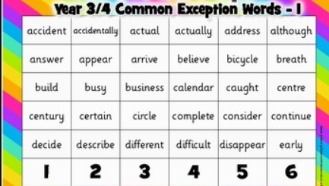
Handwriting and Spellings Group 2

Slide 13
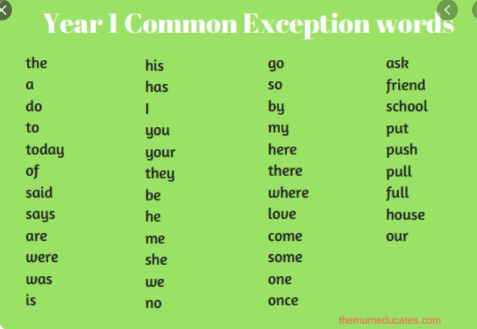
Handwriting + Spellings Group 1

Slide 14
Handwriting
Use the spelling sheets to practise your handwriting. You will not be able to trace the word, unless you can print the sheets off, but you will be able to copy it.
Practise at least 8 words per day on lined paper and then have a go at writing sentences with those words in
Remember, it is quality joined writing that we are looking for, with your proper tripod grip
You can also practise other letters and words via https://www.letterjoin.co.uk using the username lj8493 and the password L (capital l)

Slide 15
Grammar
2Do Purple Mash
Complete the sentence

Slide 16
Writing
Today we are looking at Cause and Effect words to use in our explanation texts
Read through the slides below to find out what we mean by causal conjunctions and adverbials
Have a go at the tasks or questions included

Slide 18
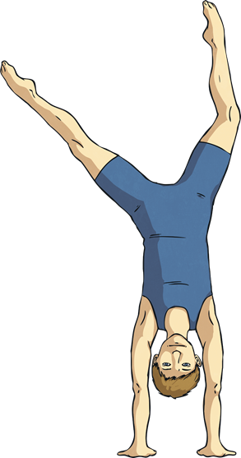
What Do You Notice about the Highlighted Words?
I am usually late because I often forget to set my alarm.
My sister loves animals, so we went on a trip to the zoo for her birthday.
As a result of practising hard, I came first in the gymnastics competition.

Slide 19
What Do You Notice about the Highlighted Words?
They are all causal conjunctions, which are used to explain how things work or why something happens.
They can be:
subordinating conjunctions, e.g. because;
co-ordinating conjunctions, e.g. so;
causal adverbials, e.g. as a result.

Slide 20
Sort the Causal Conjunctions
Sort the causal conjunctions into the correct category below:
Subordinating conjunctions
Coordinating conjunctions
Adverbials
as a result
therefore
yet
as
accordingly
consequently
hence
because
so
even though
since
now that

Slide 21
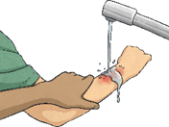
Spin the Wheel
Click on the wheel to spin it to choose a causal conjunction to use within a sentence or sentences about the picture you reveal below:
?
?
since
even though
?
?
as a result
as
therefore
now that
?
?
yet
so

Slide 22
When Are Causal Conjunctions Used?
Causal conjunctions are used:
to link independent clauses in the middle of sentences
e.g. I dislike dogs, so I don’t enjoy visiting my uncle who has four huskies.
to link independent clauses at the beginning of a sentence
e.g. Because I had forgotten my lunch, the school cook let me have a hot dinner.
at the beginning of a sentence to refer to the sentence before
e.g. I lost my homework on the way to school. Consequently, I will have to stay in to complete it at lunchtime.
to add cohesion within paragraphs
e.g. Many schools have a rule that children wear uniform, which most parents and children are happy with. Wearing a school uniform means that pupils all look the same and nobody feels different. Accordingly, most pupils attend school looking smart and feeling proud to be part of their school.

Slide 23
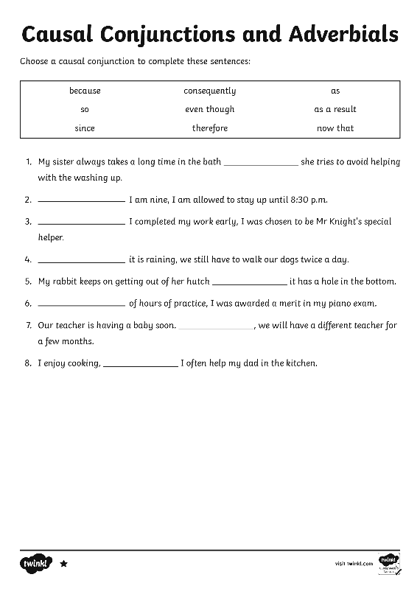
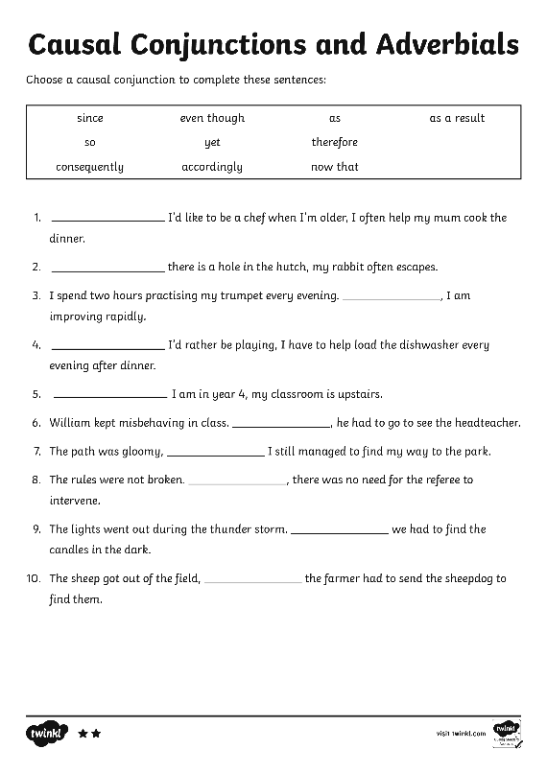
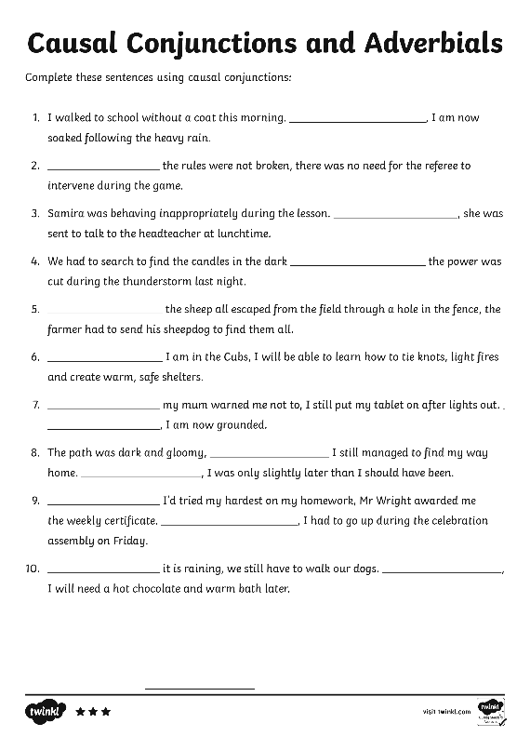
Your Turn
Now have a go at the Causal Conjunctions and Adverbials Differentiated Activity Sheets.

Slide 24
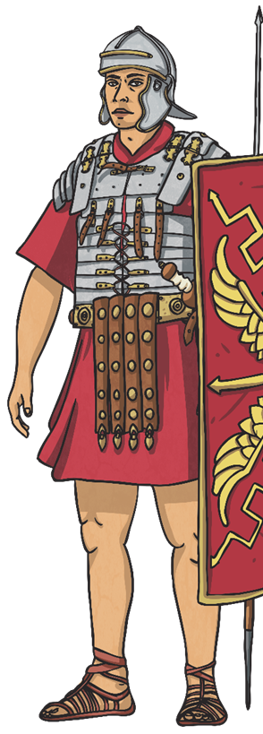
Is It a Causal Conjunction?
Read each sentence to decide whether the highlighted words are causal conjunctions or not.
1. Even though it was a warm, sunny day, my mum said we could not fill the paddling pool.
2. My little sister always follows me around, which really annoys me.
3. Since we visited the Roman ruins, I have been reading history books to find out more information.
Reveal

Slide 25
Writing task
2Do Purple Mash
Causal conjunctions

