Slide 1
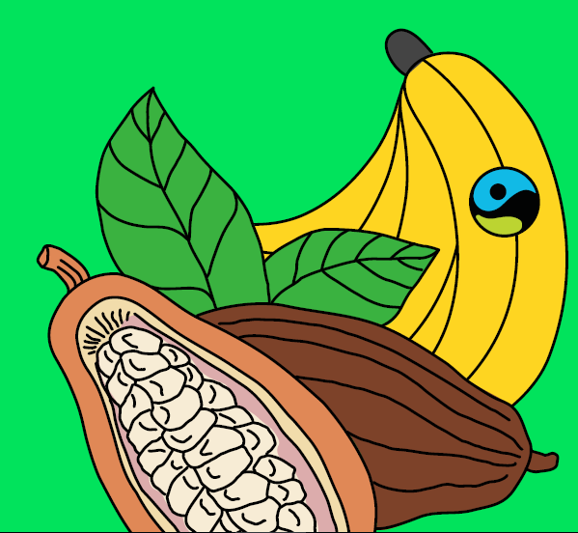
Tuesday 2nd March 2021
Geography Fairtrade Fortnight
(22nd February-7th march 2021)

Slide 2
Today we are learning: That bananas are grown in hot countries. That Fairtrade Bananas can make a difference to a banana farmer’s life. I will learn how a banana gets from where it grows to me.

Slide 3
Where do bananas grow?

Slide 5
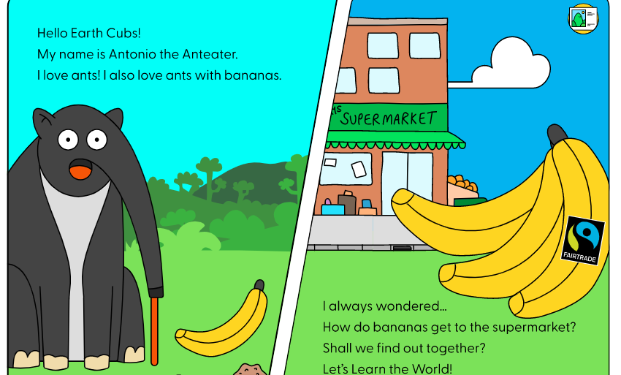

Slide 8
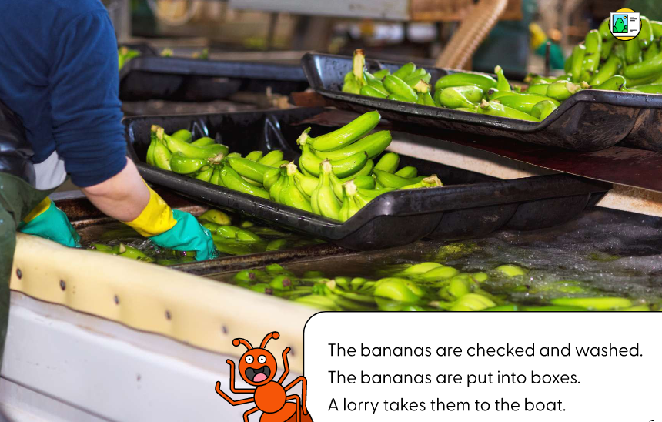

Slide 9
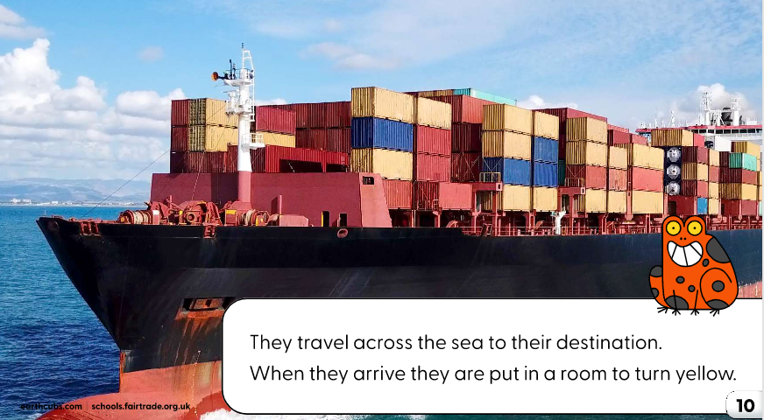

Slide 11
Can you tell the story of the banana’s journey to someone else? Where does it begin? How does it get to us? Can you write about the journey of a banana?
What is Fairtrade?
Why is Fairtrade important?
Remember to send any pictures of any of your work to me at s.hiley@worthvalleyprimary.co.uk

Slide 12
Watch this video to find out more https://www.youtube.com/watch?v=TV7tsXyq7ow

