Slide 1
Maths
4/03/21

Slide 2
Times Tables
If you can`t remember which personal times table you are working on, then please contact me.
For this week we will be practising the 8 times table as a whole class.
Use www.timestables.co.uk to have a go at this one, as well as https://ttrockstars.com/
Try the worksheets and games, just like we have done in class, as well as singing or chanting them to your family!
Spend 10 – 15 minutes on this exercise

Slide 3
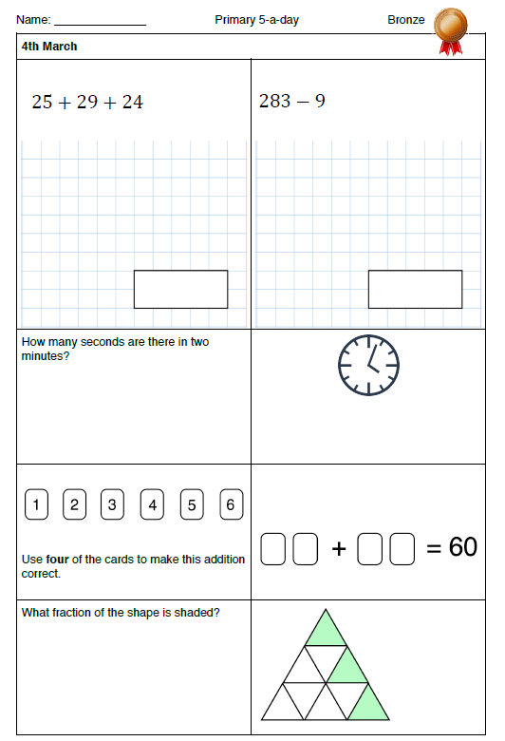
Warm-up

Slide 4
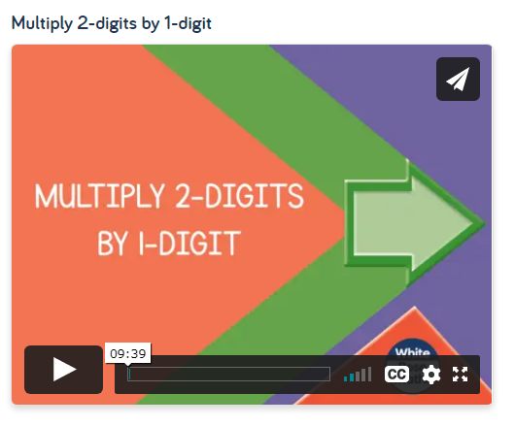
Main lesson
LC: Can I multiply 2 digit numbers by 1 digit?
Watch the following online lesson, having a go at the quizzes and tasks where the teacher asks you to https://whiterosemaths.com/homelearning/year-4/spring-week-2-number-multiplication-division/
Then have a go at the 2Do Purple Mash task called Maths Thursday

