Slide 1
Special Clothes

Slide 2
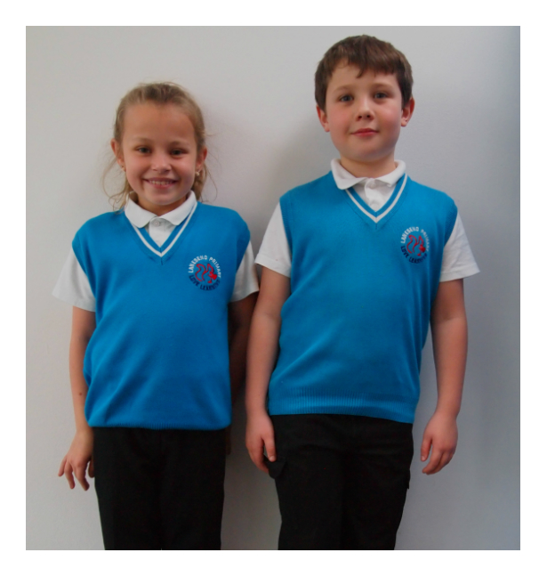
School Uniform
Photo courtesy of (Omarukai@flickr.com) - granted under creative commons licence - attribution

Slide 3
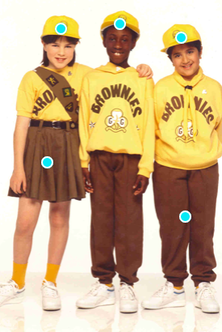
Brownies
Photo courtesy of (JoshBerglund@flickr.com) - granted under creative commons licence - attribution

Slide 4
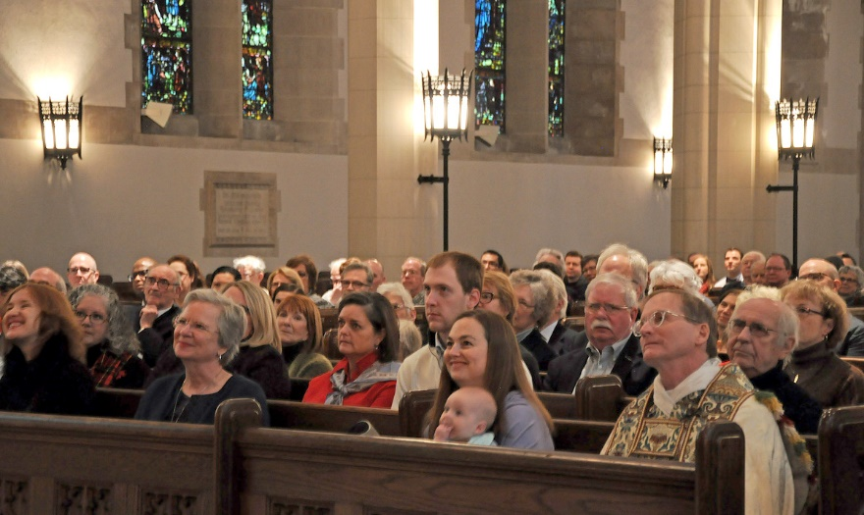
People like to wear their ‘best’ clothes when visiting Church to show respect.
Photo courtesy of (ai@ce@flickr.com) - granted under creative commons licence - attribution

Slide 5
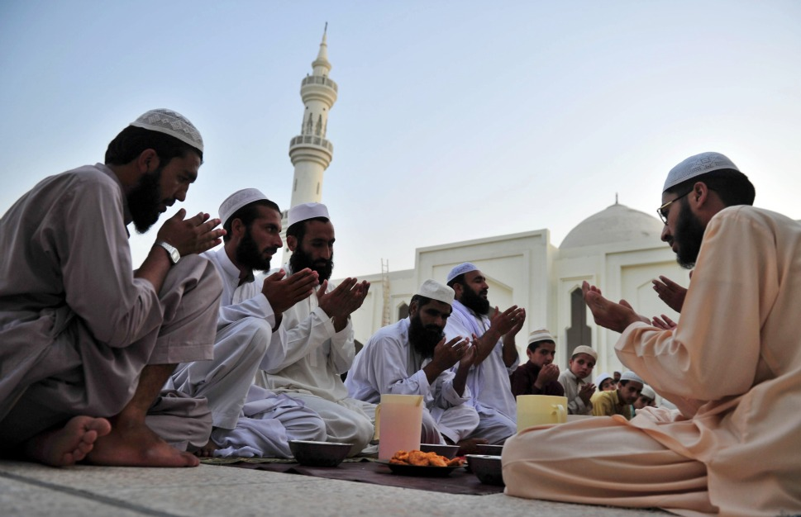
Clothes people wear for mosque
Photo courtesy of (Omarukai@flickr.com) - granted under creative commons licence - attribution

Slide 6
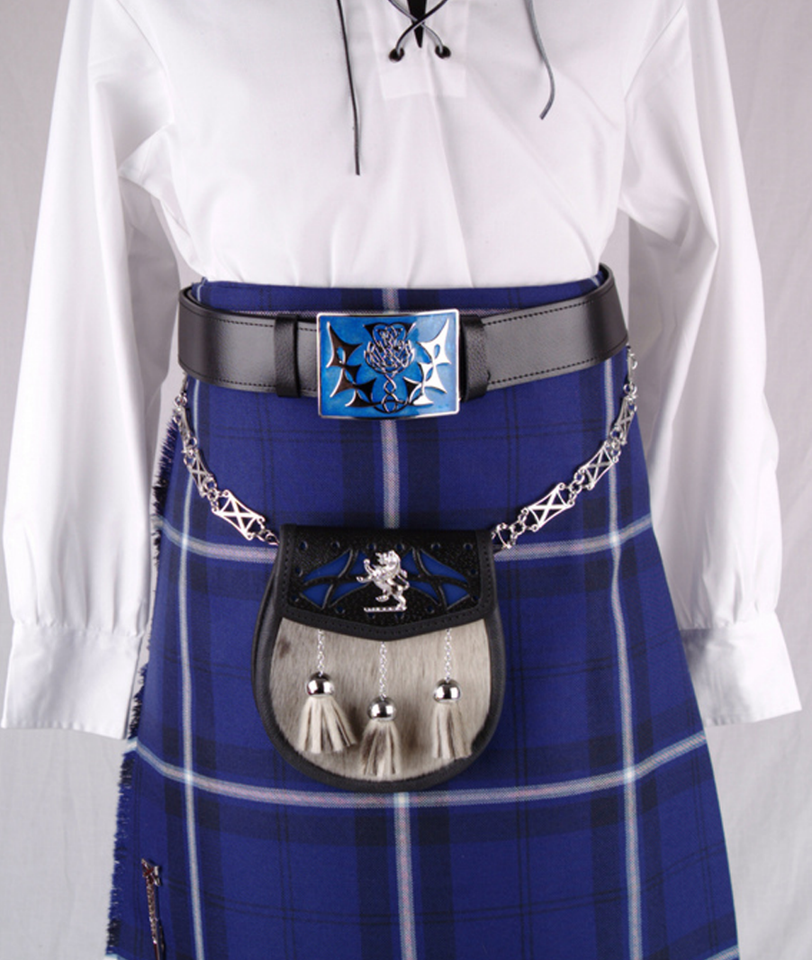
Scottish
Photo courtesy of (hobo!@flickr.com) - granted under creative commons licence - attribution

Slide 7
Indian
Photo courtesy of (kevin.j@flickr.com) - granted under creative commons licence - attribution

Slide 8
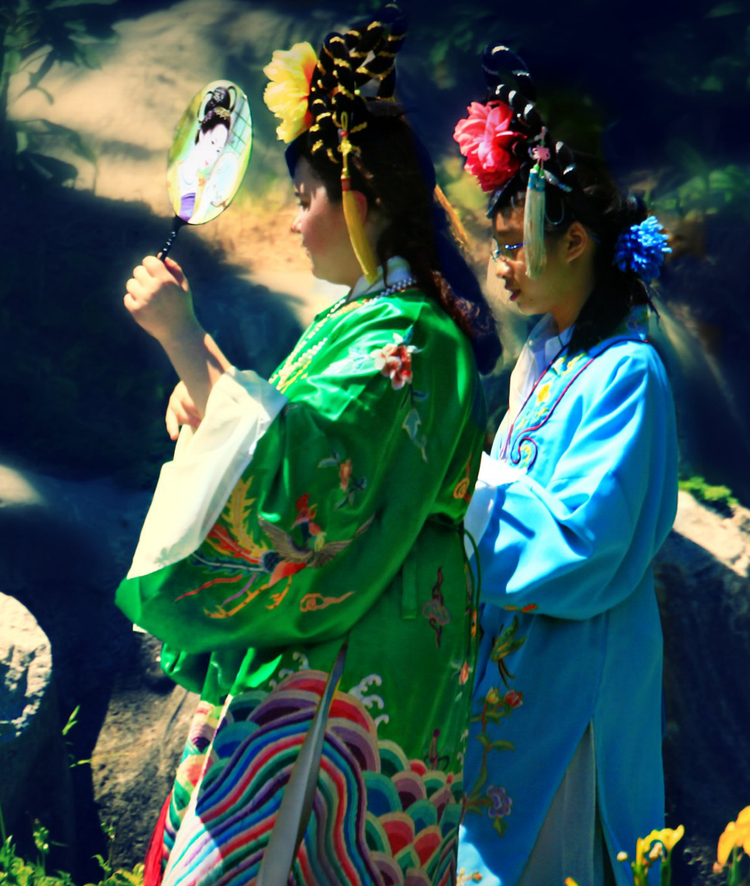
Chinese
Photo courtesy of (paloetic@flickr.com) - granted under creative commons licence - attribution

Slide 9
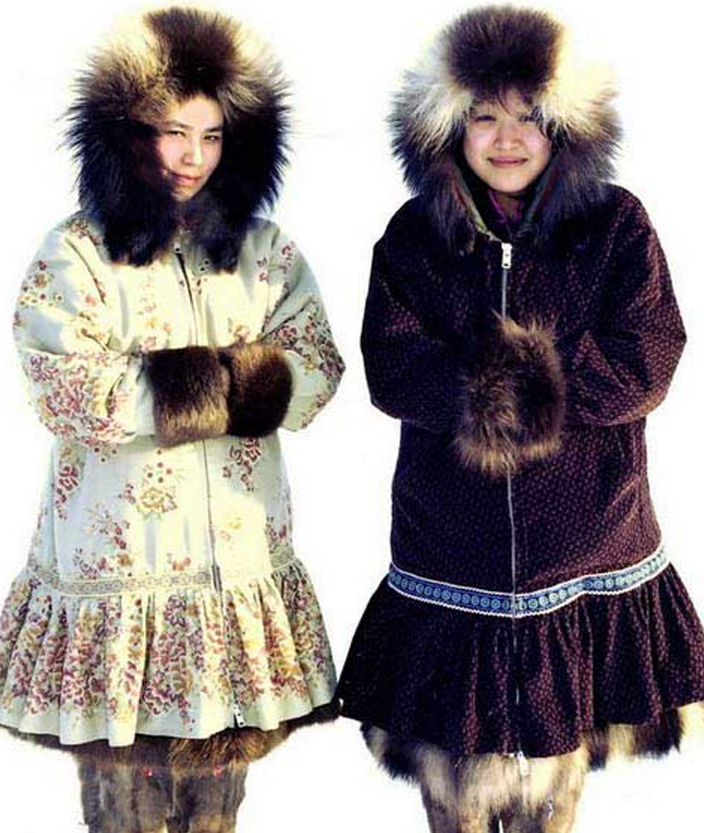
Arctic
Photo courtesy of (Omarukai@flickr.com) - granted under creative commons licence - attribution

Slide 10
Activity Where do you wear your special clothes? How do they make you feel? Could you draw a picture and write about your special clothes.

