Slide 1
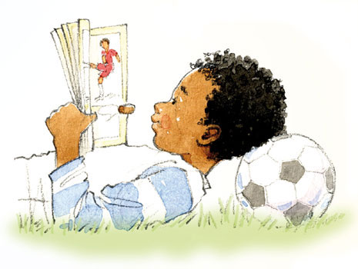
Thursday 4th March 2021
English tasks.

Slide 2
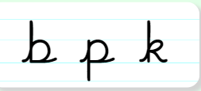
Handwriting
Can you practise the letters
Look on the letterjoin website to see how to form them correctly.
https://letterjoin.co.uk Then click on harder letters third set
Username: lj8943
If you are using a laptop the password is: home
If using an ipad or tablet the password is: capital L (Make the shape of a capital L)

Slide 3
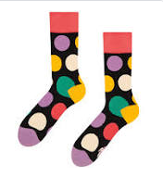
Can you knock my socks off with your neat writing?
Now that you have practised your letters on letterjoin can you practise on a piece of paper?
Can you send a picture of your writing to me?
s.hiley@worthvalleyprimary.co.uk

Slide 4
World Book Day
Today is a very special day. It is World Book Day. World book day is all about celebrating books, and reading.
It is celebrated in the UK and Ireland today. In other countries World Book Day happens at a different time of the year, usually April.
.

Slide 5
Here are some of my favourite books
What is your favourite book? Why is it your favourite?

Slide 6
Can you write about your favourite book? Why is this your favourite? What do you like about it? Is it a story book (fiction) or an information book (non-fiction)?

Slide 7
Here are a few little extra activities you could try today to celebrate World Book Day

Slide 8
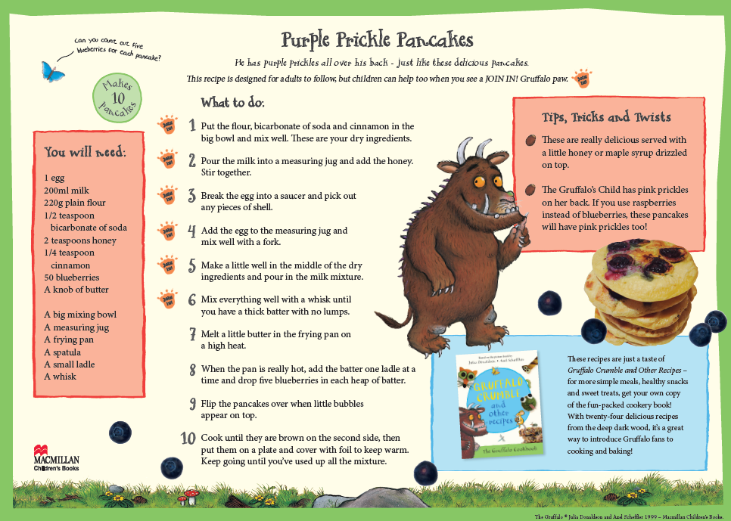
You might want to make some tasty snacks inspired by books. Click this link for more recipe ideas: https://www.worldbookday.com/resources/cooking/

Slide 9
Remember I love to see your work so please email pictures to me at:
s.hiley@worthvalleyprimary.co.uk

