Slide 1
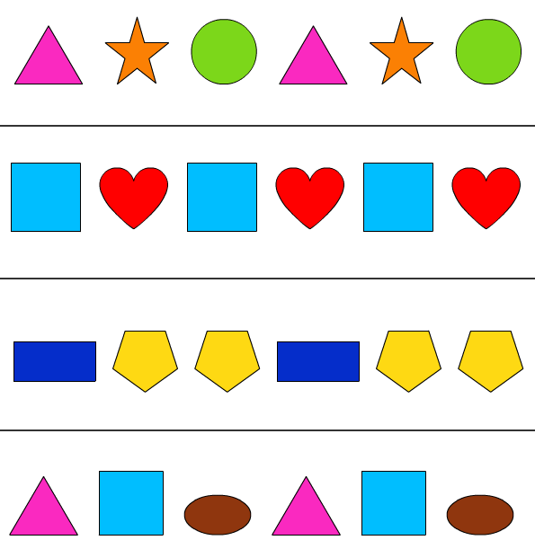
Thursday 04-03-21
This week we are looking at patterns; how to make them
and how to describe them. How to use language to say where a
shape is in an arrangement
https://classroom.thenational.academy/lessons/to-use-the-language-of-position-60u32t
Now have a go. Draw the squares on a piece of paper and colour them in. if you haven’t go the colours you could
write in the names.
It might be fun to use yesterdays pattern maker to solve the problem as you can move the squares about.
https://www.coolmath4kids.com/manipulatives/pattern-blocks

Slide 2
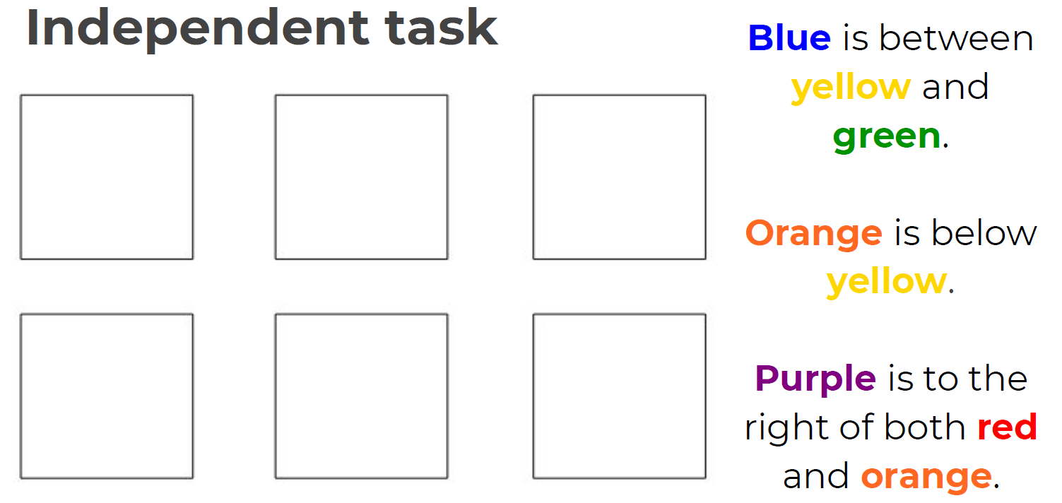

Slide 3
I am so looking forward to seeing you all on Monday

