Slide 1
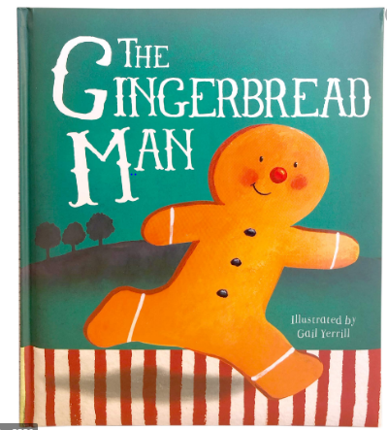
Tuesday 2nd March 2021
English tasks.

Slide 2
Handwriting
Can you practise the letters
Look on the letterjoin website to see how to form them correctly.
https://letterjoin.co.uk Then click on harder letters first set
Username: lj8943
If you are using a laptop the password is: home
If using an ipad or tablet the password is: capital L (Make the shape of a capital L)

Slide 3
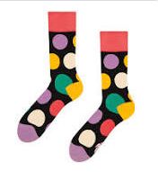
Can you knock my socks off with your neat writing?
Now that you have practised your letters on letterjoin can you practise on a piece of paper?
Can you send a picture of your writing to me?
s.hiley@worthvalleyprimary.co.uk

Slide 4
Traditional Tales
This half term our English tasks will be based on Traditional Tales.
A traditional tale is a story that has been told and re-told for many years. It becomes a story that almost everyone knows. Traditional tales are also sometimes called fairy stories or fairy tales.
Stories such as Cinderella, Goldilocks and the Three Bears and Jack and the Beanstalk are all traditional stories.

Slide 5
Reading and Writing Task
This week we are reading
The Gingerbread Man
Can you watch a film version of the story using the link below?
https://www.youtube.com/watch?v=YoQyyB5xvLk

Slide 6
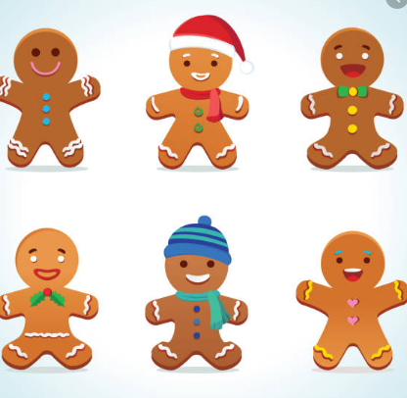
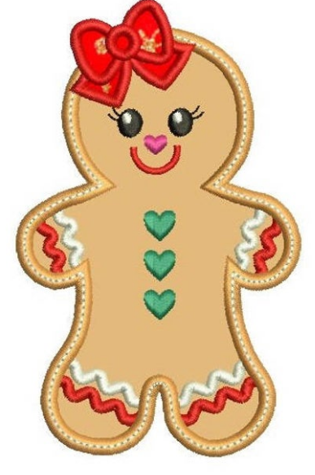
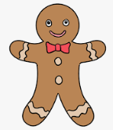
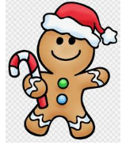
Writing Task:
Can you design your own gingerbread person? It could be a girl, a boy or an animal. Here are some ideas

Slide 7
Can you write sentences to describe your gingerbread person?
My gingerbread girl has a shiny, red bow on the top of her head. She has three emerald green heart shaped buttons down the middle of her body. She has a big smile because she is very friendly.

Slide 8
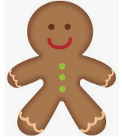
Remember I love to see your work so please email pictures to me at:
s.hiley@worthvalleyprimary.co.uk

