Slide 1
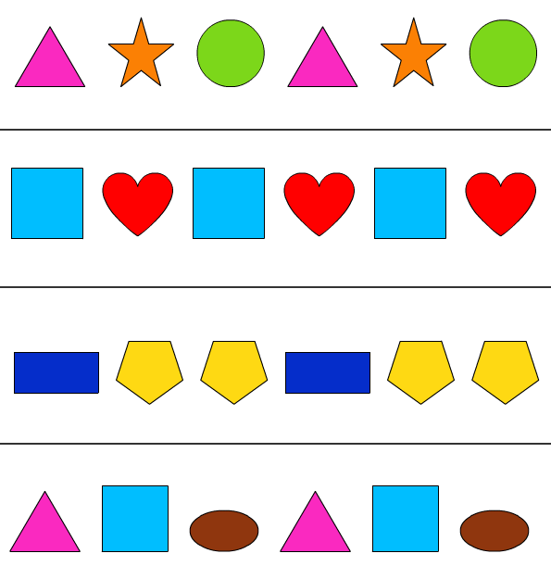
Tuesday 02-03-21
This week we are looking at patterns; how to make them
and how to describe them. How to use language to say where a
shape is in an arrangement
https://classroom.thenational.academy/lessons/to-recognise-and-create-repeating-patterns-6rtpac
Now have a go!
https://www.topmarks.co.uk/ordering-and-sequencing/shape-patterns

