Slide 1
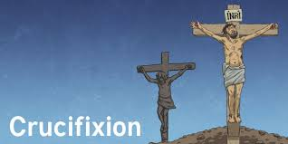

R.E.
What do Christians believe about Jesus’s death and resurrection?
Wednesday 03.03.21

Slide 2
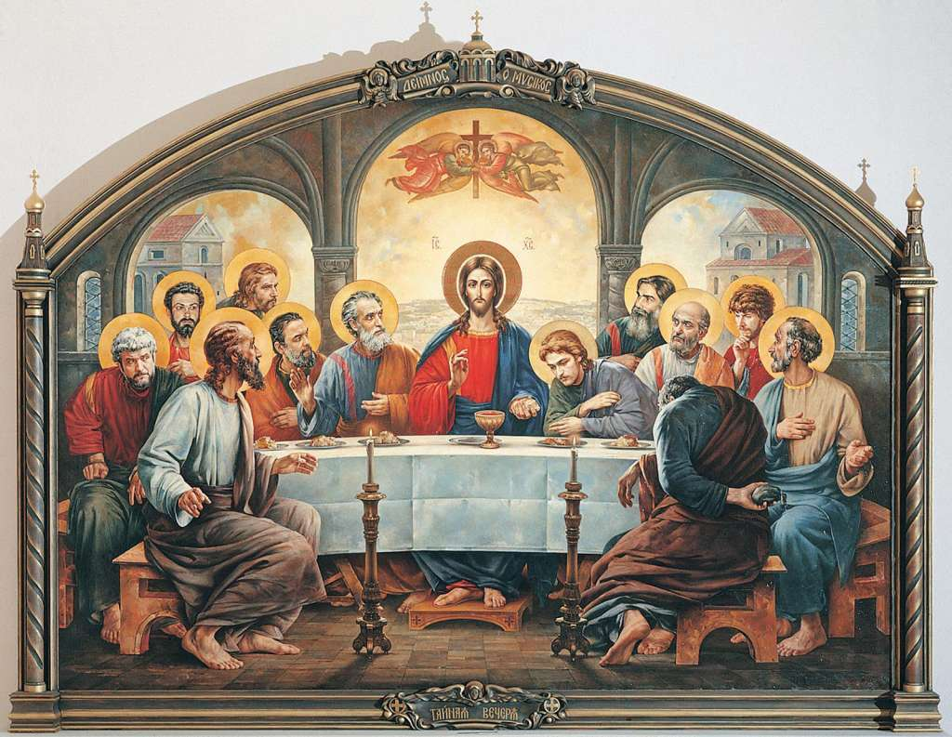
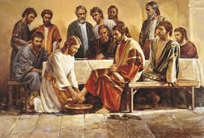

Can I explain what the Gospels say about the Last Supper?
Can I explain what happens on Maundy Thursday?
Can I explain Christian traditions on Maundy Thursday?
Can I understand and explain what the word betrayal means?

Slide 3
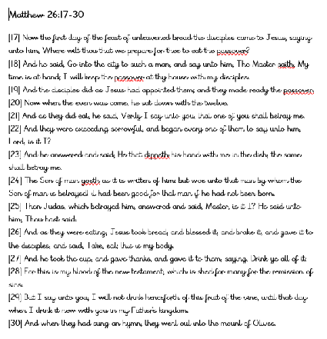
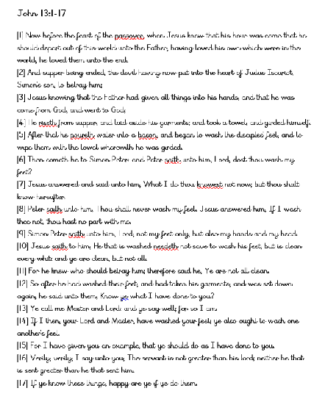
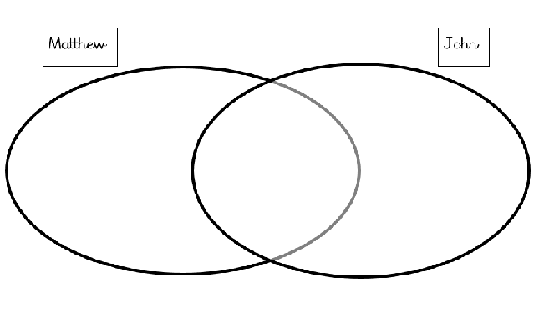

Slide 5
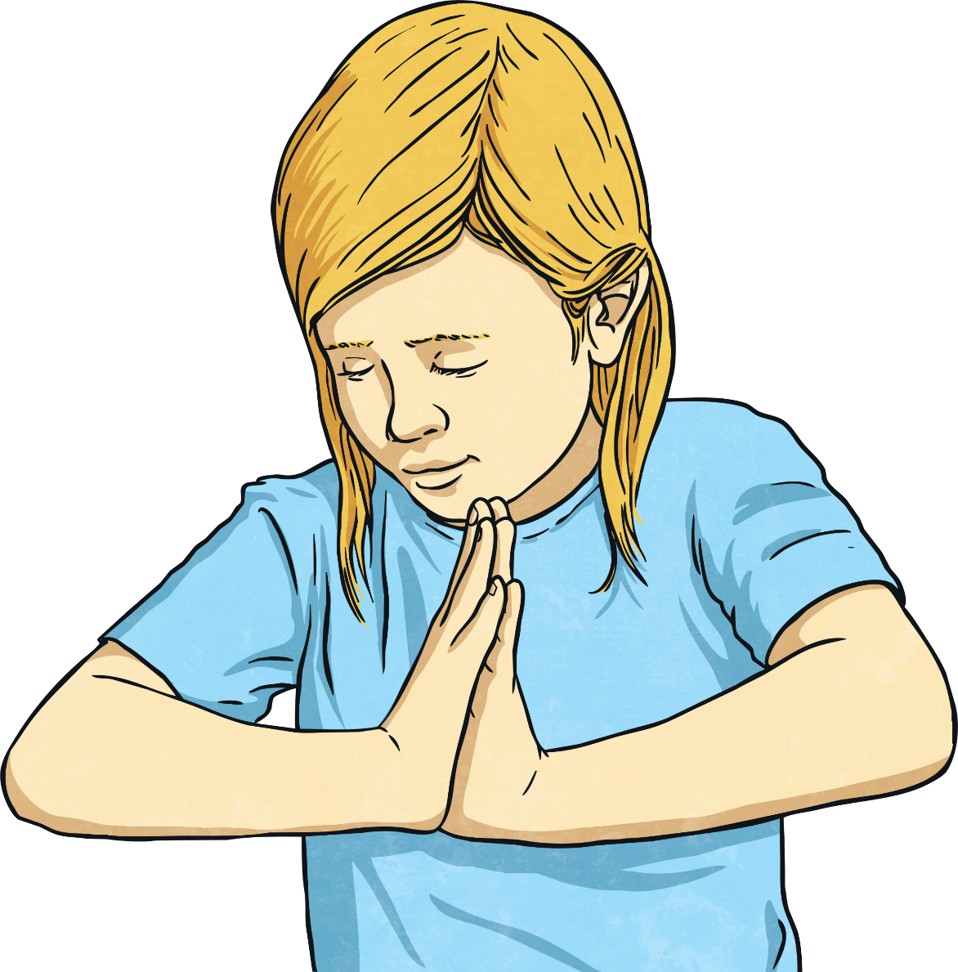
What Is Maundy Thursday?
Maundy Thursday is the day before Good Friday. The word ‘Maundy’ means ‘command’. It is part of an important week in the Christian religion called Holy Week.
The key days in Holy Week are:
Palm Sunday;
Maundy Thursday;
Good Friday;
Easter Sunday.

Slide 6
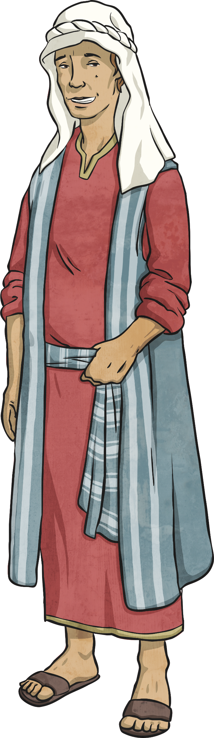
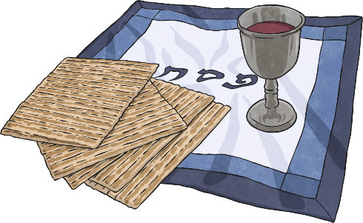
What Happened on Maundy Thursday?
Jesus and his disciples were in Jerusalem. They were there to celebrate the Jewish festival of Passover, which celebrates when the Jews were freed from slavery in Egypt.
‘Go and find somewhere we can celebrate together,’ Jesus told Peter and John, two of his disciples.
Peter and John found an upstairs and the disciples prepared their Passover meal.

Slide 7
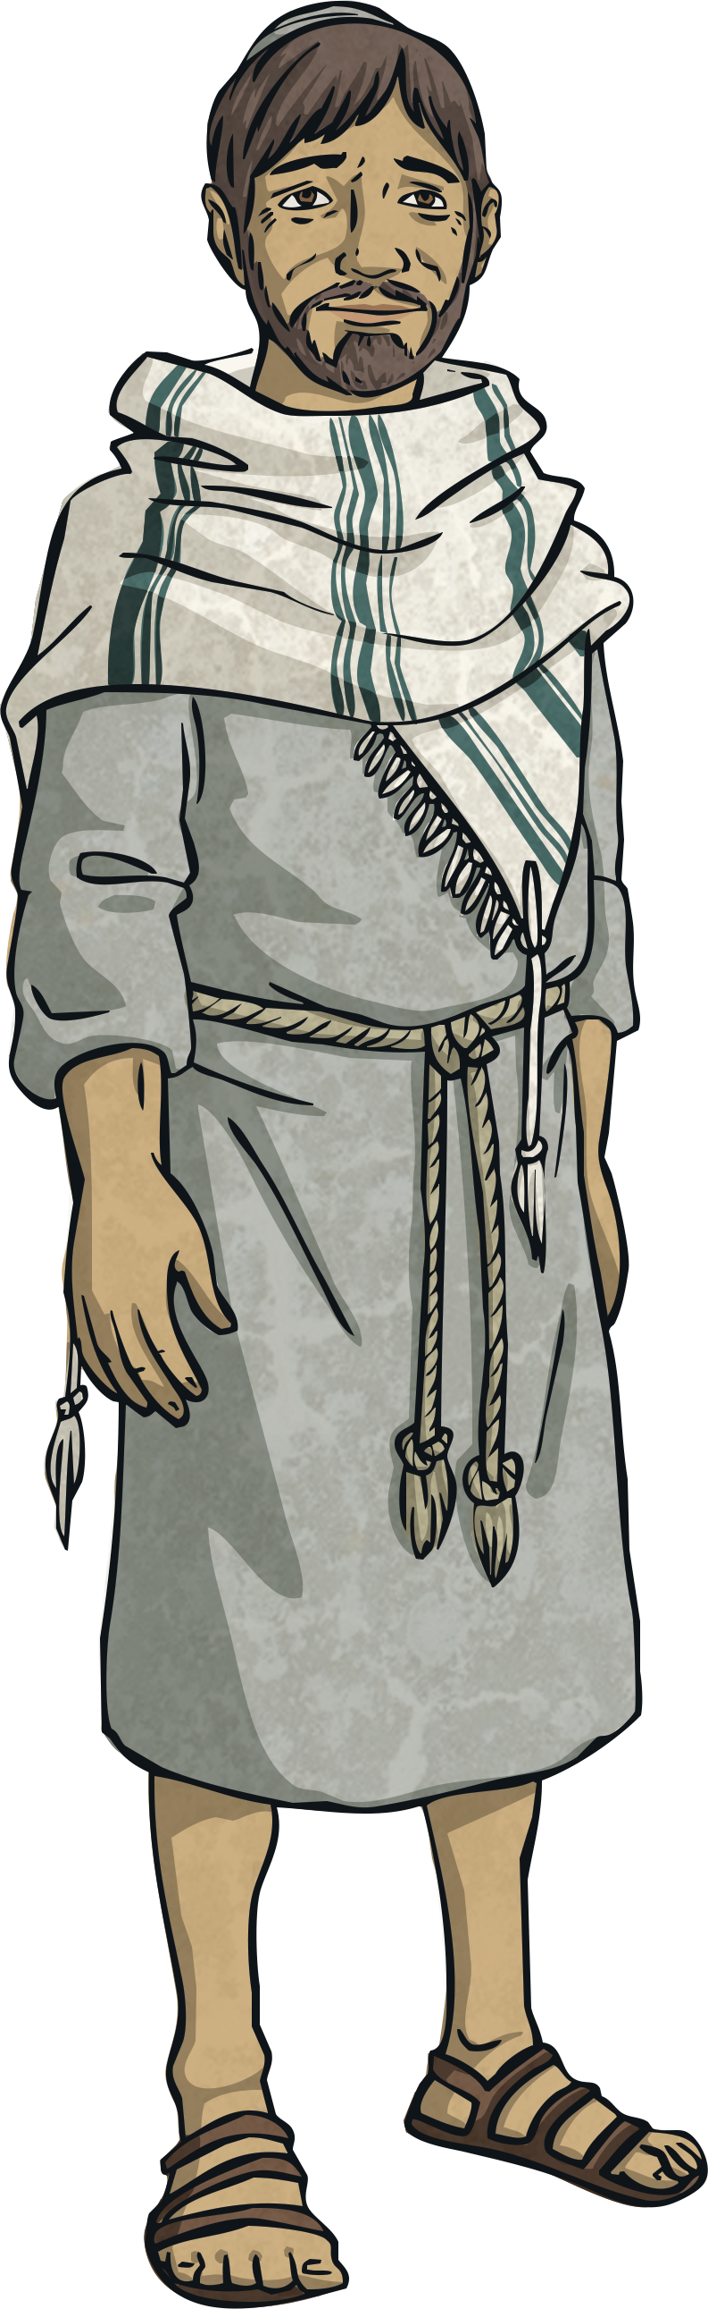
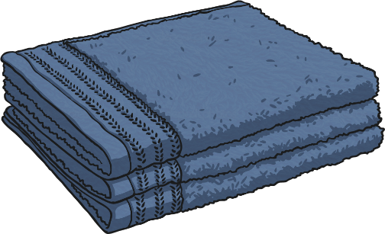
What Happened on Maundy Thursday?
In those days, people wore sandals. People’s feet got very dirty and dusty. In lots of houses, there would be a servant to wash guests’ feet.
When they arrived at the room, the disciples were surprised to see Jesus holding a bowl of water and carrying a towel.
‘What are you doing, Jesus?’ one of them asked.
‘I’m going to wash your feet,’ Jesus replied. ‘I’m doing this to be an example to you. You should serve and help each other, just as I am serving you.’

Slide 8
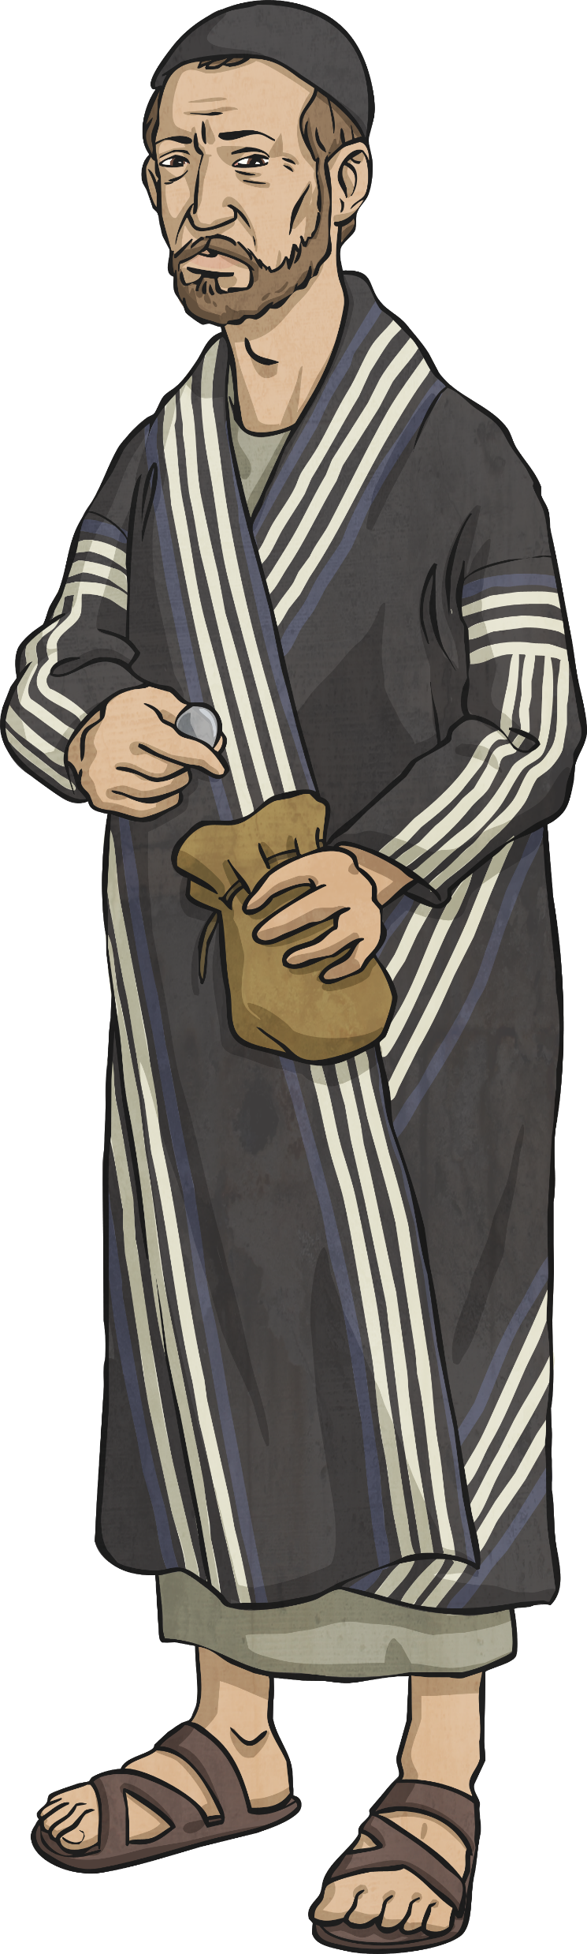
What Happened on Maundy Thursday?
As they sat at the table, Jesus made a shocking announcement. ‘One of you is going to betray me and hand me over to my enemies.’
Most of the disciples were distressed, for they loved Jesus very much.
Judas Iscariot was the one who would betray Jesus.
Today, we use the term ‘Judas’ to describe a traitor.

Slide 9
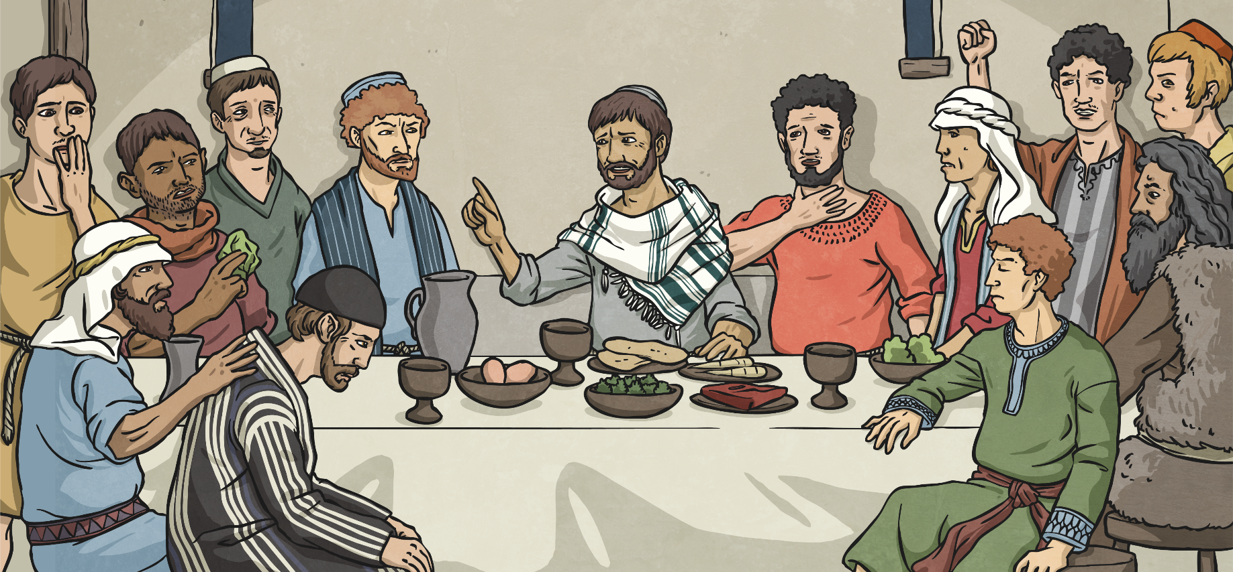
What Happened on Maundy Thursday?
Jesus and his disciples then ate their Passover meal.
This meal is now known as the Last Supper, because it was the last meal Jesus would have with his followers before his death.

Slide 10
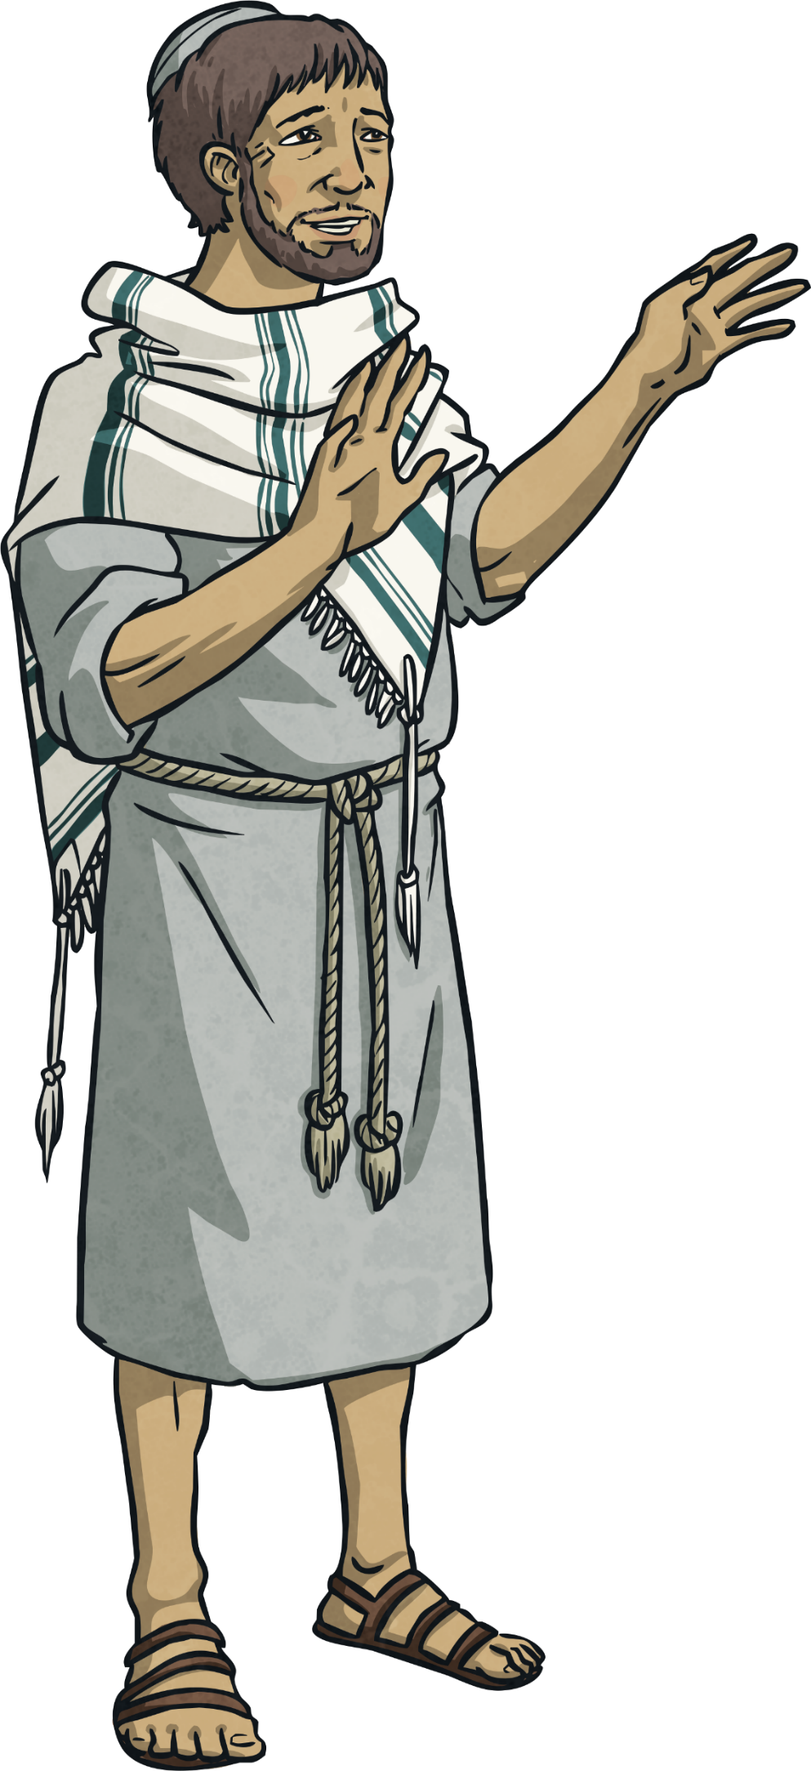
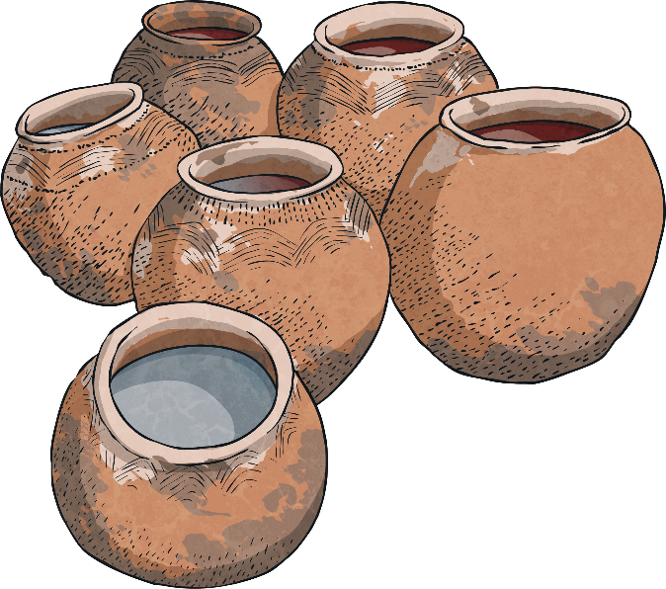
What Happened on Maundy Thursday?
After they had eaten, Jesus took a piece of bread and broke it. ‘This bread is a symbol of my body, which is going to be broken.’
Then, he took a cup of wine and said ‘This wine is a symbol of my blood.’
Christians remember this by having a special ceremony called Communion or the Eucharist, where they eat bread and drink wine.

Slide 11
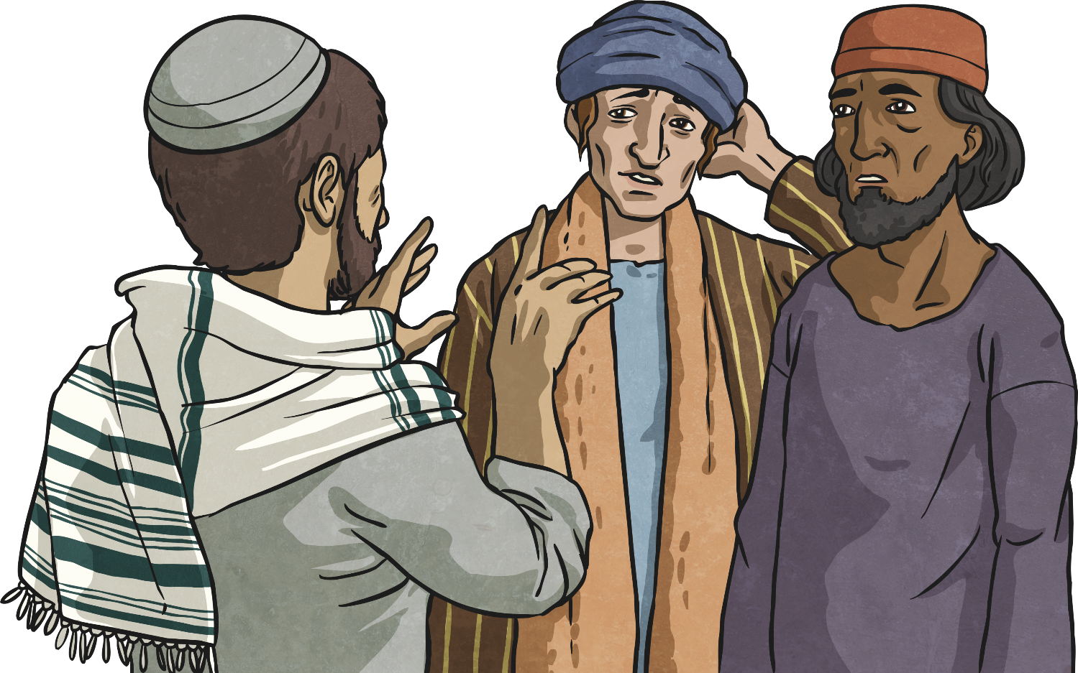
What Happened on Maundy Thursday?
Jesus then spoke to his disciples. ‘I’m giving you a new commandment. You have to love each other the way I love you’, he explained.
This command is why the day is called ‘Maundy’.

Slide 12
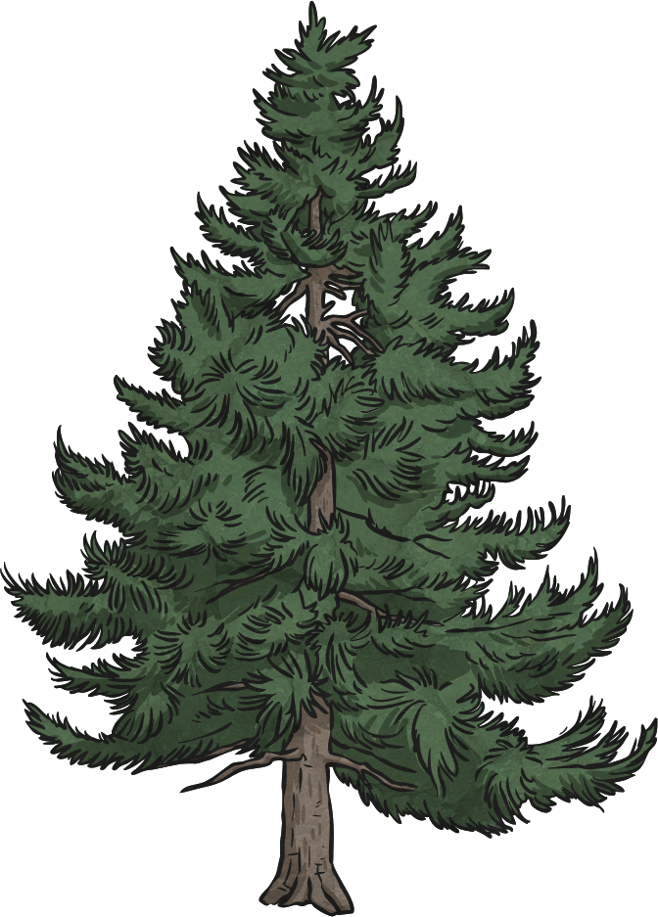
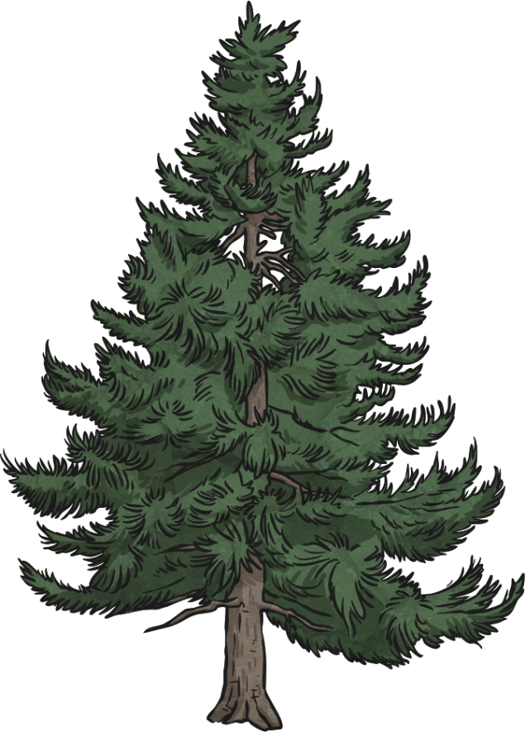
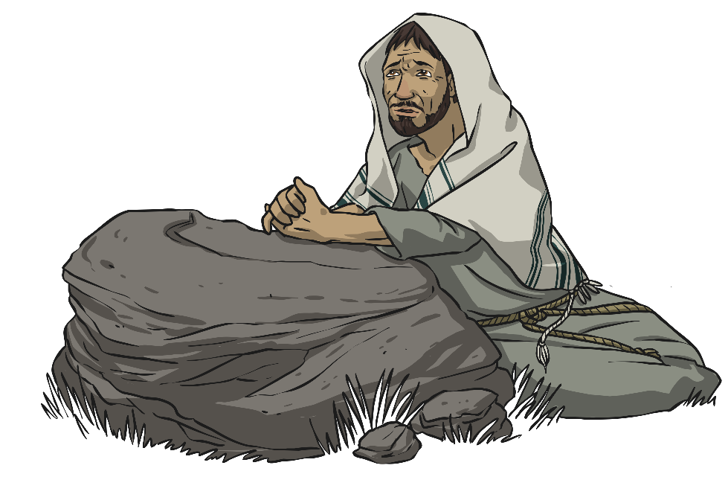
What Happened on Maundy Thursday?
Jesus and some of the disciples then went to a garden called Gethsemane. Jesus spent time praying.
Suddenly, there was a loud commotion. A group of Roman soldiers had appeared in the garden and they were looking for Jesus.
From the crowd of soldiers, Judas appeared. He walked over to Jesus and kissed him. This was the sign to the soldiers who Jesus was. The soldiers arrested Jesus and took him away.

Slide 13
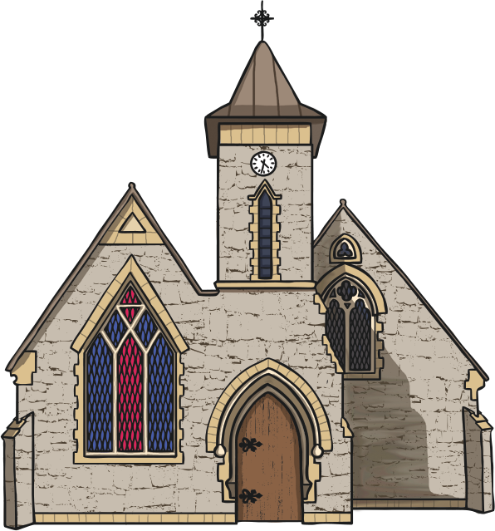
How Do Christians Remember
Maundy Thursday?
Some churches have special feet washing services on Maundy Thursday.
Hundreds of years ago, our monarch used to wash poor people’s feet on Maundy Thursday. Can you imagine the Queen washing your feet?

Slide 14
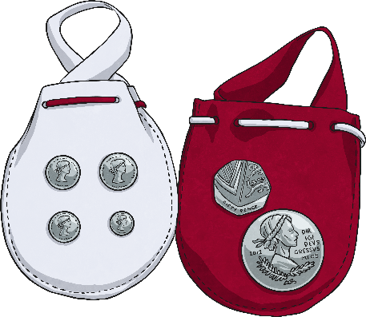
Maundy Money
Henry IV started a different tradition, where he gave gifts, the number of which matched his age.
Today, the monarch gives special coins called Maundy Money. This year, The Queen choses men and woman to receive the money. These people are chosen because of acts of Christian service they have shown.
Each person receives two leather purses, one white and one red. The red purse contains normal coins, whereas the white purse contains special silver coins to match the age of the Queen.

Slide 15
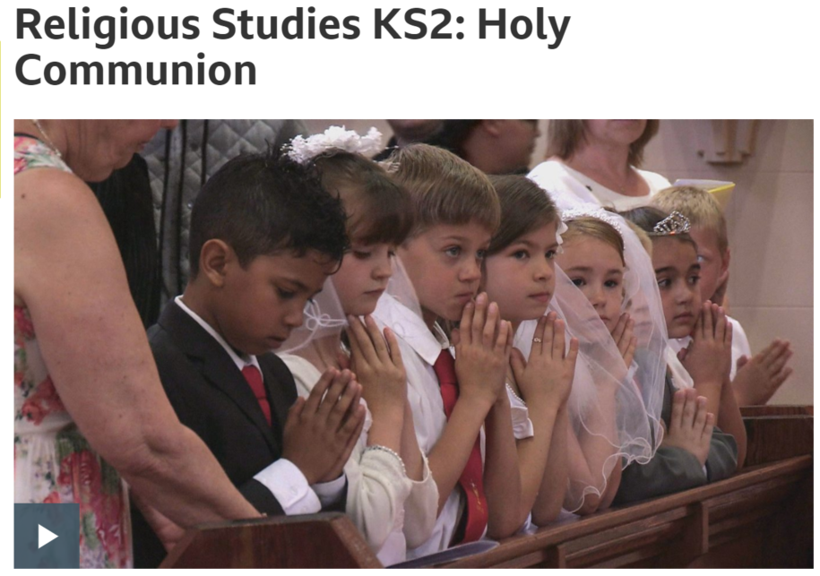
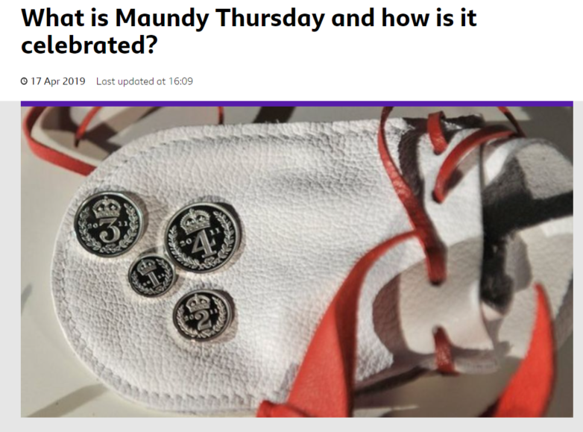
Can I explain Christian traditions on Maundy Thursday?
https://www.bbc.co.uk/newsround/21967564
https://www.bbc.co.uk/teach/class-clips-video/religious-studies-ks2-holy-communion/z7xhy9q

Slide 16
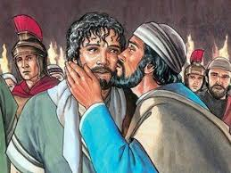
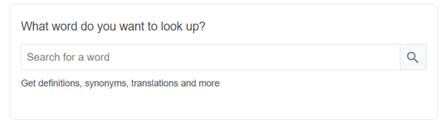

Can I understand and explain what the word betrayal means?

