Slide 1
You will need…
Pencil
Paper
Scissors

Slide 2
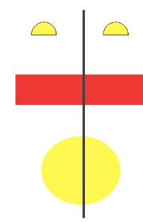
What is symmetry?
Something is symmetrical when it is identical on both sides
A shape or pattern has symmetry if a mirror line can be drawn on it to show that both sides are exactly the same!

Slide 3
Is there a line of symmetry? How could we check?

Slide 4
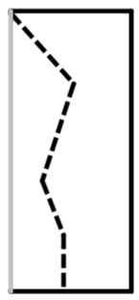
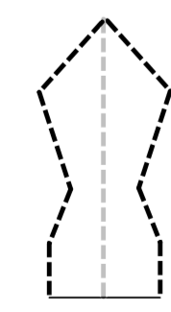
Talk task
1. Fold a piece of paper
2. Cut out a shape (without cutting across the fold).
3. Open the shape so that you can see the line of symmetry.

Slide 9
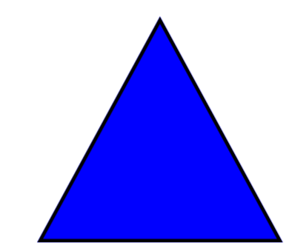

Slide 11
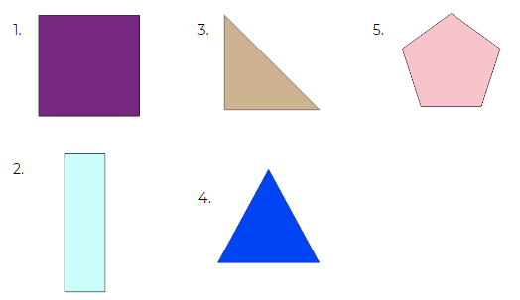
Independent task
For each shape can you tell me:
What it is called
How many sides it has
How many vertices it has
How many lines of symmetry

Slide 12
Answers
Number | Name | Sides | Vertices | Lines of symmetry
1 | Square | 4 | 4 | 4
2 | Rectangle | 4 | 4 | 2
3 | Right angle triangle | 3 | 3 | 1
4 | Equilateral triangle | 3 | 3 | 3
5 | Pentagon | 5 | 5 | 5

