Slide 1
Confession

Slide 2
The Catholic sacrament of reconciliation (also known as penance) has three elements: conversion, confession and celebration. By undertaking this sacrament, Catholic Christians find God’s forgiveness. In turn, Catholic Christians are called to forgive others.
The sacrament of reconciliation is a sacrament of healing. The word reconciliation means ‘to be at peace again’.

Slide 3
Reconciliation
Catholic Christians believe in four stages of forgiveness:
Contrition - the state of feeling remorseful.
Confession - the priest helps Catholic Christians to confess. They must say sorry and promise to change their ways.
Satisfaction - the priest sets a task or suggests prayers to be said in order to achieve forgiveness. This is sometimes called 'penance'.
Absolution - release from the feeling of guilt.
Catholics believe that they must seek to obtain forgiveness in the hope that they can restore their relationship with God.

Slide 4
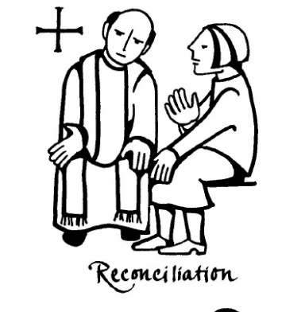
The Sacrament of Reconciliation
There are 7 stages to the Sacrament of Reconciliation.
The Greeting – ‘In the name of the Father, and of the Son and of the Holy Spirit, Amen.’
Reading from Bible
Confession of sin - priest will help you confess properly (help you understand what you actually did wrong)
Penance is given – the priest will give you something to do that will, in some way, make up for the sin you committed and confessed.
Prayer of Pardon – known as the Act of Contrition.
Absolution – your sins are forgiven by the priest on behalf of God.
Prayer of Thanks – ‘Praise the Lord for he is good’.

Slide 5
With your own research and the information on this powerpoint and the pdf document you are going to create a leaflet called
‘ A guide to the sacrament of confession for young children’.

