Slide 1
English 08/07/2021
Settings

Slide 2
Spellings – Group 1
Continue practising your contraction words
Use the following link on Spelling Frame to practise and test yourself
https://spellingframe.co.uk/spelling-rule/102/25-Contractions

Slide 3
Spellings – Group 2
Continue practising your suffixes
Practise and test yourself using the following link on Spelling Frame
https://spellingframe.co.uk/spelling-rule/8/1-Adding-suffixes-beginning-with-vowel-letters-to-words-of-more-than-one-syllable

Slide 4
Grammar – speech
Let`s recap using inverted commas for writing speech
We can also call these speech marks
“I hope you`re all doing well!” exclaimed Miss Bethell
Read through the following slides and have a go at the practise questions and tasks with a pen and paper

Slide 5
Inverted commas

Slide 6
Inverted commas
Inverted commas are also known as speech marks and quotation marks. Inverted commas show what is being said.
Sometimes, they might look like a small 66 and 99.
“ ”
Sometimes, they might look like two small lines.

Slide 7
Inverted commas
Inverted commas go around the words the character says.
“We are going for a walk,” announced Zia.
words the character is saying
Zia announced, “We are going for a walk.”
words the character is saying

Slide 8
Inverted commas
Inverted commas are always placed before the first word of the speech and after the end punctuation of the speech.
“Are you nearly ready?” asked Mrs Matthews.
first word of speech
end punctuation of the speech
Mrs Matthews asked, “Are you nearly ready?”
first word of speech
end punctuation of the speech

Slide 9
Inverted commas
The reporting clause tells us who is speaking. It is never punctuated with inverted commas.
“I’m exhausted!” complained Oliver.
reporting clause
Oliver complained, “I’m exhausted.”
reporting clause

Slide 10
Inverted commas
The character’s speech sentence must contain the correct end punctuation.
If the end of the character’s sentence is also the end of your sentence, this will usually be a full stop, question mark or exclamation mark.
Isla mumbled, “I’m ready.”
. at the end of sentence
Isla yelled, “Let’s go!”
! to add emphasis
Isla asked, “Where is he?”
? as it is a question

Slide 11
Practise
Rewrite the sentences below, inserting the correct punctuation.
Tia asked, “What time will the train get here”
Everyone screamed, “Run faster”
Marcus whispered, “It is over here”
Amandine wondered, “How can I fix it”
Which have more than one option?

Slide 12
Inverted commas
If the end of the character’s speech sentence is not the end of your sentence, you will need a comma, question mark or exclamation mark.
Your sentence will end with a full stop.
, at the end of Isla’s sentence as it is not the end of your sentence
“I’m ready,” mumbled Isla.
“Let’s go!” yelled Isla.
! to add emphasis
“Where is he?” asked Isla.
? as it is a question

Slide 13
Practise
Rewrite the sentences below, inserting the correct punctuation.
“What is that for” he questioned.
“These are for you” smiled Kayla.
“Please help me” begged Farhim.
“You need to glue it” explained Miss Rose.
Which have more than one option?

Slide 14
Inverted commas
If the reporting clause is at the beginning, use a comma before you start the speech to allow the reader to pause and change their voice, if needed.
Mr Ahmed mentioned, “The library is closed today.”
If the reporting clause is at the end, you will already have used a comma, exclamation mark or question mark at the end of the character’s sentence.
“The library is closed today,” mentioned Mr Ahmed.

Slide 15
Practise
Insert the missing commas.
Masuma grinned “I can’t wait.”
Ben mumbled “I can’t find my coat anywhere.”
“See you later” he smiled.
Miss Karim complained “These pencils are all broken.”

Slide 16
Practise
Tick two boxes to show where the inverted commas should be placed.
B
E
Everyone cheered and clapped , We made it !
A
C
D

Slide 17
Practise
Which sentence is punctuated correctly?
“When did the Vikings come to Britain” wondered Bethan.
“When did the Vikings come to Britain?” wondered Bethan.
“When did the Vikings come to Britain?” Wondered Bethan.
“When did the Vikings come to Britain,” wondered Bethan.
Which are not? Explain what is wrong!

Slide 18
How did you do?
Which sentence is punctuated correctly?
“When did the Vikings come to Britain” wondered Bethan.
“When did the Vikings come to Britain?” wondered Bethan.
“When did the Vikings come to Britain?” Wondered Bethan.
“When did the Vikings come to Britain,” wondered Bethan.
Which are not? Explain what is wrong!

Slide 19
Practise
Rewrite the speech sentences below using the correct punctuation.
what shall we do now asked masud
toni answered we could go for a walk
Remember: inverted commas are used around the actual words the character says.

Slide 20
How did you do?
Rewrite the speech sentences below using the correct punctuation.
“What shall we do now?” asked Masud.
Toni answered, “We could go for a walk.”
Remember: inverted commas are used around the actual words the character says.

Slide 21
Practise
Explain two mistakes with how each speech sentence has been punctuated below.
“I’ve lost my bag.” Grumbled Nathan.
“What is that” asked Jill?

Slide 22
How did you do?
Explain two mistakes with how each speech sentence has been punctuated below.
“I’ve lost my bag.” Grumbled Nathan.
There should be a comma after ‘bag’ as it is not the end of the writer’s sentence. ‘Grumbled’ should not have a capital letter as it is not the start of the writer’s sentence or the character’s sentence.
“What is that” asked Jill?
The question mark should be after ‘that’ as this is the end of the question sentence. There should be a full stop after ‘Jill’.

Slide 23
Reflection
Remember to use these tips to help you use inverted commas correctly.
Use inverted commas around what the character actually says.
Both your sentence and the speech sentence that your character is saying must start with a capital letter. Remember to use capital letters for any proper nouns.
Make sure you use the correct end punctuation for your sentence as well as the character’s speech sentence.

Slide 24
Settings
As yesterday, can you continue to describe the different settings on the images below
As well as fronted adverbials and expanded noun phrases, perhaps you could use some similes (as pointy as…) metaphors (that volcano is a cauldron of fire) or even alliteration (the majestic, magical mountain)

Slide 25
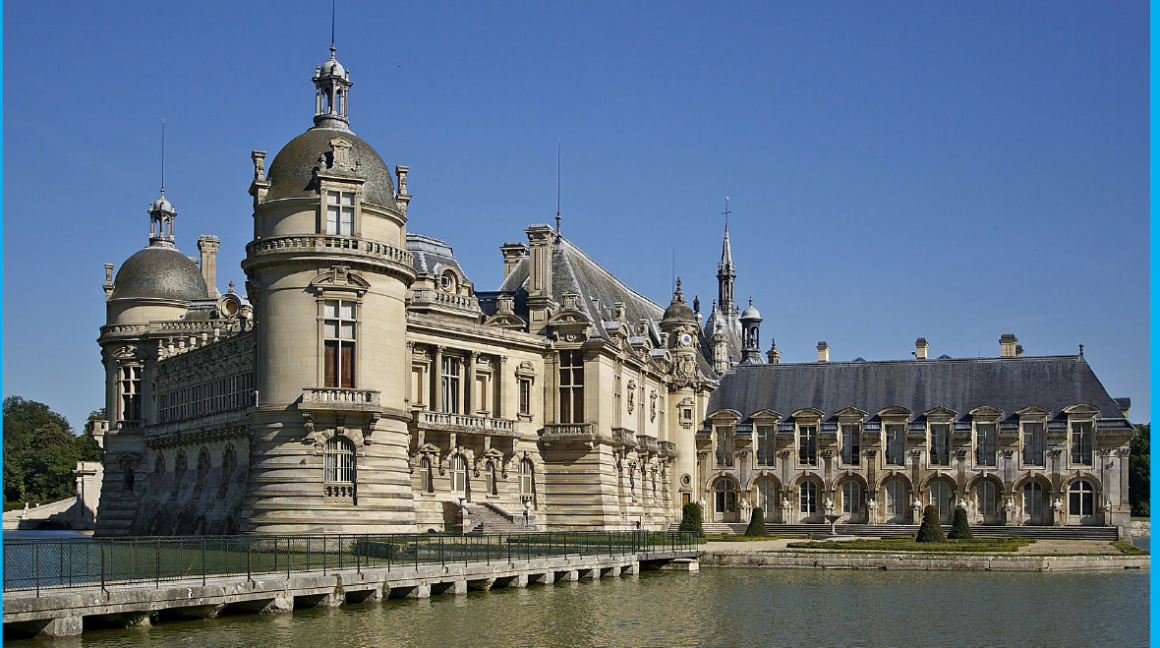

Slide 26
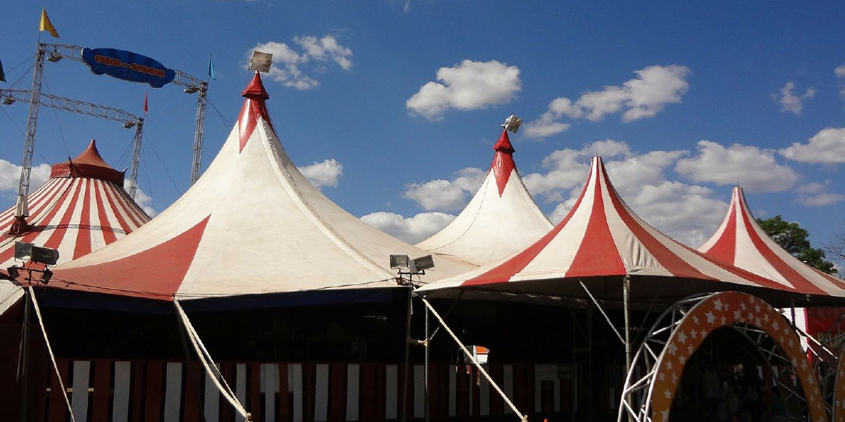

Slide 27
