Slide 1
English
06/07/2021
Settings

Slide 2
Grammar – fronted adverbial phrases
On Purple Mash, have a go at the 2Do Day Out
Did you notice the fronted adverbial there??

Slide 3
Spellings – Group 1
Continue practising your contraction words
Use the following link on Spelling Frame to practise and test yourself
https://spellingframe.co.uk/spelling-rule/102/25-Contractions

Slide 4
Spellings – Group 2
Continue practising your suffixes
Practise and test yourself using the following link on Spelling Frame
https://spellingframe.co.uk/spelling-rule/8/1-Adding-suffixes-beginning-with-vowel-letters-to-words-of-more-than-one-syllable

Slide 5
Writing
For the next 3 weeks we will be writing our own story about the Firework Maker`s Daughter
We will be using similar characters but changing the settings
What settings have we noticed in the story already?

Slide 6
Settings
Look at the following text and note down any of the powerful language you notice and like
Can you identify these words and phrases as adjectives, verbs and adverbs?

Slide 7
Text
The jungle is a hot and steamy world where enormous trees loom up to the sky, lush vegetation, ferns and fungi thrust up from the forest floor, and vines and lianas curl around the tall trunks, reaching eagerly towards the high canopy. Buttress and stilt roots sprawl across the shallow soil. Orchids burst into incredible swirls of colour and form, frogs and butterflies flaunt vibrant hues, emerald snakes glisten, parrots soar in a blaze of orange, scarlet, blue and green while hummingbirds probe exotic flowers for nectar. Toucans and birds of paradise add to this amazing colour spectrum. A myriad of plants and animals find their own special niche in this kaleidoscope of life and energy.

Slide 8
Writing – your task
Describe the following images using powerful adjectives, expanded noun phrases, fronted adverbials, similes and metaphors
For example
As the sun shone in the hazy sky, the waves crashed violently against the waiting rocks. The sea shore was a carpet of shells.

Slide 9
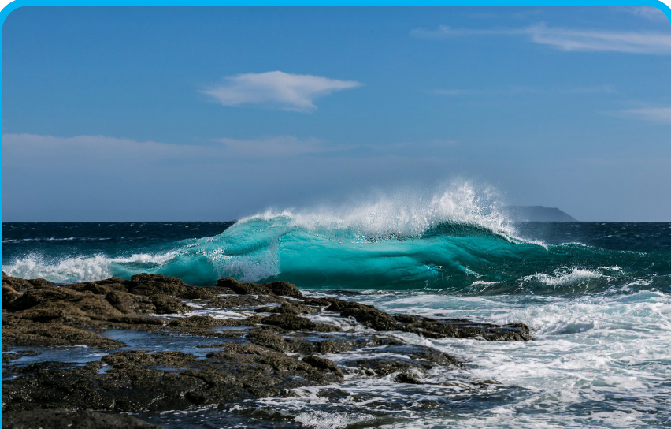
Your turn…

Slide 10
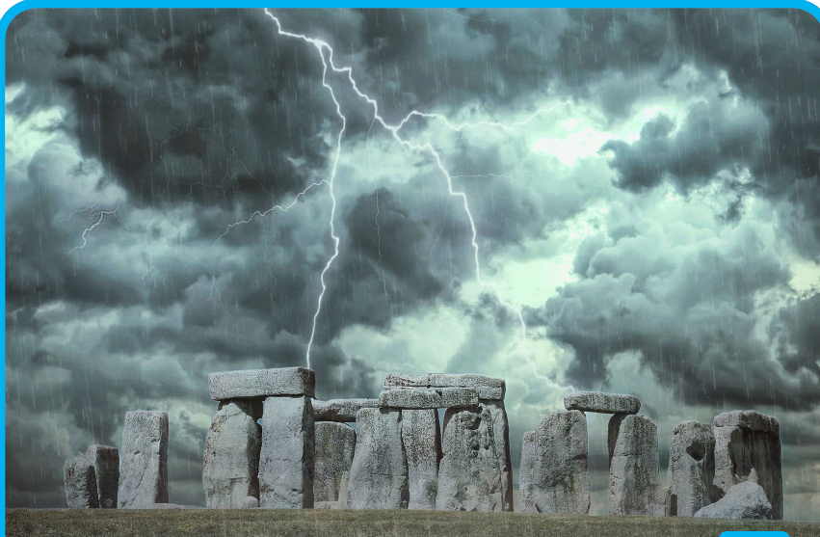
Your turn…

