Slide 1
English
07/07/2021
Settings

Slide 2
Spellings – Group 1
Continue practising your contraction words
Use the following link on Spelling Frame to practise and test yourself
https://spellingframe.co.uk/spelling-rule/102/25-Contractions

Slide 3
Spellings – Group 2
Continue practising your suffixes
Practise and test yourself using the following link on Spelling Frame
https://spellingframe.co.uk/spelling-rule/8/1-Adding-suffixes-beginning-with-vowel-letters-to-words-of-more-than-one-syllable

Slide 4
Grammar – fronted adverbials
Watch the following video from Oak Academy
Use a pen and paper to have a go at the tasks Mrs Hardisty (the online teacher) sets
https://classroom.thenational.academy/lessons/to-explore-the-functions-of-fronted-adverbials-60u68e?step=1&activity=video

Slide 5
Fronted adverbials
Have a go at Purple Mash 2Do Campsite Jim

Slide 6
Settings
Have a go at describing the settings on the following slides
You can use phrases (A windswept moor, or The haunted house perched on top of the misty mountain) or you can use full sentences
If you use full sentences you will need to include verbs and maybe even some characters – Scratching her head in puzzlement, Lila didn’t know how she would even attempt to climb the steep, craggy hillside.
Use a pen and paper or type and save on a word document

Slide 7
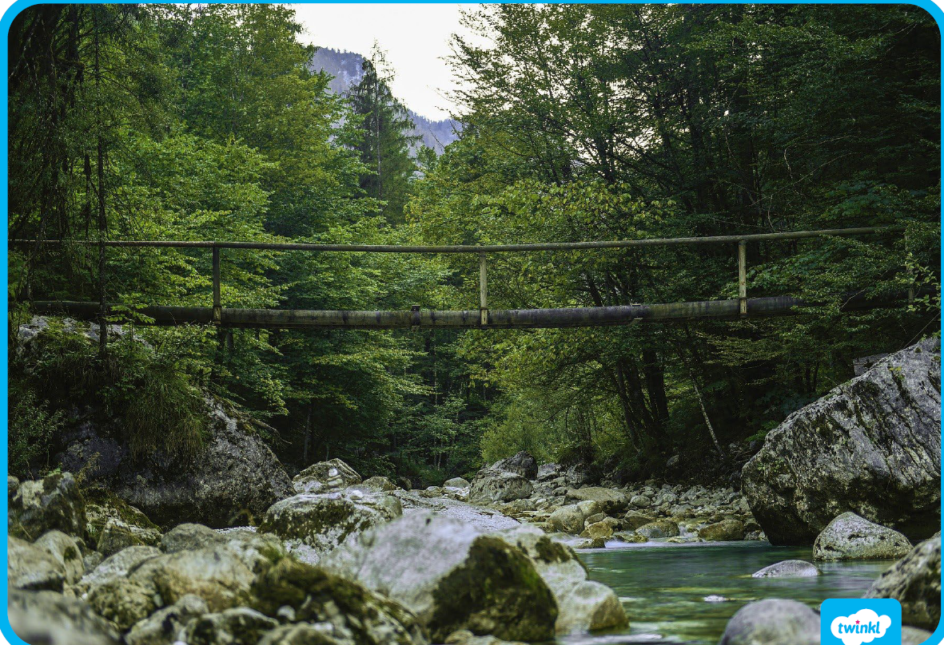
Describe this setting

Slide 8

Describe this setting

