Slide 1
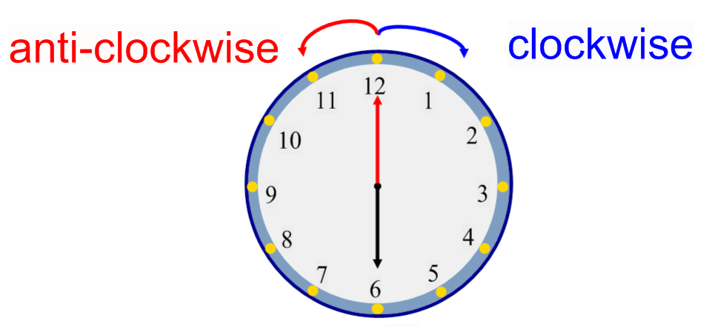
Friday 09-07-21
Identify how patterns have been created through rotation.
Watch the video,
https://classroom.thenational.academy/lessons/identifying-how-patterns-have-been-created-through-rotation-cdk3cd
You can draw the patterns on a sheet of paper and the check your answers. I have left yesterdays slide so that you can have another look at what you learnt.

Slide 2
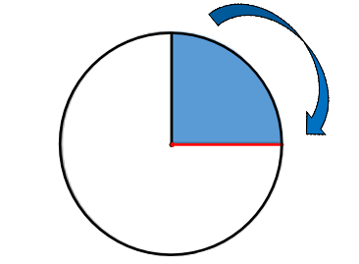
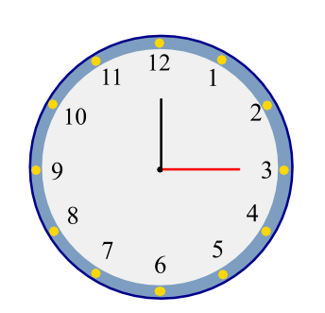
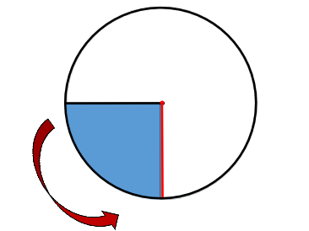
¼ turn

Slide 3
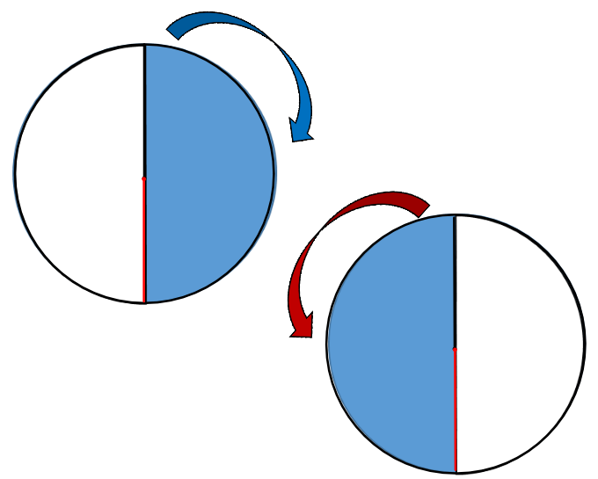
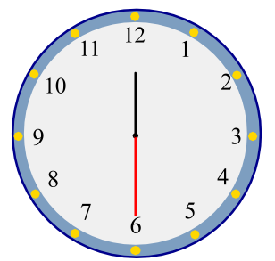
½ turn

Slide 4
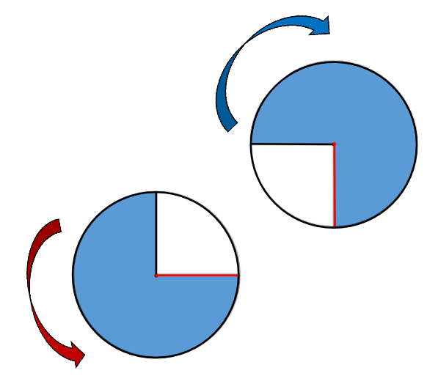
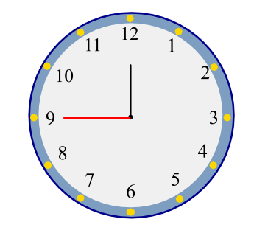
¾ turn

Slide 5
Independent task

Slide 6
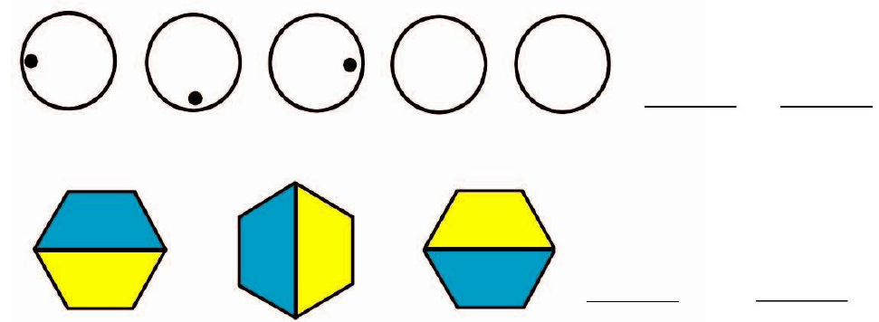
Independent task

Slide 7
Answers

Slide 8
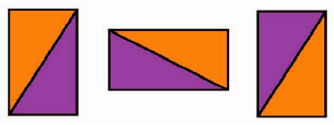
Answers

Slide 9
Answers

