Slide 1
Geography
Where our food comes from?

Slide 2
Biomes
How are the earth`s biomes being damaged?
Watch the following video and have a go at answering the questions and quiz at the end
https://classroom.thenational.academy/lessons/how-are-biomes-being-damaged-6mwp4c

Slide 3
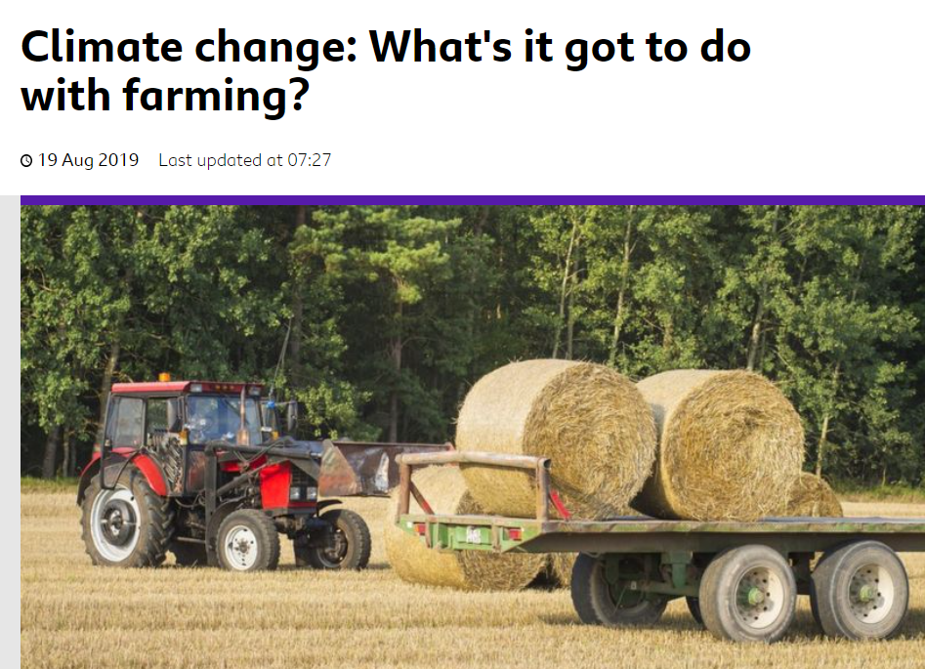
Climate change research
Think about how climate change links to food production and what may happen in the future?
Perhaps you could do your own research using the internet.
A good website is CBBC Newsround https://www.bbc.co.uk/newsround/49371062

Slide 4
Your task
Draw a poster, or flow diagram, or design a leaflet to tell me How is climate change affecting world food production?

