Slide 1
Maths
09/07/2021

Slide 2
Warm-up with some times tables
Use TTRockstars to practise your recall facts and speed
https://ttrockstars.com/
Please contact me if you have forgotten your password

Slide 3
Purple Mash
Have a go at the 2Do Purple Mash Equivalent Fractions and Decimals
Then try the reasoning and problem solving questions on the slides below

Slide 4
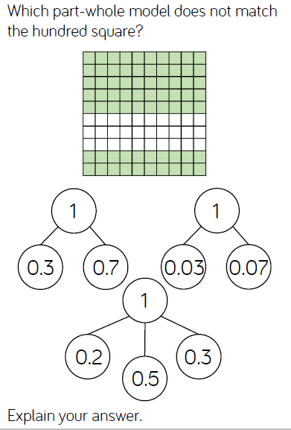
Decimal reasoning

Slide 5
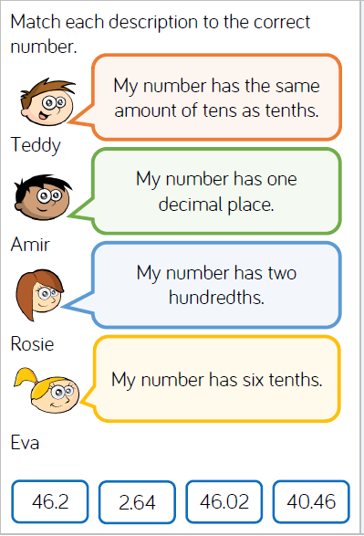
Problem solving

Slide 6
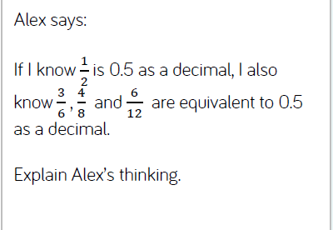
Problem solving

Slide 7
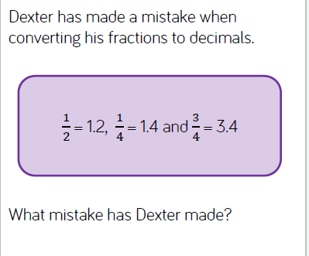
Problem solving

Slide 8
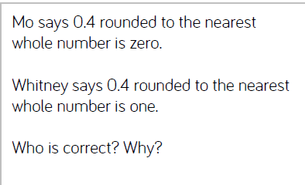
Problem solving

Slide 9
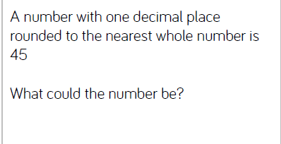
Problem solving

