Slide 1
Maths 05/07/2021

Slide 2
Warm-up with some times tables
Use TTRockstars to practise your recall facts and speed
Please contact me if you have forgotten your password

Slide 3
Decimals
Practise counting up and down in tenths, starting at zero
1/10, 2/10….how far can you get?
Then practise counting up and down in hundredths, starting at 1
99/100, 98/100, 97/100…how far can you get?
What is the decimal equivalent of 6 tenths? 10 tenths? 3 hundredths? 26 hundredths? 80 hundredths?

Slide 4
Decimals – rounding revision
Tomorrow we will be looking at rounding decimal numbers, so let`s recap how to `round` numbers
Have a look at the video lesson below
https://classroom.thenational.academy/lessons/rounding-2-and-3-digit-numbers-to-the-nearest-10-6gu3er

Slide 5
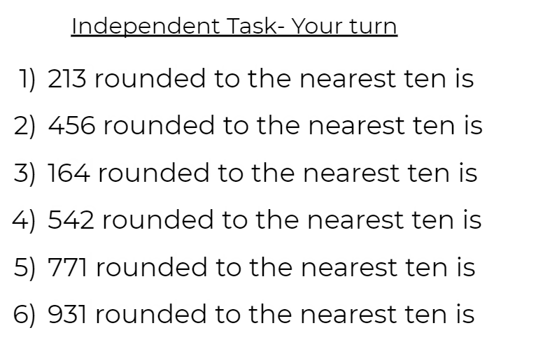
Rounding tasks

Slide 6
Rounding decimals to the nearest whole number
How do you think you would round numbers containing decimals?
0.3?
0.8?
1.6?
4.5?
We shall look at how to do these tomorrow.

