Slide 1
Maths
08/07/2021

Slide 2
Warm-up with some times tables
Use TTRockstars to practise your recall facts and speed
https://ttrockstars.com/
Please contact me if you have forgotten your password

Slide 3
Can I compare numbers with the same number of decimal places, up to two decimal places?

Slide 4
Decimals – comparing numbers
Watch the following online lesson from Oak Academy about comparing decimal numbers up to 2 decimal places
https://classroom.thenational.academy/lessons/ordering-decimals-6gt66r
Then have a go at the questions below

Slide 5
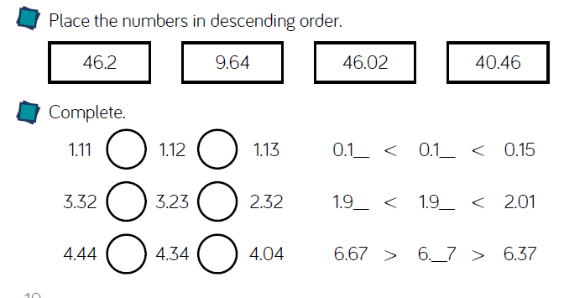
Comparing decimals – your turn

Slide 6
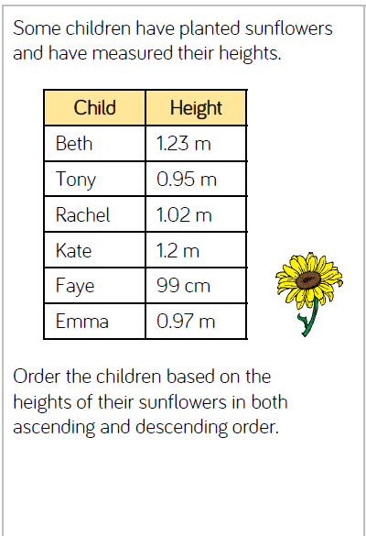
Challenge

