Slide 1
Spellings
05/07/2021

Slide 2
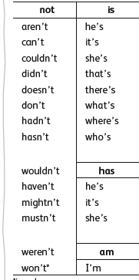
Group 1
Contractions
For example
She does not becomes
She doesn`t
Practise these contractions at home

Slide 3
Group 2
Suffixes
Remember, we found that consonants are sometimes doubled on the root word before suffixes are added
For example: beginning, regretted, preferred
But other times, the consonants remain single: thunderous
Can you remember why?

Slide 4
Doubling the consonant or not?
Practise suffixes with the root words below
Use -ous, -er, -ing, -ed,
Do the consonants need doubling?
Say the root word aloud to work out whether the emphasis is on the beginning of the word, or the end!

