Slide 1
Thursday 8th July 2021
English tasks:
Handwriting, writing task, reading task.

Slide 2
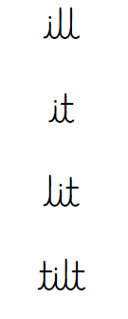
Handwriting
Can you practise the words ill, it, lit, tilt
Look on the letterjoin website to see how to form them correctly.
https://letterjoin.co.uk Then click on easy words first set.
Username: lj8943
If you are using a laptop the password is: home
If using an ipad or tablet the password is: capital L (Make the shape of a capital L)

Slide 3
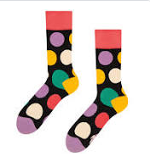
Can you knock my socks off with your neat writing?
Now that you have practised your letters on letterjoin can you practise on a piece of paper?
Can you send a picture of your writing to me?
s.hiley@worthvalleyprimary.co.uk

Slide 4
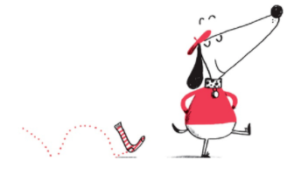
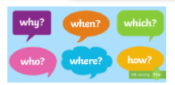
Can I write questions to ask Claude and Sir Bobblysock?
If you could ask Claude and Sir Bobblysock any questions what would you ask them?
How many of the different question starters can you use?
Remember to end each question with a question mark.

Slide 5
Writing Task:
What is your favourite adventure to go on?
How did you find your way to the city?
Here are some examples of questions you might ask.

Slide 6
Writing task: It is up to you how you would like to complete this task. 1:You could write it on a piece of paper at home and email me a picture of your work. 2: You could type this on to purple mash. I have sent you a 2Do task for this. Remember to save your work and hand it in so I can see it.

Slide 7
Reading task Can I make inferences about a picture?
Have a look at this picture. What can you see? What do you think is happening?

Slide 8
Reading task:
Where do you think this is?
How do you know?
How many cats are in this class?
What time of day is it?
Why do you think that?
Why is the white cat putting its paw up?
What are the other cats doing/thinking?
How is the black cat feeling? Why?
Which cat is the cleverest?
Which cat is the best behaved?
Draw/describe what you think their teacher looks like.
What do you think the other classes in the school are like?
What lessons are taught in cat school?

Slide 9
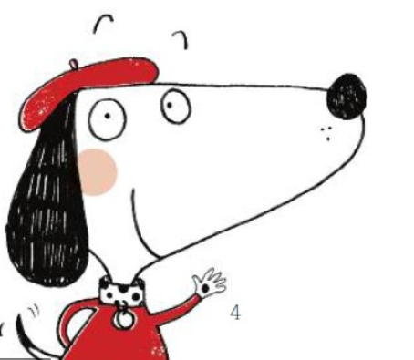
Remember I love to see your work so please email pictures to me at:
s.hiley@worthvalleyprimary.co.uk

