Slide 1
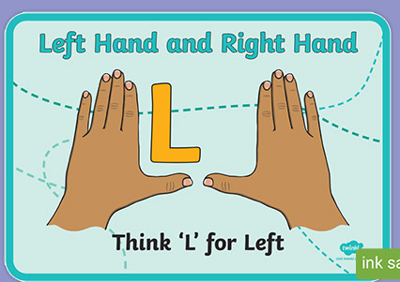
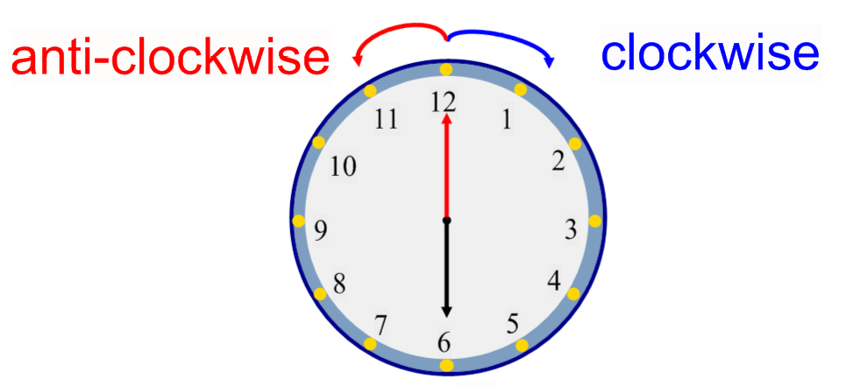
Thursday 08-07-21
Using the language of rotation
Here is an easy way to remember Left and right,
Watch the video, Think about the fraction work we have done.
https://classroom.thenational.academy/lessons/using-the-language-of-rotation-6wup6t
It doesn’t matter if your tree drawing is a bit odd; it’s how it turns that matters.

Slide 2
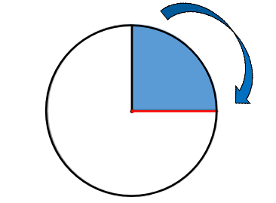
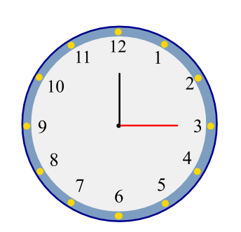
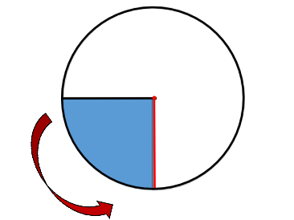
¼ turn

Slide 3
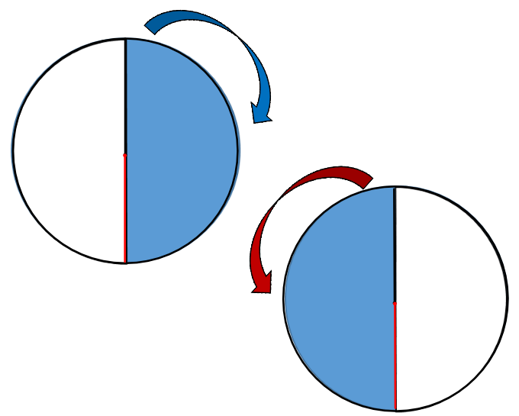
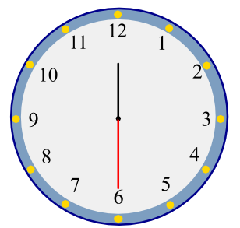
½ turn

Slide 4
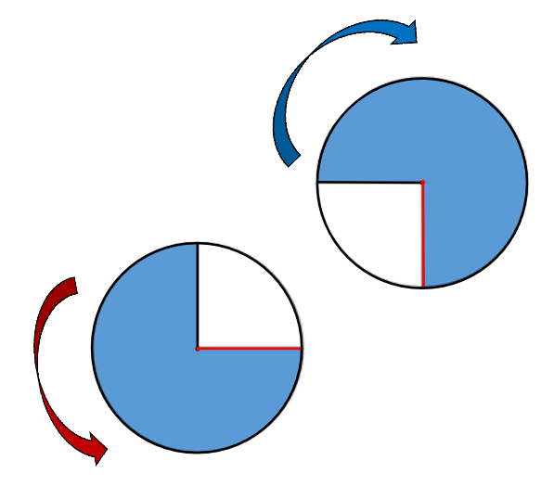
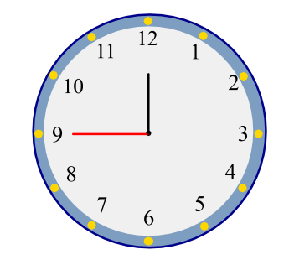
¾ turn

Slide 5
Independent task
Show me what this tree would look like if it was rotated:
a ¼ turn clockwise
a ½ turn clockwise
a ¼ turn anti-clockwise
a ¾ turn clockwise
a ½ turn anti-clockwise
a ¾ turn anti-clockwise

Slide 6
Answers

Slide 7
Answers
Show me what this tree would look like if it was rotated:
2.
3.
4.
5.
6.

Slide 8
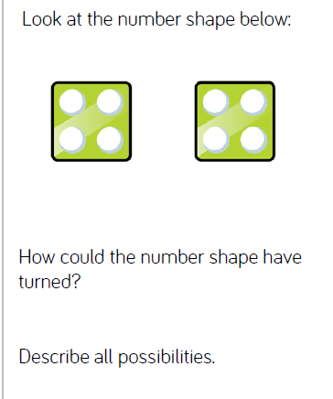
Now for some brain steaming!

Slide 9
